Slide 1

An Efficient Trie-based Method for Approximate
Entity Extraction with Edit-Distance Constraints
Dong Deng (Tsinghua, China)
Guoliang Li (Tsinghua, China)
Jianhua Feng (Tsinghua, China)

Slide 2
Outline
Motivation
Problem Formulation
Trie-based Framework
Trie-based Algorithms
Optimizing Partition Scheme
Experiment
Conclusion

Slide 3
Named Entity Recognition
Dictionary-based NER
Dictionary of Entities
Documents
1 Sir Isaac Newton was an English physicist, mathematician, astronomer, natural philosopher, alchemist, and theologian and one of the most influential men in human history. His Philosophiæ Naturalis Principia Mathematica, published in 1687, is by itself considered to be among the most influential books in the history of science, laying the groundwork for most of classical mechanics.
2 Sigmund Freud was an Austrian psychiatrist who founded the psychoanalytic school of psychology. Freud is best known for his theories of the unconscious mind and the defense mechanism of repression and for creating the clinical practice of psychoanalysis for curing psychopathology through dialogue between a patient and a psychoanalyst.
Isaac Newton Sigmund Freud English Austrian physicist mathematician astronomer philosopher alchemist theologian psychiatrist economist historian sociologist ...

Slide 4
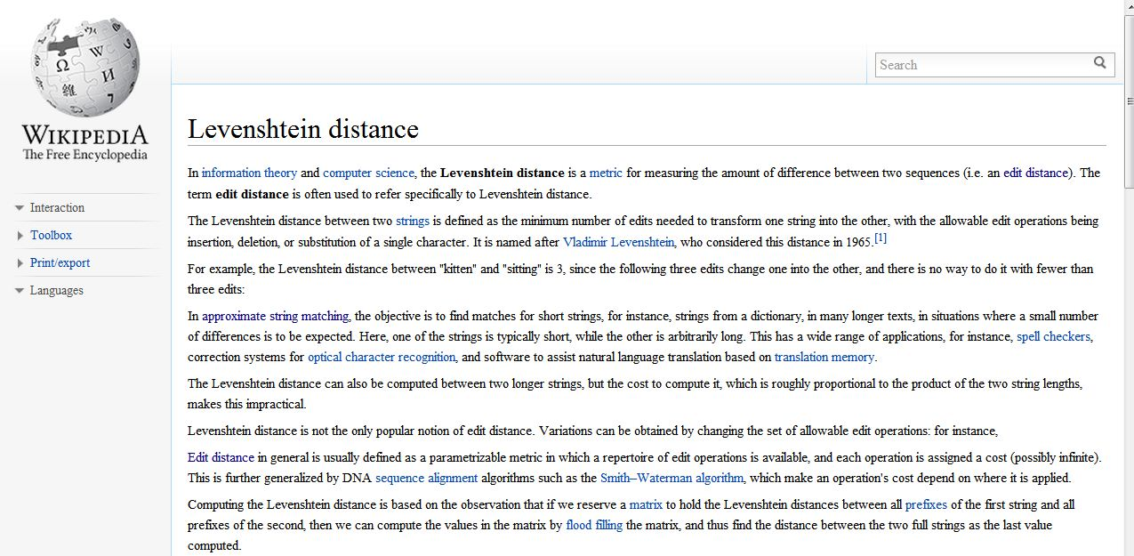
Automatically add the links
Wikipedia
http://en.wikipedia.org/wiki/Levenshtein_distance

Slide 5
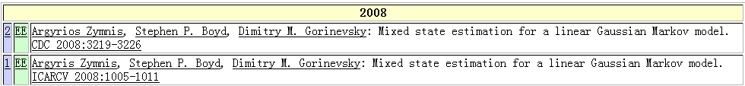
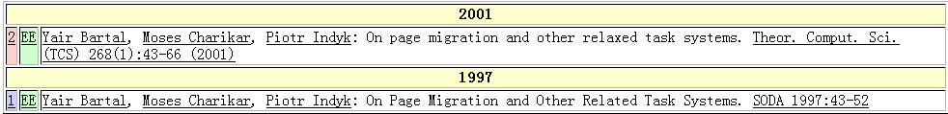
Real-world Data is Rather Dirty！☹
DBLP Complete Search
Typo in “author”
Typo in “title”
Argyrios Zymnis
Argyris Zymnis
relaxed
related

Slide 6
Approximate Entity Extraction
Approximate dictionary-based entity extraction finds all substrings from the document that approximately match the predefined entities.
For example:
Sigmund Freund was an Austrian psychiatrest who founded the psychoanalytic school of psychology. Freud is best known for his theories of the unconscious mind and the defense mechanism of repression and for creating the clinical practice of psychoanalysis for curing psychopathology through dialogue between a patient and a psychoanalayst.
Documents
Dictionary of Entities
Isaac Newton
Sigmund Freud
physicist
astronomer
alchemist
theologian
economist
sociologist ...

Slide 7
Outline
Motivation
Problem Formulation
Trie-based Framework
Trie-based Algorithms
Optimizing Partition Scheme
Experiment
Conclusion

Slide 8
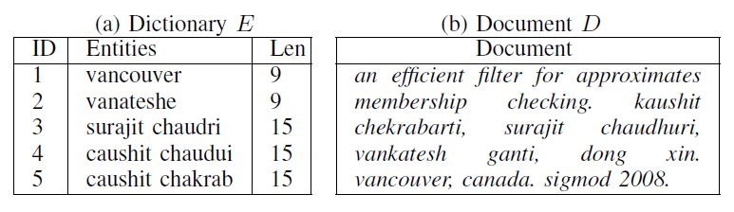
Problem Formulation
Approximate Entity Extraction: Given a dictionary of entities E = {e₁, e₂, . . . , e_{n}}, a document D, and a predefined edit distance threshold τ, approximate entity extraction finds all “similar” pairs <s, e_{i}> such that ED(s, ei) ≤ τ, where s is a substring of D and ei∈ E.

Slide 9
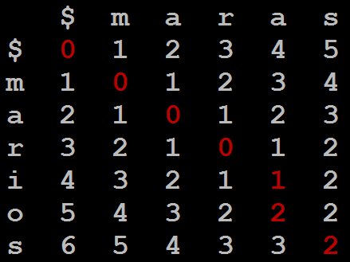
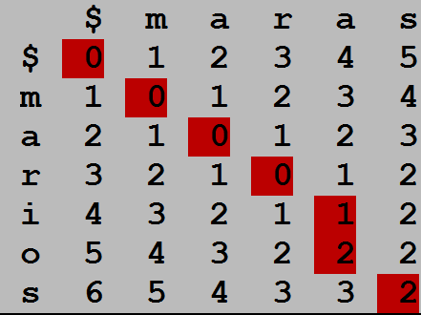
Edit Distance
ED(r, s): The minimum number of single-character edit operations(insertion/deletion/substitution) to transform r to s.
For example: ED(marios, maras) = 2
D_{i,0} = i, D_{0,j} = j,
D_{i,j} = min{D_{i-1, j} + 1, D_{i, j-1} + 1,
D_{i-1, j-1} + t_{i, j}},
0 if a_{i} = b_{j}
1 if a_{i} ≠ b_{j}.
Substitute a->i
Insert o
where t_{i, j} =

Slide 10
State-of-the-art Methods
Shortage:
  Large Index Size
  Need to Tune Parameters
  Not efficient for large threshold
 | NGPP | Faerie
Inverted Index | Prefix of 1-variant family | q-grams
Filtering Condition | a substring matches with the prefix of 1-variant of partition | Overlap must be larger than a threshold

Slide 11
Outline
Motivation
Problem Formulation
Trie-based Framework
Trie-based Algorithms
Optimizing Partition Scheme
Experiment
Conclusion

Slide 12
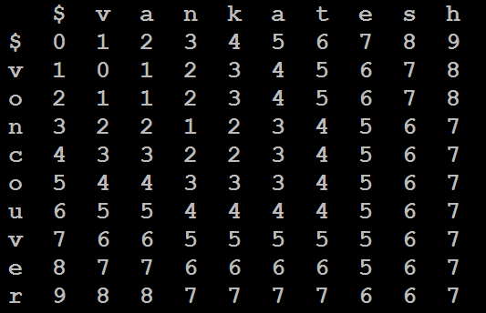
Observation
Set τ=2 entity:vankatesh
document: …voncouver…
Split the entity into τ+1=3 segments
A substring in document

Slide 13
Observation
Set τ=2 entity:vankatesh
document: …voncouver…
>= 1
edit operation
>= 1
edit operation
>= 1
edit operation
>= τ + 1 = 3
edit operation
NOT SIMILAR

Slide 14
Observation
Valid Substring: s is a valid substring if
L_{min}− τ <=|s|<= L_{max}+ τ
  L_{min}: the minimum entity length.
  L_{max}: the maximum entity length.

Slide 15
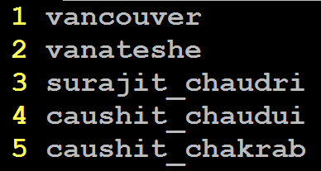
Trie-based Framework
Step1: Partition entities into segments using even partition scheme.

Slide 16
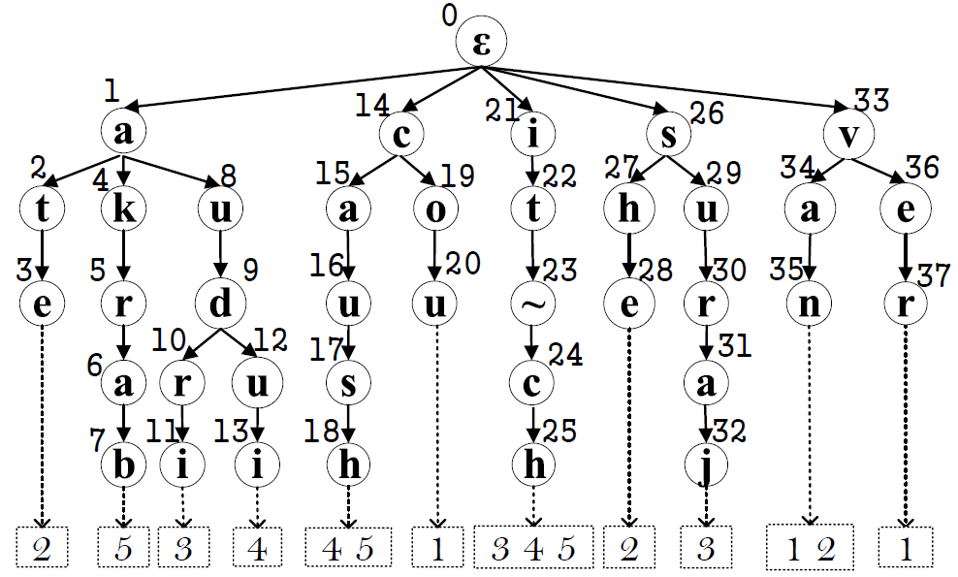
Trie-based Framework
Step2: Index the segments using a trie structure

Slide 17
Trie-based Framework
Step3: From the document, find the matched segments from the trie structure.
Baseline: Trie-search Method
  3.1 Enumerator all valid substrings.
  3.2 Find each suffix of every substring in the trie structure to check if it can reach the leaf node.
  3.3 Verify the candidate pairs.

Slide 18
Trie-search Method
3.1 Enumerator all valid substrings.
if L_{min} - τ = 9-2=7 L_{max} + τ = 15+2=17
kaushit chekrabarti, surajit chaudhuri, vankatesh ganti,
Len = 7

Slide 19
Trie-search Method
3.1 Enumerator all valid substrings.
if L_{min} - τ = 9-2=7 L_{max} + τ = 15+2=17
kaushit chekrabarti, surajit chaudhuri, vankatesh ganti,
Len = 8

Slide 20
Trie-search Method
3.1 Enumerator all valid substrings.
if L_{min} - τ = 9-2=7 L_{max} + τ = 15+2=17
kaushit chekrabarti, surajit chaudhuri, vankatesh ganti,
Len = 11

Slide 21
Trie-search Method
3.1 Enumerator all valid substrings.
if L_{min} - τ = 9-2=7 L_{max} + τ = 15+2=17
kaushit chekrabarti, surajit chaudhuri, vankatesh ganti,
Len = 17

Slide 22
Trie-search Method
3.2 Find each suffix of every substring in the trie structure to check if it can reach the leaf.
chaudhuri
Pruned

Slide 23
Trie-search Method
3.2 Find each suffix of every substring in the trie structure to check if it can reach the leaf.
surajit chaud
Candidate
of entity 3

Slide 24
Trie-search Method
3.3 Verify the candidate pairs
ED(surajit chaud, surajit chaudri)=2

Slide 25
Trie-search Method
Shortage
  Candidate pairs may overhead:
  <surajit_chaudhuri, surajit_chaudri>
  < urajit_chaudhuri, surajit_chaudri>
  <surajit_chaudhur , surajit_chaudri>
  …...
Duplicate Computations

Slide 26
Outline
Motivation
Problem Formulation
Trie-based Framework
Trie-based Algorithms
Optimizing Partition Scheme
Experiment
Conclusion

Slide 27
Trie-based Algorithm
Step3: From the document, find the matched segments from the trie structure.
To avoid duplicate computation, we do not enumerate all valid substrings.
Trie-based Method
  3.1 Search: Search matched segments.
  3.2 Extension: Extend the matched segments to find similar pairs.

Slide 28
Trie-based Algorithm
3.1 Search: Search matched segments.
kaushit chekrabarti, surajit chaudhuri, vankatesh ganti,

Slide 29
Trie-based Algorithm
3.2 Extend the matched segments to find similar pairs.
D: kaushit chekrabarti, surajit chaudhuri, vankatesh ganti,
e₃: surajit chaudri
e₄: caushit chaudui
e₅: caushit chakrab

Slide 30
 | k | a | u | s | h | i | t | _ | c | h | e | k | r | a | b | a | r
s | 5 | 4 | 4 | 4 | 5 | 5
u | 5 | 4 | 3 | 4 | 4 | 4
r | 4 | 4 | 3 | 3 | 3 | 3
a | 4 | 3 | 3 | 2 | 2 | 2
j | 5 | 4 | 3 | 2 | 1 | 1
i | 5 | 4 | 3 | 2 | 1 | 0
t
_
c
h
a
u
d
r
i
All Bigger
Than Two,
Terminate!
e₃
No Need to Compute This Range

Slide 31
 | k | a | u | s | h | i | t | _ | c | h | e | k | r | a | b | a | r
c | 1 | 1 | 2 | 3 | 4 | 5
a | 1 | 0 | 1 | 2 | 3 | 4
u | 2 | 1 | 0 | 1 | 2 | 3
s | 3 | 2 | 1 | 0 | 1 | 2
h | 4 | 3 | 2 | 1 | 0 | 1
i | 5 | 4 | 3 | 2 | 1 | 0
t
_
c
h |  |  |  |  |  |  |  |  |  | 0 | 1 | 2 | 3 | 4 | 5 | 6 | 7
a |  |  |  |  |  |  |  |  |  | 1 | 1 | 2 | 3 | 3 | 4 | 5 | 6
u |  |  |  |  |  |  |  |  |  | 2 | 2 | 2 | 3 | 4 | 4 | 5 | 6
d |  |  |  |  |  |  |  |  |  | 3 | 3 | 3 | 3 | 4 | 5 | 5 | 6
u |  |  |  |  |  |  |  |  |  | 4 | 4 | 4 | 4 | 4 | 5 | 6 | 6
i |  |  |  |  |  |  |  |  |  | 5 | 5 | 5 | 5 | 5 | 5 | 6 | 7
Not Bigger
Than Two,
Extend The
Right Part!
e₄
No Need to Compute This Range
All Bigger
Than Two,
Prune!

Slide 32
 | k | a | u | s | h | I | t | _ | c | h | e | k | r | a | b | a | r
c | 1 | 1 | 2 | 3 | 4 | 5
a | 1 | 0 | 1 | 2 | 3 | 4
u | 2 | 1 | 0 | 1 | 2 | 3
s | 3 | 2 | 1 | 0 | 1 | 2
h | 4 | 3 | 2 | 1 | 0 | 1
i | 5 | 4 | 3 | 2 | 1 | 0
t
_
c
h |  |  |  |  |  |  |  |  |  | 0 | 1 | 2 | 3 | 4 | 5 | 6 | 7
a |  |  |  |  |  |  |  |  |  | 1 | 1 | 2 | 3 | 3 | 4 | 5 | 6
k |  |  |  |  |  |  |  |  |  | 2 | 2 | 1 | 2 | 3 | 4 | 5 | 6
r |  |  |  |  |  |  |  |  |  | 3 | 3 | 2 | 1 | 2 | 3 | 4 | 5
a |  |  |  |  |  |  |  |  |  | 4 | 4 | 3 | 2 | 1 | 2 | 3 | 4
b |  |  |  |  |  |  |  |  |  | 5 | 5 | 4 | 3 | 2 | 1 | 2 | 3
Same as the
left part of e₄
Share Prefix!
Not Bigger
Than Two,
Extend The
Right Part!
e₅
No Need to Compute This Range
Share Prefix!
Not Bigger
Than Two,
Get
Candidates!

Slide 33
Trie-based Algorithm
3.2 Extend the matched segments to find similar pairs.
it_ch
ush 2
aush 1
kaush 1
2 ekra
1 ekrab
2 ekraba

Slide 34
Trie-based Algorithm
3.2 Extend the matched segments to find similar pairs.
We get two results pairs:
<caushit chakrab, aushit_chekrab> <caushit chakrab, kaushit_chekrab>

Slide 35
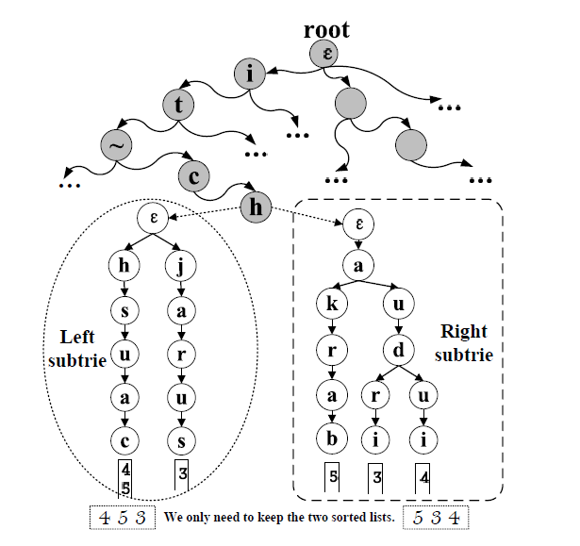
Trie-based Algorithm
Two-level Trie

Slide 36
Outline
Motivation
Problem Formulation
Trie-based Framework
Trie-based Algorithms
Optimizing Partition Scheme
Experiment
Conclusion

Slide 37
Obvservation
Even Partition:
vanateshe
van
ate
she

Slide 38
Obvservation
Even Partition:
vanateshe
Extend 5 times.
C=5
van
ate
she
an efficient filter for approximate membershep
checking. kaushit chekrabarti, surajit chaudhuri, vankatesh ganti, dong xin. vancouver, canada. sigmod 2008.

Slide 39
Obvservation
Uneven Partition:
vanateshe
vana
tes
he

Slide 40
Obvservation
Uneven Partition:
vanateshe
Extend 2 times.
C=2
vana
tes
he
an efficient filter for approximate membershep
checking. kaushit chekrabarti, surajit chaudhuri, vankatesh ganti, dong xin. vancouver, canada. sigmod 2008.

Slide 41
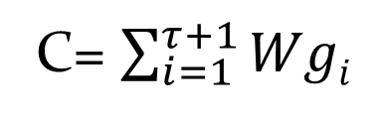
Optimize Object
Entity: c₁ c₂ c₃ c₄ … … c_{m-2} c_{m-1} c_{m}
Segments:
g₁
g₂
… …
g_{τ}
g_{τ+1}
Appear Time:
Wg₁
Wg₂
Wg_{τ}
Wg_{τ+1}
C= $\sum_{i=1}^{τ+1}{Wgi}$
Document
Optimize Object: C=M[τ+1][m].
M[i][j]: the minimum totle partition weight
to partition c₁c₂ … c_{j-1}c_{j} into i segments.

Slide 42
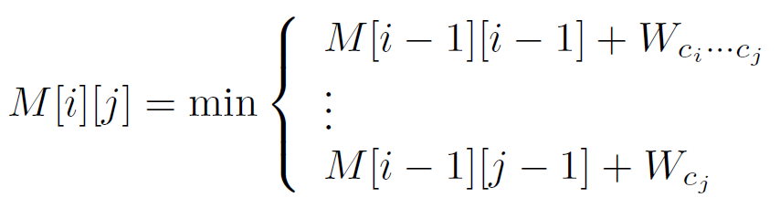
Dynamic Way:
If the start position of last partition is p,
Then:
$$\text{C}\text{=}\text{M}\text{[}\text{τ}\text{+1][}\text{m}\text{]=}\text{M}\text{[}\text{τ}\text{][}\text{p}\text{−1]+}\text{W}c_{p}…c_{m}$$
Iterative we have

Slide 43
Determining Wg
Build A Suffix Trie.
The segment g
The number of subtrie leaf nodes
= The occurrence time in document = Wg

Slide 44
Pruning
Even VS. Dict+Doc Method
  Even involves larger candidate set
  Dict+Doc counts the indexing time
Make indexing more efficient
  Using Segment Length to Do Pruning.
  Using Even-Partition Weight as An Upper Bound.
  Adding Extra Pointers On Suffix Trie.

Slide 45
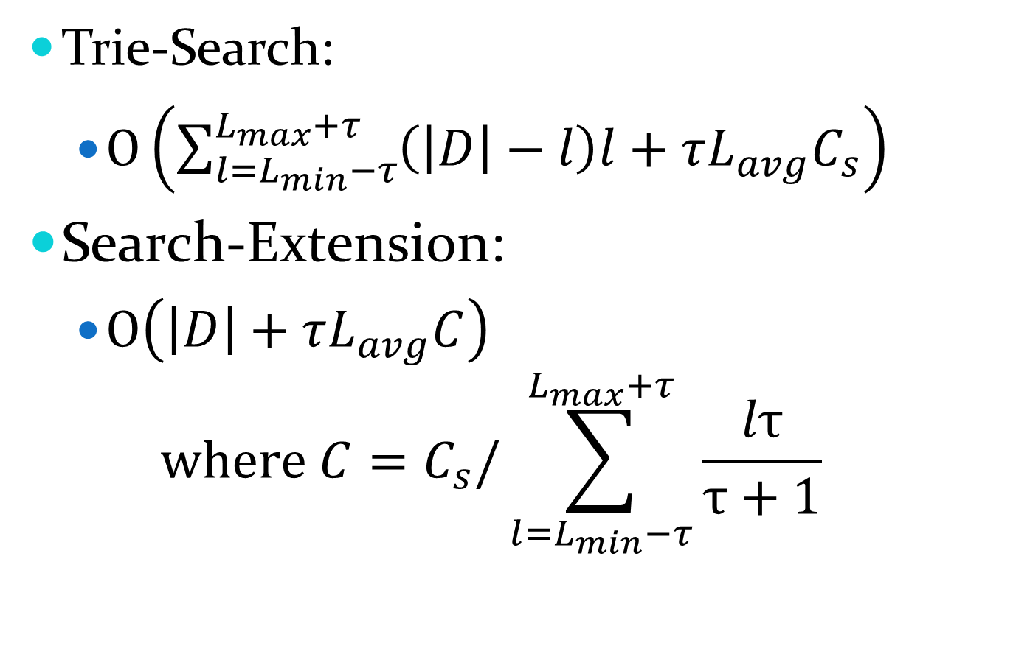
Time Comlexity:
Trie-Search:
  $O\left(\sum_{l=L_{min}−τ}^{L_{max}+τ}{\left(\left|D\right|−l\right)l}+τL_{avg}C_{s}\right)$
Search-Extension:
  $O\left(\left|D\right|+τL_{avg}C\right)$
  $$where C=C_{s}/\sum_{l=L_{min}−τ}^{L_{max}+τ}{\frac{lτ}{τ+1}}$$

Slide 46
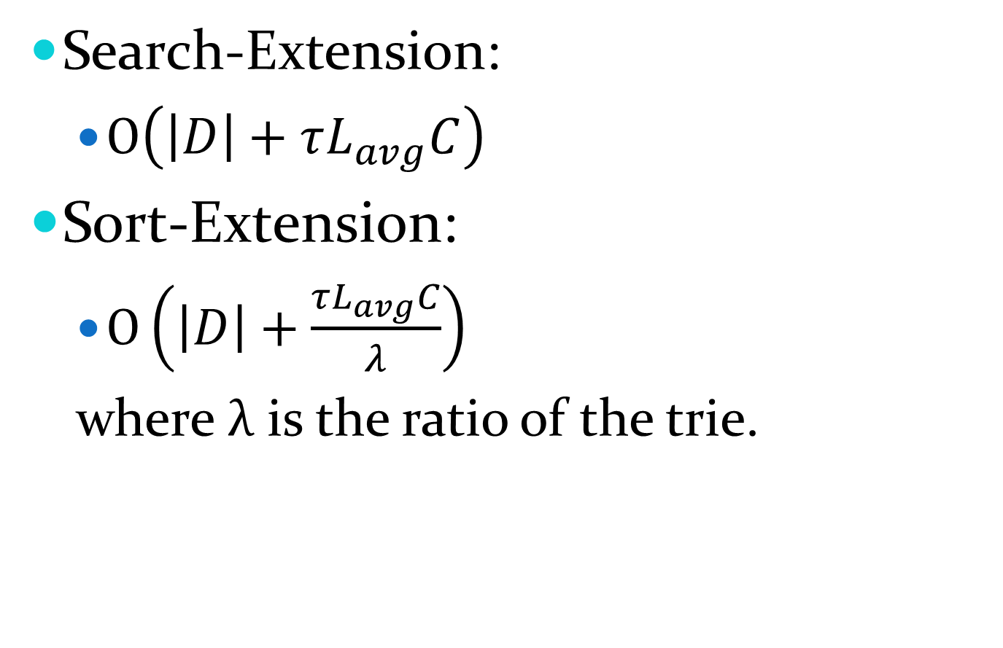
Time Comlexity:
Search-Extension:
  $O\left(\left|D\right|+τL_{avg}C\right)$
Sort-Extension:
  $O\left(\left|D\right|+\frac{τL_{avg}C}{λ}\right)$
  where $λ$ is the ratio of the trie.

Slide 47

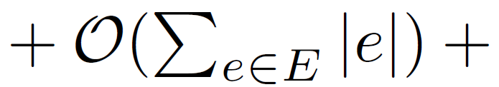
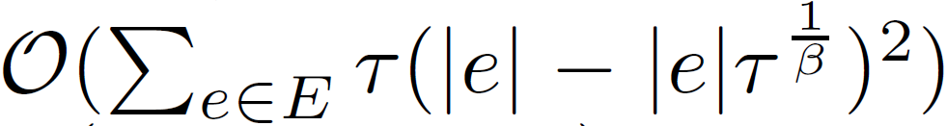
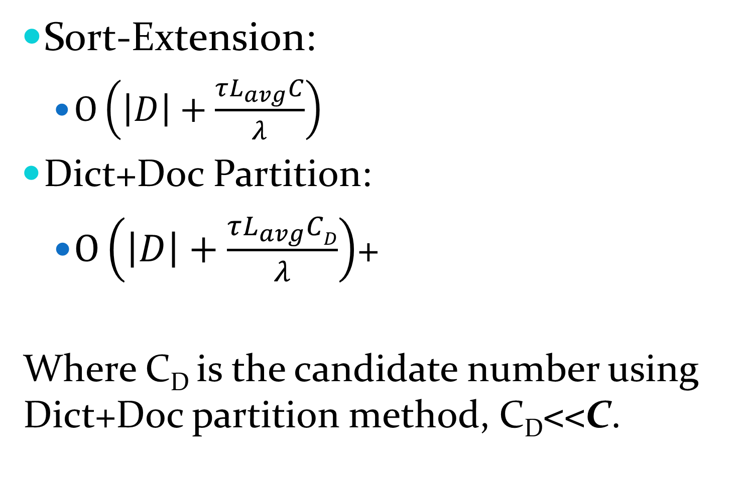
Time Comlexity:
Sort-Extension:
  $O\left(\left|D\right|+\frac{τL_{avg}C}{λ}\right)$
Dict+Doc Partition:
  $O\left(\left|D\right|+\frac{τL_{avg}CD}{λ}\right)$+
Where C_{D} is the candidate number using Dict+Doc partition method, C_{D}<<C.

Slide 48
Outline
Motivation
Problem Formulation
Trie-based Framework
Trie-based Algorithms
Optimizing Partition Scheme
Experiment
Conclusion
Reference

Slide 49
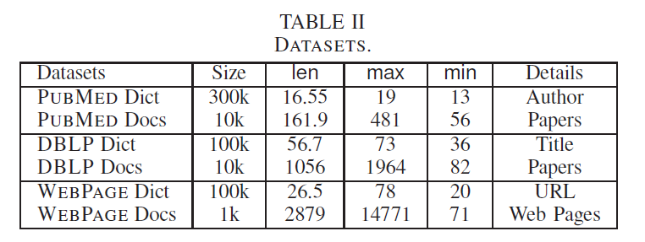
Experiment Setup
Three real Data sets
Existing algorithms
    NGPP (downloaded from its hompage)
    Faerie (we implemented)

Slide 50
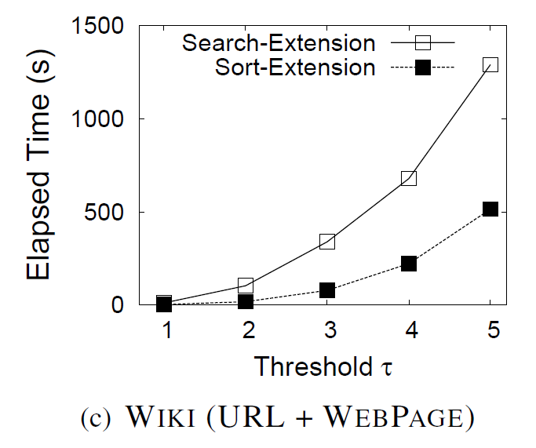
Search-Extension VS Sort-Extension
SORT-EXTENSION was about 3-4 times faster than SEARCH-EXTENSION. This is because SORT-EXTENSION shares the computation on the common prefixes for different entities.

Slide 51
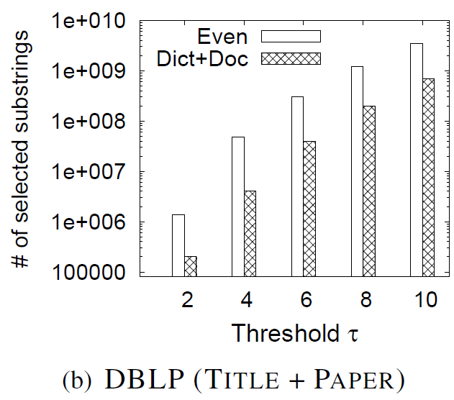
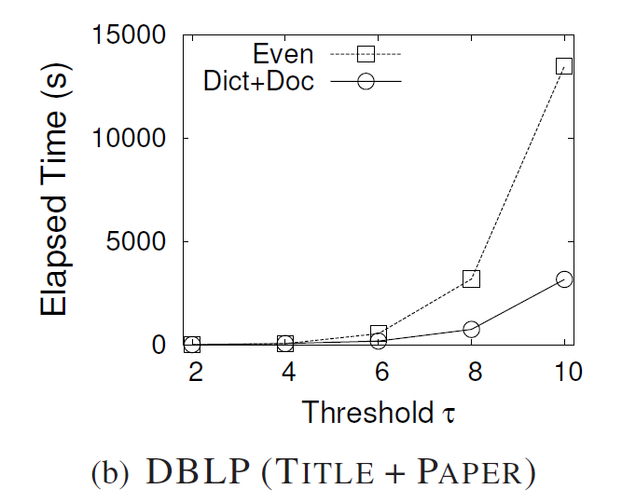
Partition : Even vs Dict+Doc
EVEN partition method may involve large numbers of candidates for large thresholds and thus may lead to low performance.

Slide 52
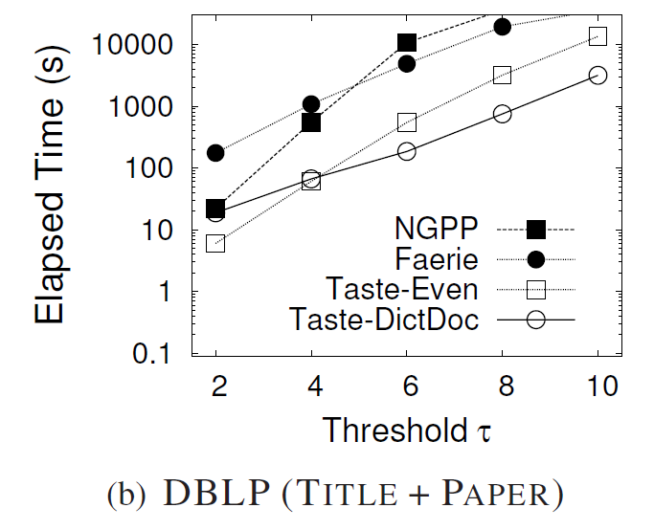
Comparison with State-of-the-art Methods
Faerie VS NGPP

Slide 53
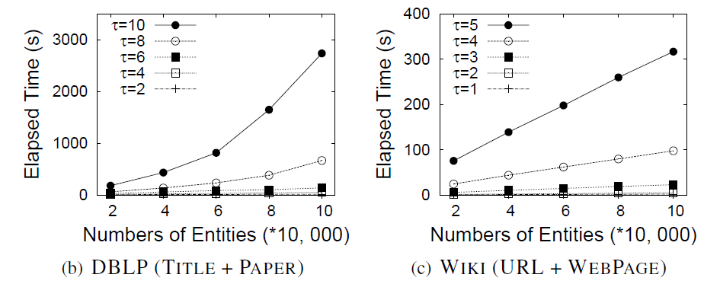
Scalability with Dictionary Sizes

Slide 54
Outline
Motivation
Problem Formulation
Trie-based Framework
Trie-based Algorithms
Optimizing Partition Scheme
Experiment
Conclusion

Slide 55
Conclusion
Approximate entity extraction
  A trie-based framework
  Search-and-extension-based search method
  Selecting high-quality partition scheme

Slide 56

Thanks!
Q&A
http://dbgroup.cs.tsinghua.edu.cn/dd/projects/taste/

