Slide 1

Top-k String Similarity Search with Edit-Distance Constraints
Dong Deng (Tsinghua, Beijing, China)
Guoliang Li (Tsinghua, Beijing, China)
Jianhua Feng (Tsinghua, Beijing, China)
Wen-Syan Li(SAP Labs, Shanghai, China)

Slide 2
Outline
Motivation
Problem Formulation
Progressive Framework
Pivotal Entry-based Method
Range-based Method
Experiment
Conclusion

Slide 3
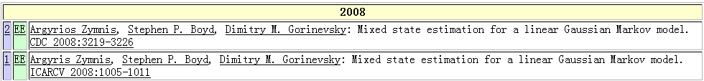
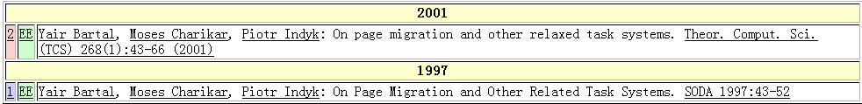
Real-world Data is Rather Dirty！☹
DBLP Complete Search
Typo in “author”
Typo in “title”
Argyrios Zymnis
Argyris Zymnis
relaxed
related

Slide 4


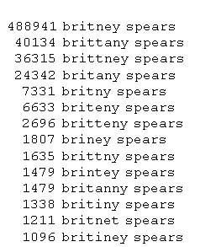
Web Search
Errors in queries
Errors in data
Bring query and meaningful results closer together
Actual queries gathered by Google

Slide 5


Example: a movie database
Iron man
The man
Find movies starred Samuel Jackson
Star | Title | Year | Genre
Keanu Reeves | The Matrix | 1999 | Sci-Fi
Samuel Jackson | Iron man | 2008 | Sci-Fi
Schwarzenegger | The Terminator | 1984 | Sci-Fi
Samuel Jackson | The man | 2006 | Crime

Slide 6


Query: Schwarzenegger?
The user doesn’t know the exact spelling!
Star | Title | Year | Genre
Keanu Reeves | The Matrix | 1999 | Sci-Fi
Samuel Jackson | Iron man | 2008 | Sci-Fi
Schwarzenegger | The Terminator | 1984 | Sci-Fi
Samuel Jackson | The man | 2006 | Crime

Slide 7
Relaxing Conditions
Find movies with a star “similar to” Schwarrzenger.
Star | Title | Year | Genre
Keanu Reeves | The Matrix | 1999 | Sci-Fi
Samuel Jackson | Iron man | 2008 | Sci-Fi
Schwarzenegger | The Terminator | 1984 | Sci-Fi
Samuel Jackson | The man | 2006 | Crime

Slide 8
String Similarity Search
String Similarity Search finds all entries from the dictionary that approximately match the query.
Applications:
  Biology, Bioinformatics
  Information Retrieve
  Data Quality, Data Cleaning
  ….

Slide 9
Outline
Motivation
Problem Formulation
Progressive Framework
Pivotal Entry-based Method
Range-based Method
Experiment
Conclusion

Slide 10
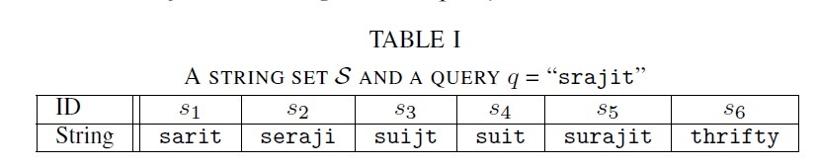
Problem Formulation
Top-k String Similarity Search: Given a string set S and a query string q, top-k string similarity search returns a string set R ⊆ S such that |R|=k and for any string r∈ R and s∈ S − R, ED(r, q) ≤ ED(s, q).
the top-3 similar strings of srajit

Slide 11
Edit Distance
ED(r, s): The minimum number of single-character edit operations(insertion/deletion/substitution) to transform r to s.
ED(srajit, seraji) = 2

Slide 12
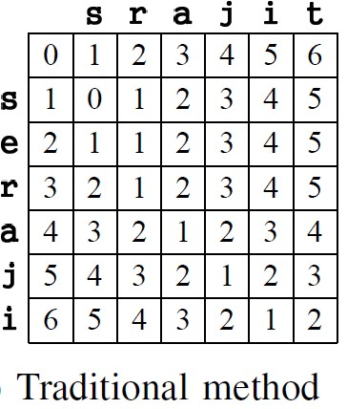
Dynamic Programming
Insertion
Deletion
Match/Subsitition
D_{i,j} = min{D_{i-1, j} + 1, D_{i, j-1} + 1, D_{i-1, j-1} + 0/1}

Slide 13
Dynamic Programming
ED(srajit, seraji) = 2
D_{i,0} = i, D_{0,j} = j,
D_{i,j} = min{D_{i-1, j} + 1, D_{i, j-1} + 1,
D_{i-1, j-1} + t_{i, j}},
0 if a_{i} = b_{j}
1 if a_{i} ≠ b_{j}.
Insert e
where t_{i, j} =
Delete t

Slide 14
Outline
Motivation
Problem Formulation
Progressive Framework
Pivotal Entry-based Method
Range-based Method
Experiment
Conclusion

Slide 15
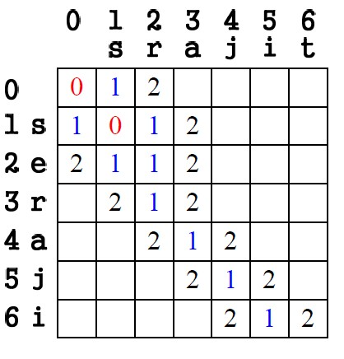
Progressive Method
Smallest Cell First.
E₀ : (0, 0) (1,1)

Slide 16
Progressive Method
Extending Cells
E₀ : (0, 0) (1,1)

Slide 17
Progressive Method
Extending Cells
E₀ : (0, 0) (1,1)
E₁ : (1,0) (0,1)(2,1)
(1,2) (2,2)

Slide 18
Progressive Method
Find Match Cells.
E₀ : (0, 0) (1,1)
E₁ : (1,0) (0,1)(2,1)
(1,2) (2,2)

Slide 19
Progressive Method
Find Match Cells.
E₀ : (0, 0) (1,1)
E₁ : (1,0) (0,1)(2,1)
(1,2) (2,2) (3,2) (4,3)
(5,4) (6,5)

Slide 20
Progressive Method
Extend Smallest Cells
E₀ : (0, 0) (1,1)
E₁ : (1,0) (0,1)(2,1)
(1,2) (2,2) (3,2) (4,3)
(5,4) (6,5)
E₂: (2,0) (3,1) (4,2)
(5,3) (6,4) (1,3)(2,3)
(3,3) (4,4) (5,5) (6,6)

Slide 21
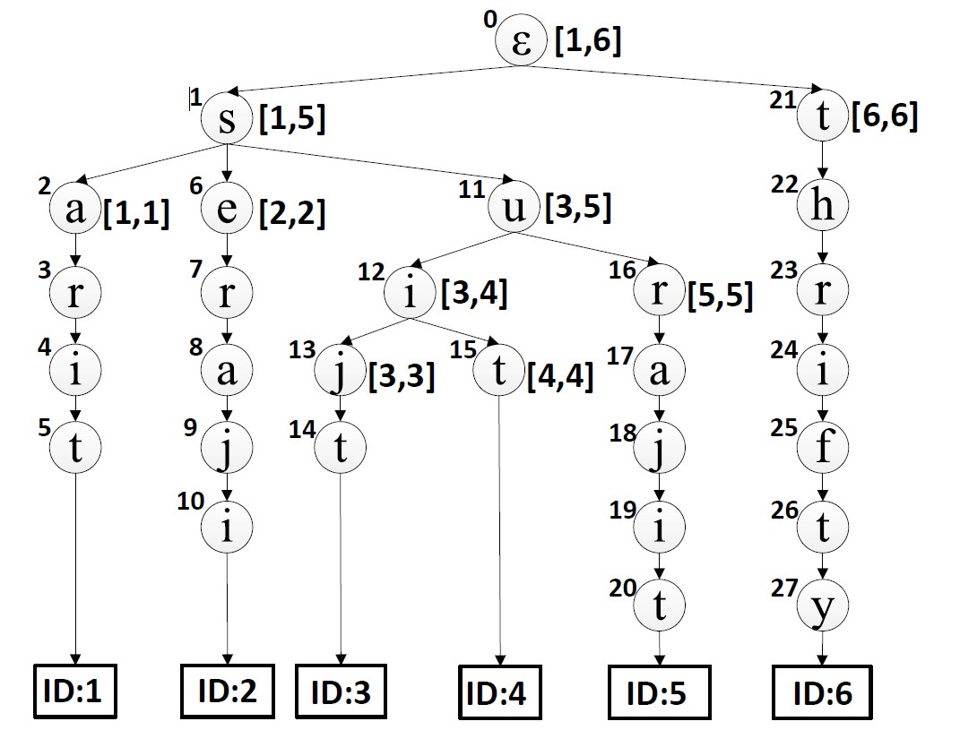
Progressive Framework
Index all strings using a trie structure
Top3-Query:
Q=srajit
Entry
i-th node of trie;
j-th character of Q
(n_{i} j)
Tx: node and char with ED=x

Slide 22
Progressive Framework
index: 0 1 2 3 4 5 6
Find Match Nodes from (n₀ 0) Top3-Query: ε s r a j i t
T₀: (n₀ 0) (n₁ 1)
i-th node of trie;
j-th character of Q
(n_{i} j)
Tx: node and char with ED=x

Slide 23
Progressive Framework
index: 0 1 2 3 4 5 6
Extends Nodes (n₀, 0) Top3-Query: ε s r a j i t
T₀: (n₀ 0) (n₁ 1)
i-th node of trie;
j-th character of Q
(n_{i} j)
Tx: node and char with ED=x

Slide 24
Progressive Framework
index: 0 1 2 3 4 5 6
Extends Nodes (n₀, 0) Top3-Query: ε s r a j i t
T₀: (n₀ 0) (n₁ 1)
T₁: (n₀ 1) (n₁ 0) (n₂₁ 0)
(n₂₁ 1) (n₁ 1)
i-th node of trie;
j-th character of Q
(n_{i} j)
Tx: node and char with ED=x

Slide 25
Progressive Framework
index: 0 1 2 3 4 5 6
Return Results:n₂₀ n₅ n₁₀ Top3-Query: ε s r a j i t
T₀: (n₀ 0) (n₁ 1)
T₁: (n₀ 1) (n₁ 0) (n₂₁ 0)
(n₂₁ 1) (n₁ 1)
……(n₂₀ 6)……
T₂: …(n₅ 6)… (n₁₀ 6)…

Slide 26
Outline
Motivation
Problem Formulation
Progressive Framework
Pivotal Entry-based Method
Range-based Method
Experiment
Conclusion

Slide 27
Pivotal Entry-based Method
Definition 2 (Pivotal Entry): An entry ⟨i, j⟩ in Ex is called a pivotal entry, if D[i + 1][j + 1] > D[i][j].
We only need to keep the
pivotal entry
0

Slide 28
Pivotal Entry-based Method
Smallest Pivotal Entry First.
P₀ : (1,1)

Slide 29
Pivotal Entry-based Method
Extending Cells
P₀ : (1,1)

Slide 30
Pivotal Entry-based Method
Extending Cells
P₀ : (1,1)
P₁ : (2,1) (1,2) (2,2)

Slide 31
Pivotal Entry-based Method
Find Match Entries.
P₀ : (1,1)
P₁ : (2,1) (1,2) (2,2)

Slide 32
Pivotal Entry-based Method
Find Match Cells.
P₀ : (1,1)
P₁ : (1,2) (2,2) (6,5)

Slide 33
Pivotal Entry-based Method
Extend Smallest Cells.
P₀ : (1,1)
P₁ : (1,2) (2,2) (6,5)
P₂: (1,3) (2,3) (6,6)

Slide 34
Pivotal Entry-based Method
Definition 3 (Pivotal Triple): Given an entry ⟨n, j⟩, one of
n’s children n_{c}, and a query q, triple ⟨n, j, n_{c}⟩ is called a
pivotal triple, if ED(n_{c}, q[1, j + 1]) > ED(n, q[1, j]).
n_{i}: i-th node of trie
(n_{i} j n_{c})
j : j-th character of Query
n_{c}: a child of n_{i}
Px: pivotal triples with ED(n_{i}, Q[1 … j])=x

Slide 35
Pivotal Entry-based Method
Index all strings using a trie structure
Top3-Query:
Q=srajit
(n_{i} j n_{c})
n_{i}: i-th node of trie
j : j-th character of Query
n_{c}: a child of n_{i}

Slide 36
Pivotal Entry-based Method
index: 0 1 2 3 4 5 6
Find Match Nodes Top3-Query: ε s r a j i t
P₀: … (n₁ 1 n₂) …
(n_{i} j n_{c})
n_{i}: i-th node of trie
j : j-th character of Query
n_{c}: a child of n_{i}

Slide 37
Pivotal Entry-based Method
index: 0 1 2 3 4 5 6
Extend Node (n₁ 1 n₂) Top3-Query: ε s r a j i t
P₀: … (n₁ 1 n₂) …
P₁: ...
Substitution: (n₂ 2 n₃)
Insertion: (n₂ 1 n₃) (n₃ 2 n₄)
Deletion: (n₁ 2 n₂) (n₂ 3 n₃)
…

Slide 38
Pivotal Entry-based Method
index: 0 1 2 3 4 5 6
Return Results Top3-Query: ε s r a j i t
P₀: … (n₁ 1 n₂) …
P₁: … (n₂₀ 6 φ) …
P₂: ..(n₅ 6 φ) (n₁₀ 6 φ) …
…

Slide 39
Pivotal Entry-based Method
Too many tuples
Want to group the children together

Slide 40
Outline
Motivation
Problem Formulation
Progressive Framework
Pivotal Entry-based Method
Range-based Method
Experiment
Conclusion

Slide 41
Range based Method
Definition 4 (Pivotal Quadruple): A quadruple
⟨[l, u], d, j⟩ is a pivotal quadruple, if it satisfies
(1) ⟨l, u⟩ is a sub-range of a d-th level node’s range;
(2) for any string s with ID in [l, u],
ED(s[1, d + 1], q[1, j + 1]) > ED(s[1, d], q[1, j]);
(3) strings with ID l − 1 or u + 1 do not satisfy
conditions (1) or (2).

Slide 42
Range based Method
Index all strings using a trie structure
Top3-Query:
Q=srajit
[l, u] a range
([l,u] d j)
j : j-th character
d: the d-th level
Px: pivotal quadruples
with ED=x

Slide 43
Range based Method
index: 0 1 2 3 4 5 6
Find Match Nodes Top3-Query: ε s r a j i t
P₀: ([6,6] 0 0) ([1,5] 1 1)
[l, u] a range
([l,u] d j)
j : j-th character
d: the d-th level
Px: pivotal quadruples
with ED=x

Slide 44
Range based Method
index: 0 1 2 3 4 5 6
Extend Node ([6,6] 1 1) Top3-Query: ε s r a j i t
P₀: ([6,6] 0 0) ([1,5] 1 1)
P₁: ……([6,6] 1 1)……
P₂: …
Substitution: ([6,6] 2 2)
Insertion: ([6,6] 2 1) ([6,6] 3 2)
Deletion: ([6,6] 1 2)
…

Slide 45
Range based Method
index: 0 1 2 3 4 5 6
Return Results Top3-Query: ε s r a j i t
P₀: ([6,6] 0 0) ([1,5] 1 1)
P₁: ……([6,6] 1 1)……
……([5,5] 7 6) ……
P₂: ……([1,1] 5 6)……
…….([2,2] 6 6)……

Slide 46
Outline
Motivation
Problem Formulation
Progressive Framework
Pivotal Entry-based Method
Range-based Method
Experiment
Conclusion

Slide 47
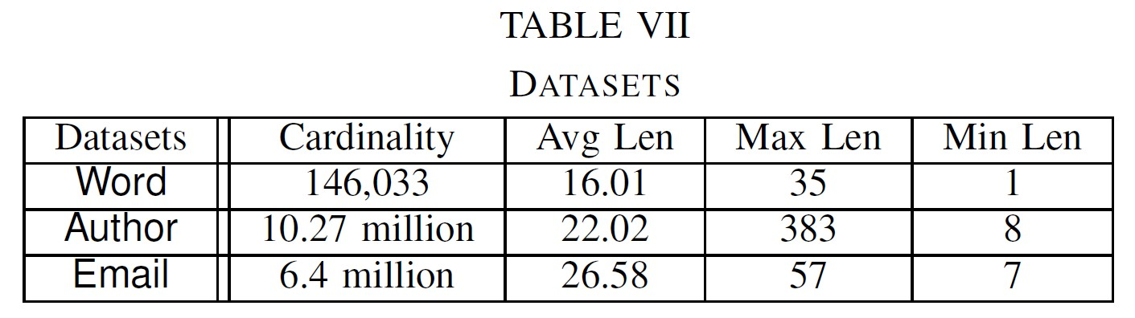
Experiment Setup
Three real Data sets
Existing algorithms
    B^{ed}-Tree (downloaded from its hompage)
    Adaptive Q-gram (we implemented)
    Flamingo(downloaded and we extended it to suppert topk query)

Slide 48
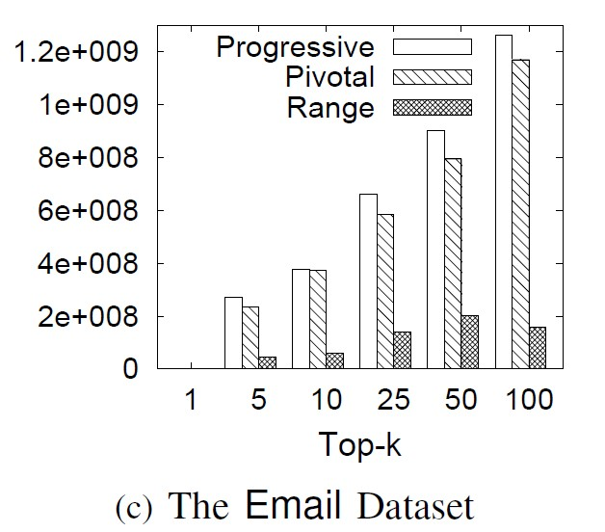
Number of entries calculated
RANGE was about 6 times lesser than PROGRESSIVE and PIVOTAL. This is because RANGE use pivotal quadruple group pivotal triples together and skip the unnecessary entries.

Slide 49
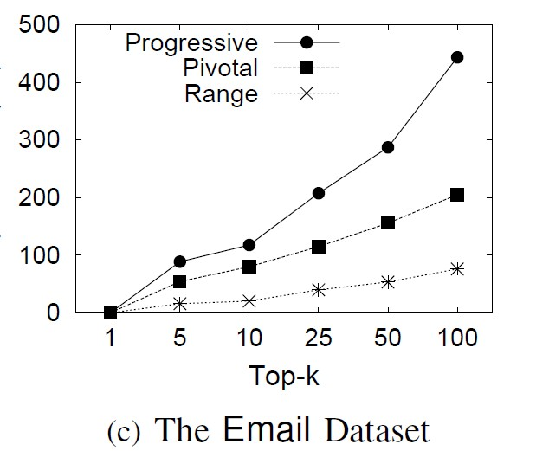
Running time of the three methods
The range-based method pruned many non-pivotal entries against the progressive-based method and grouped the pivotal entries to avoid unnecessary computations.

Slide 50
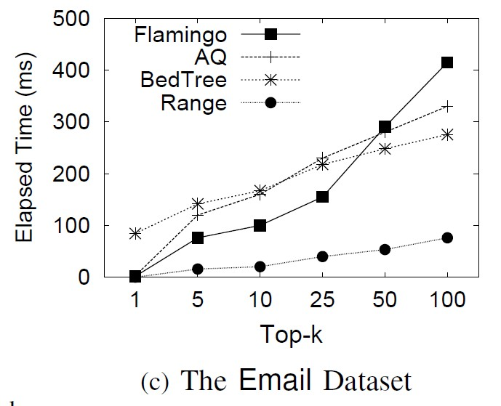
Comparison with State-of-the-art Methods

Slide 51
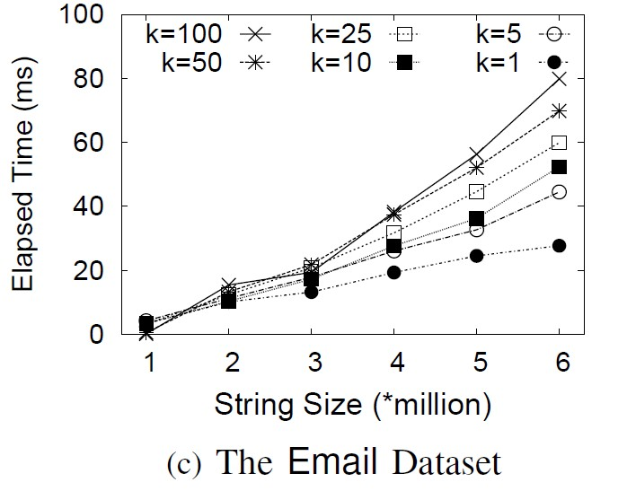
Scalability with Dataset Sizes
for k=100, our method took
27 milliseconds for 1 million strings,
52 milliseconds for 3 million strings
79 milliseconds for 6 million strings.

Slide 52
Outline
Motivation
Problem Formulation
Progressive Framework
Pivotal Entry-based Method
Range-based Method
Experiment
Conclusion

Slide 53
Conclusion
Top-k String Similarity Search
  A progressive framework to support top-k similarity search.
  A pivotal entries method to avoid unnecessary computations.
  A range-based method groups the pivotal entries.
  Experimental results show that our method significantly outperforms existing methods

Slide 54

Thanks!
Q&A
http://dbgroup.cs.tsinghua.edu.cn/dd/projects/topksearch

