Slide 1

MassJoin: A MapReduce-based Method for Scalable String Similarity Joins
Dong Deng (Tsinghua University, China)
Guoliang Li (Tsinghua University, China)
Shuang Hao (Tsinghua University, China)
Jiannan Wang (Tsinghua University, China)
Jianhua Feng (Tsinghua University, China)

Slide 2
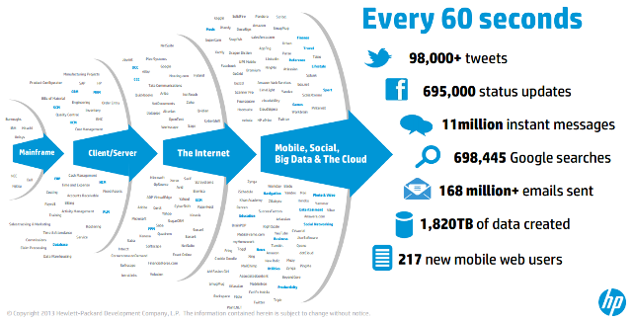
The Era of Big Data

Slide 3
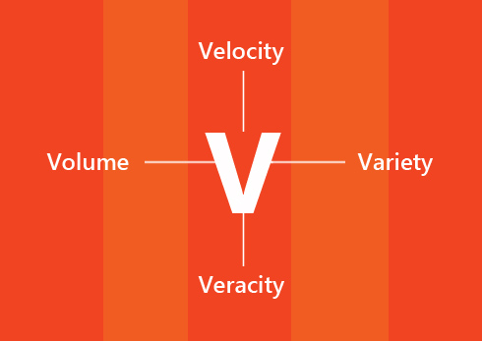
The 4V of Big Data

Slide 4
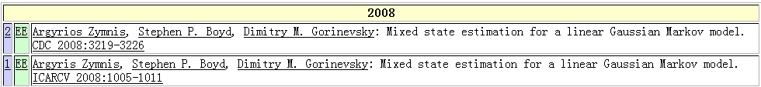
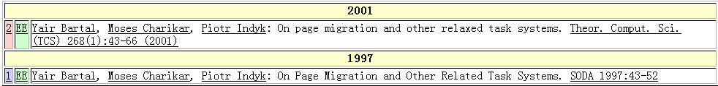
Real-world Data is Rather Dirty！☹
DBLP Complete Search
Typo in “author”
Typo in “title”
Argyrios Zymnis
Argyris Zymnis
relaxed
related

Slide 5
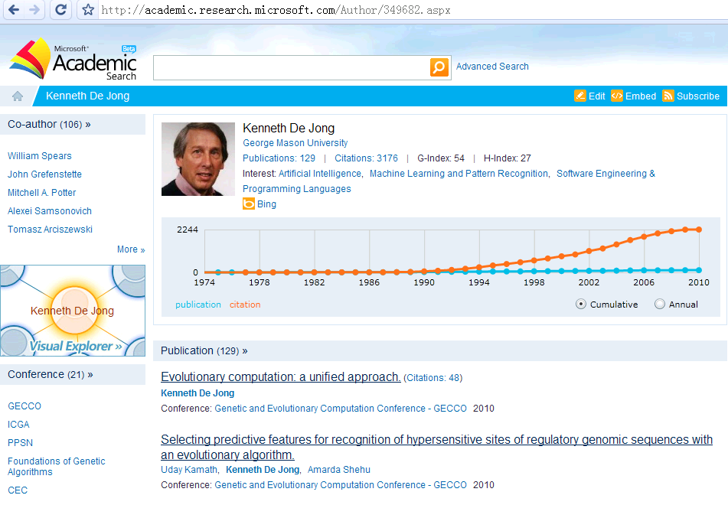
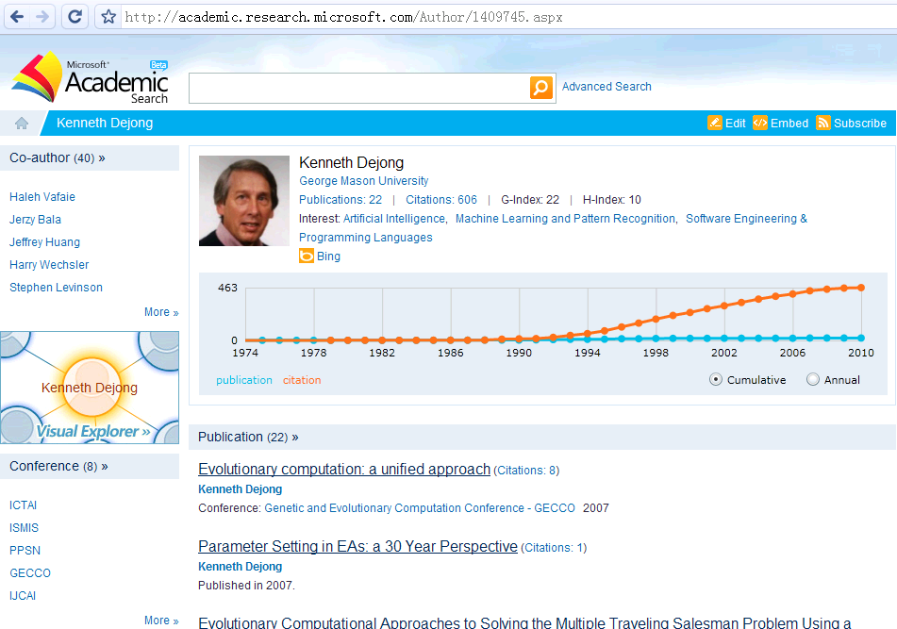
Real-world Data is Rather Dirty！☹
Microsoft Academic Search
Kenneth De Jong
Kenneth Dejong
PK
http://academic.research.microsoft.com/Author/2037349.aspx
http://academic.research.microsoft.com/Author/3054641.aspx

Slide 6


Similarity Joins
  The similarity join is an essential operation for data integration and cleaning
    Perform a similarity join on Name attribute (find all record pairs whose Name attributes are similar)
      Output: (2037349, 3054641), …
Id | Name | Univ.
2037349 | Kenneth De Jong | George …
… | … | …
3054641 | Kenneth Dejong | George …
… | … | …
R

Slide 7
Applications
Data Cleaning and Integration
Near Duplicate Object Detection
Collaborative Filtering
……..

Slide 8
Similarity Functions
Set-based similarity functions:
  Jaccard Similarity, Cosine Similarity and Dice Similarity
r: Barack H Obama II
→ r: {Barack, H, Obama, II}
s: Barack Obama II
→ s: {Barack, Obama, II}

Slide 9
Similarity Functions
Character-based similarity function: Edit Distance
ED(r, s): The minimum number of edit operations (insertion/deletion/substitution) to transform r to s.
hilton
substitute i with u
hulton
substitute l with u
huston
ED(hilton, huston) = 2

Slide 10
Problem Formulation
String Similarity Join
-----------------------------------------------
Input: two sets of strings R and S
a similarity threshold τ
Output: <r, s> ∈ R×S s.t. SIM(r, s) ≤ τ

Slide 11
Challenge
Large amounts of data:
E.g., GeneBank: 100M, Google N-gram: 1T
How to process?
MapReduce:
shared-nothing data-processing platform

Slide 12
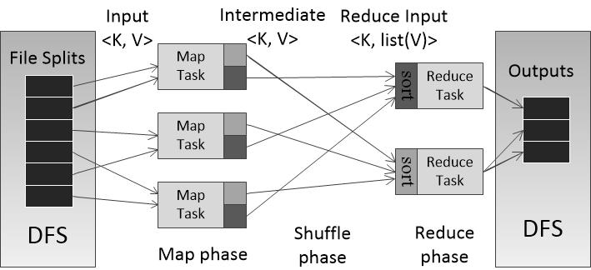
MapReduce Review

Slide 13
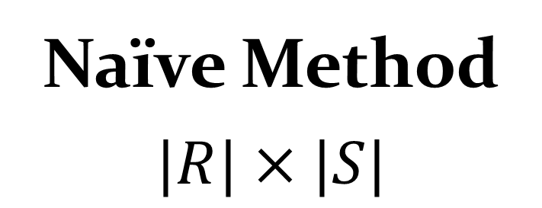
Challenge
Naïve Method
$$|R|×|S|$$
rather expensive!!
For |R|=|S|=1M, it needs to enumerate10¹² pairs.
How to avoid?
Filtering and Verification

Slide 14
Filtering-and-verification Method
Basic idea
  Filter a large number of dissimilar string pairs
  Verify the remaining potentially similar pairs

Slide 15
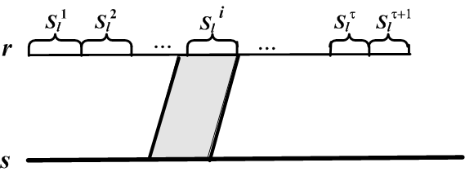
Filtering: A partition method
Split r to multiple equal-length disjoint segments
Is there any substring of s matching a segment of r ?
Yes
No
<r, s> is a candidate
We prune <r, s>
2019/5/27
15

Slide 16
Filtering: A partition-based method
Give Edit Distance threshold τ=1
hilton
hiuron
1

Slide 17
Filtering: A partition-based method
Give Edit Distance threshold τ=1
hilton
hiuron
1
Minimum # edit operations is 2
Prune!

Slide 18
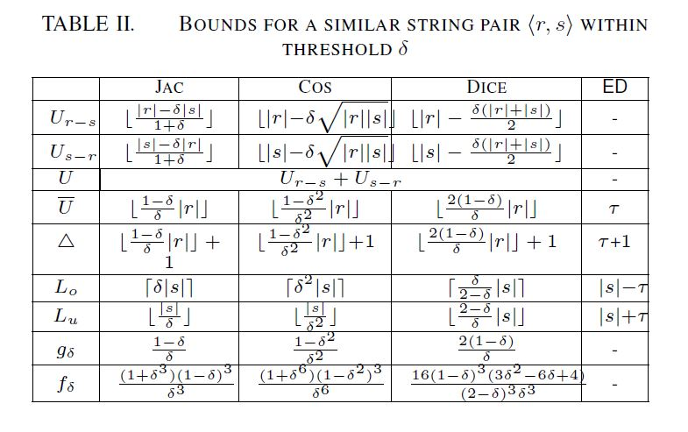
Filtering: A partition-based method
We extend the method to set-based similarity functions
Based on [LiDWF12], we only need to enumerate O(τ) substrings instead of every possible substring

Slide 19
The MassJoin Framework
Map
Shuffle
Reduce
Filtering:
Generate Segment/Substring
Use Segment or
Substring as Key
Get Candidates
Verification:
Replace SID with String
Do nothing
Use SID as Key
Replace RID with String
Verification
Use RID as Key

Slide 20
Length Filtering
Two strings with lengths different a lot can’t be similar
Add length information into Keys

Slide 21
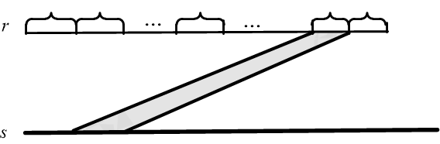
Positional Filtering
Two far away signatures cannot match
Different too much!!!
Add positiona information into Keys
2019/5/27
21

Slide 22
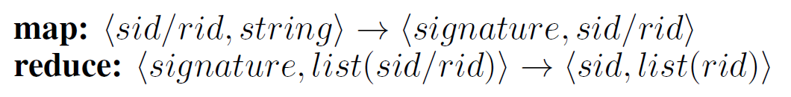
The MassJoin Framework - Filtering
MapReduce Round 1:
Map: Generate segments/substrings
Reduce: Apply filtering condition and get candidates
Key:
(substring/segment, signature position, string length)
Value:
String ID

Slide 23
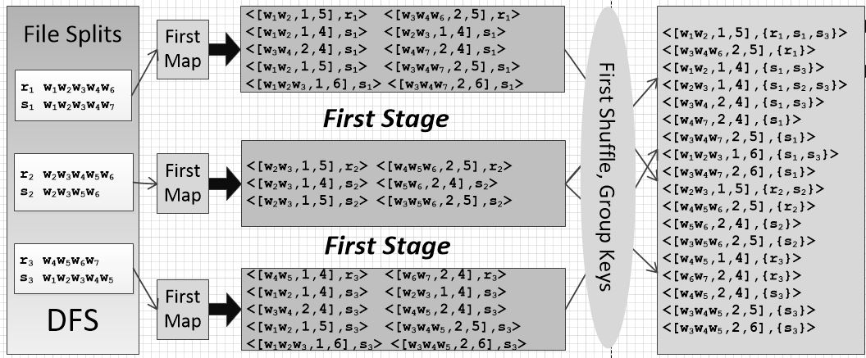

The MassJoin Framework - Filtering
Key:
(substring/segment, position information, string length)
Value:
String ID
First Reduce

Slide 24
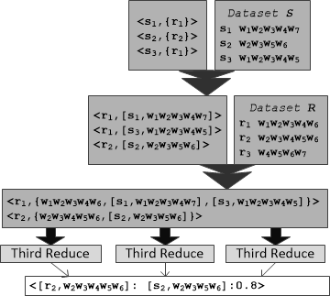
The MassJoin Framework-Verification
MapReduce Round 2 & 3:
Replace ID with its original string
Verify the candidates and output the results

Slide 25
Merging Key-Value Pairs
Key:
(substring/segment, signature position, string length)
Value:
String ID
  We need to select O(|s|³) substrings for set-based similarity functions
Moving string length |s| and |r| to Value field
And checking if L_{o} <=|r| <= L_{u} in the Reduce phase

Slide 26
Merging Key-Value Pairs
  We also move position information to Value field
Key:
substring/segment
Value:
(String ID, signature position, string length)
  Bounds checking can be done in O(1) time
  Number of Key-Value pairs reduced from O(|s|³) to O(|s|)
  for set-based similarity function

Slide 27
Light-Weight Filter Unit
Transmission and computation cost heavily relies on the number of candidate pairs
Using light-weight filtering unit to further prune dissimilar pairs.

Slide 28
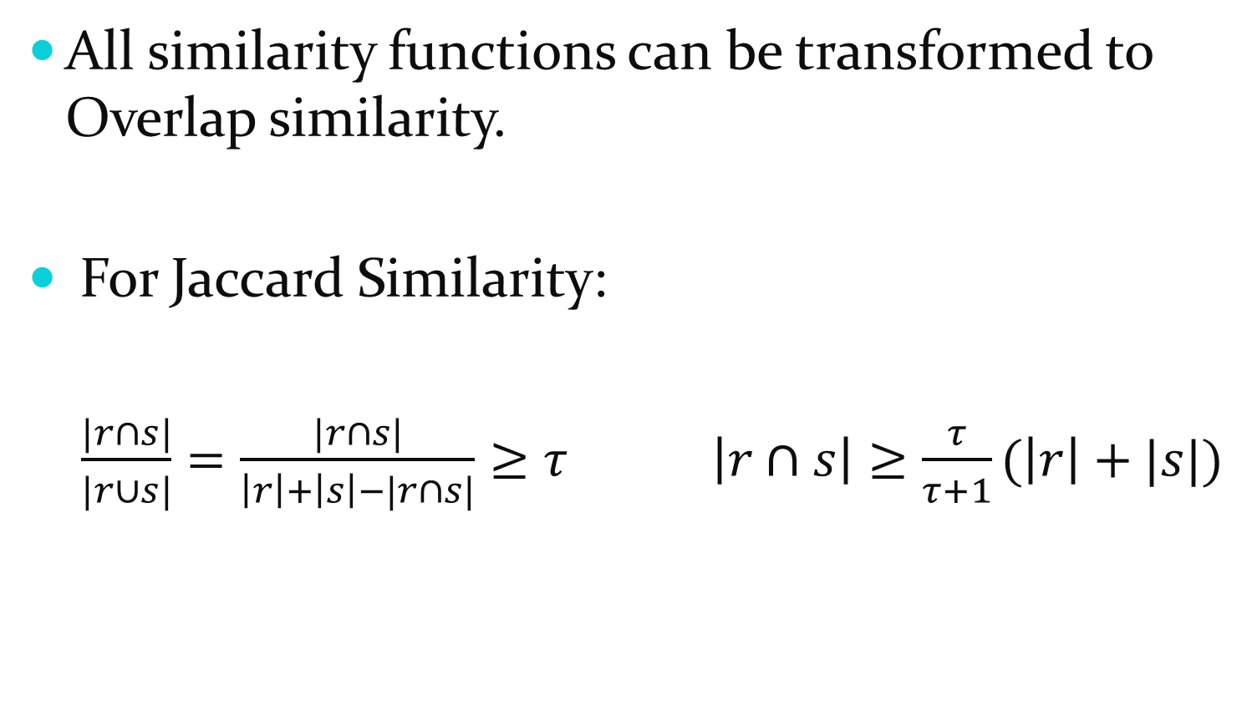
Light-Weight Filter Unit
All similarity functions can be transformed to Overlap similarity.
For Jaccard Similarity:
  $\frac{|r∩s|}{|r∪s|}=\frac{|r∩s|}{\left|r\right|+\left|s\right|−|r∩s|}≥τ$ $\left|r∩s\right|≥\frac{τ}{τ+1}(\left|r\right|+|s|)$

Slide 29
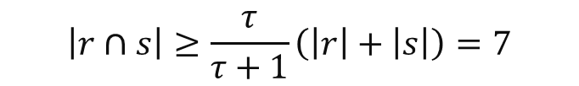
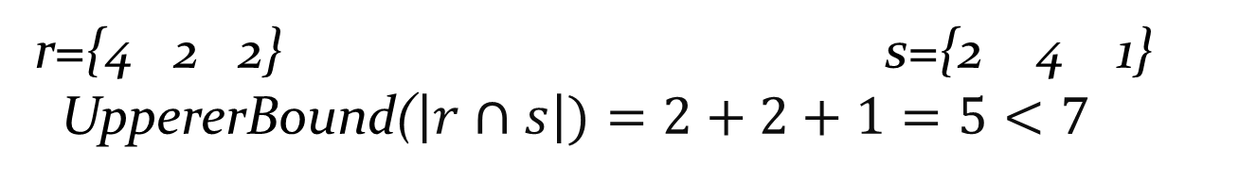
Light-Weight Filter Unit
Light Weight Filter Unit: we group all tokens into buckets and use occurrences of each group as the filter unit.
r = {A, C, E, F, I, K, Q, T} $τ$=0.8 s = {B, C, H, L, M, N, T}
$$\left|r∩s\right|≥\frac{τ}{τ+1}\left(\left|r\right|+\left|s\right|\right)=7$$
A B C D E F G H I J K L M N O P Q R S T U
r={4 2 2} s={2 4 1}
UppererBound($\left|r∩s\right|)=2+2+1=5<7$

Slide 30
Light-Weight Filter Unit
Different grouping strategy has different pruning power, finding the optimal grouping problem is NP-hard

Slide 31
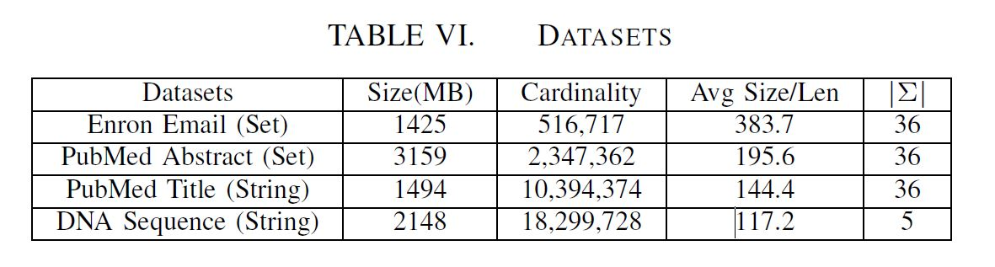
Experimental Results
Setting
  Datasets
  Hardware
    Using Hadoop and run on a 10-node Dell cluster.
    Each node had two Intel(R) Xeon(R) E5420 2.5GHZ processors with 8 cores
    16GB RAM, and 1TB disk.

Slide 32
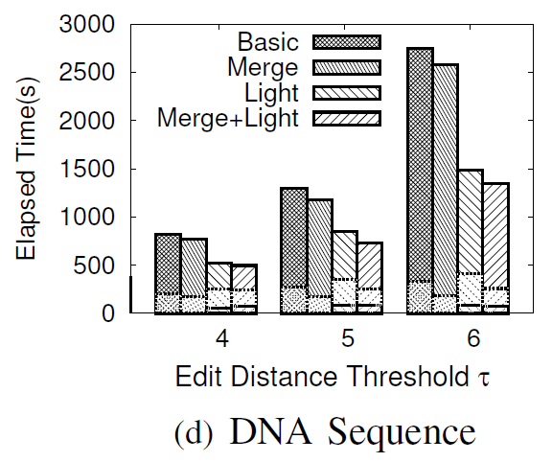
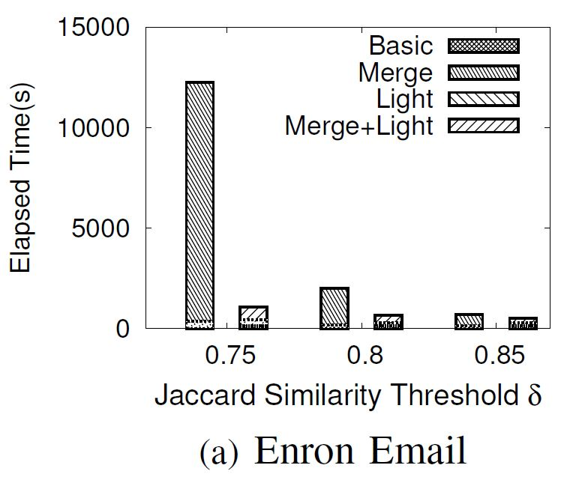
Evaluating our proposed techniques

Slide 33
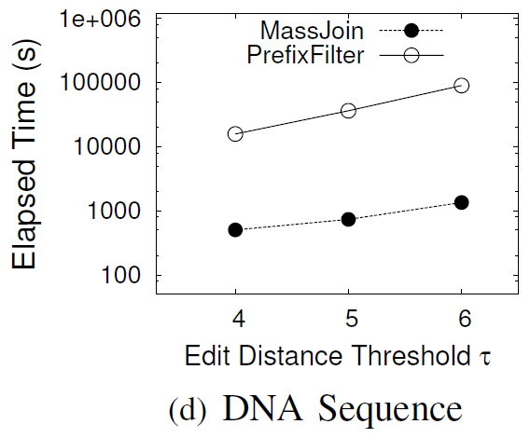
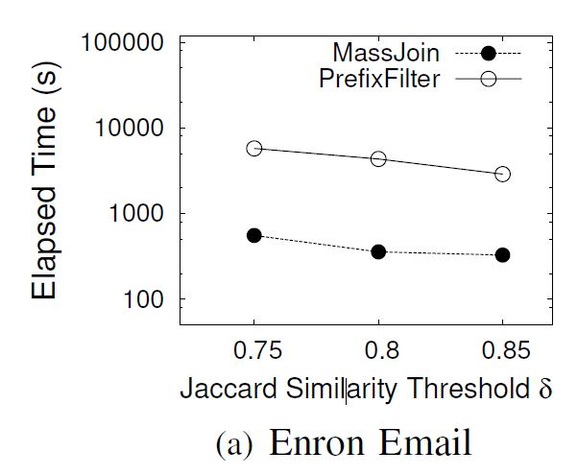
Comparison with State-of-the-art

Slide 34
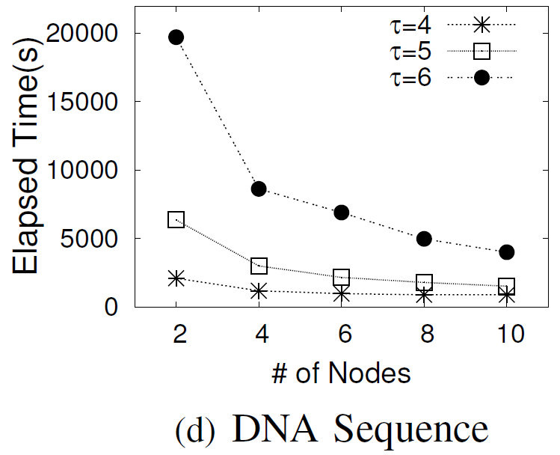
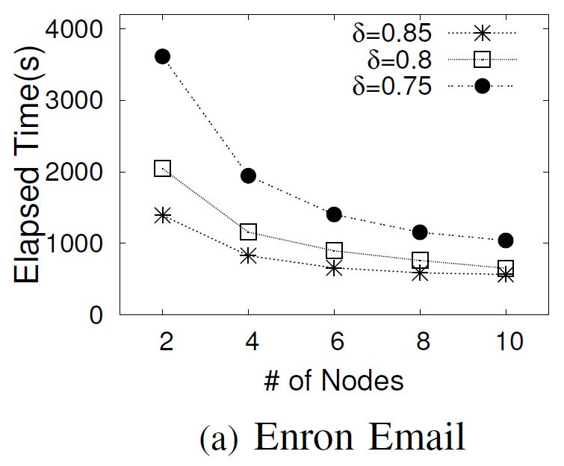
Speedup

Slide 35
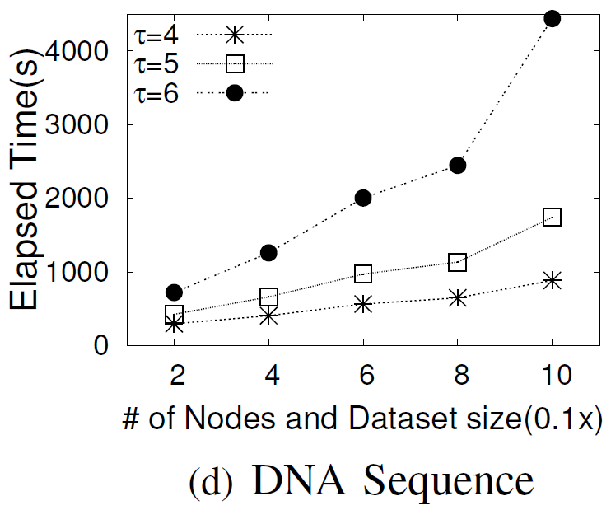
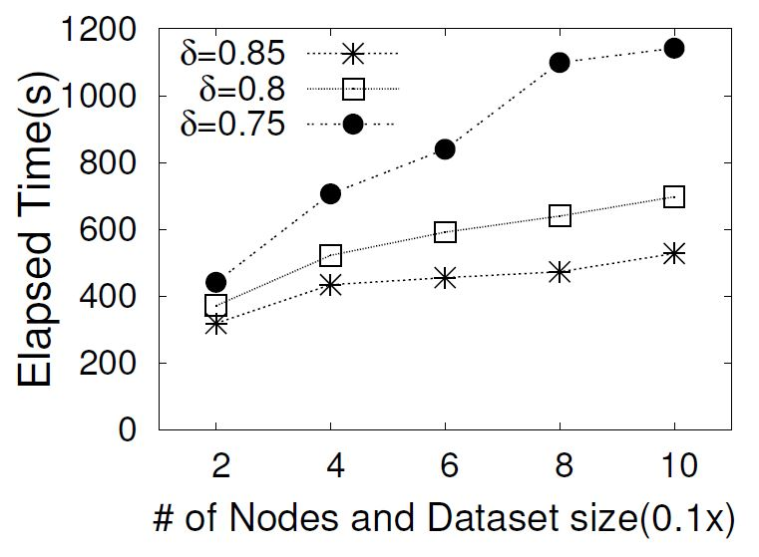
Scaleup

Slide 36

Thanks!
Q&A
http://dbgroup.cs.tsinghua.edu.cn/dd/projects/massjoin/

