Slide 1


A Pivotal Prefix Based Filtering Algorithm for String Similarity Search
Dong Deng, Guoliang Li, Jianhua Feng
Database Group, Tsinghua University
Present by Dong Deng

Slide 2
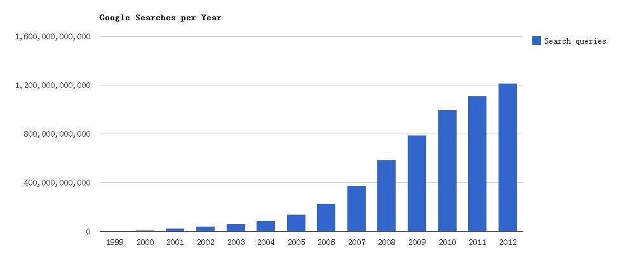
Search is Important
Google Searches per Year
Source: http://www.internetlivestats.com/google-search-statistics/

Slide 3

Speed Matters
Source:

Slide 4

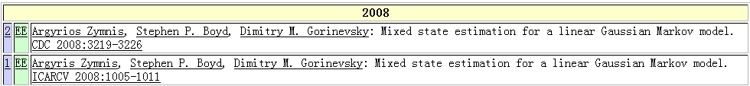
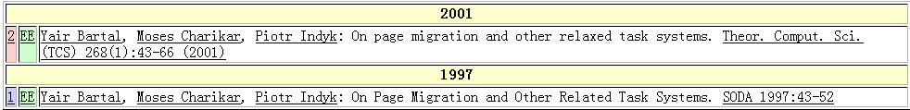
Data is Dirty
DBLP Complete Search
Typos
Typo in “title”
Argyrios Zymnis
Argyris Zymnis
relaxed
related

Slide 5



Similarity Search
Query
All the strings similar
to the query
String Dataset

Slide 6
Edit Distance
ED(r, s): The min number of edit operations (insertion/deletion/substitution) needed to transform r to s.
For example: ED(sigcom, sigmod) = 2
sigcom
substitute c with m
sigmom
substitute m with d
sigmod

Slide 7
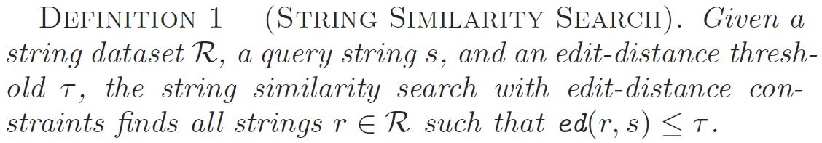
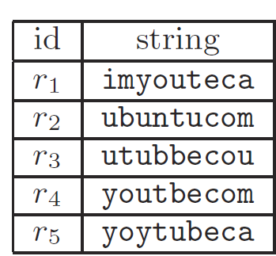
Problem Definition
Query string
s = “yotubecom” and τ = 2
ed(s, r₄) <= 2
output r₄ as a result
string dataset R

Slide 8
Application
Spell Checking
Copy Detection
Entity Linking
Bioinformatic
….

Slide 9
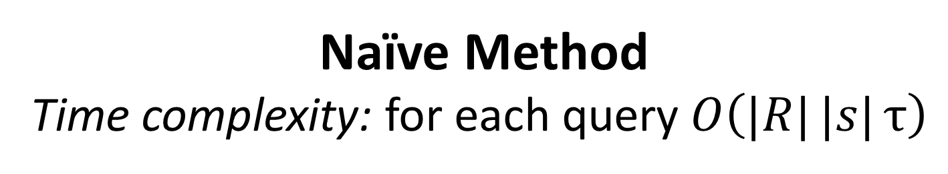
Challenge
Naïve Method
Time complexity: for each query$O\left(|R|{|s|}τ\right)$

Slide 10
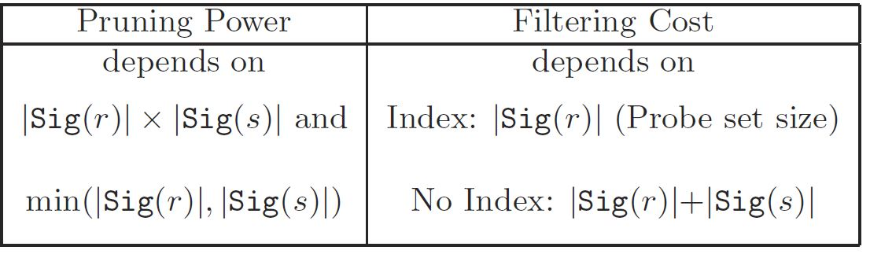
Filter-and-Verification Framework
Query string s
Filter:
Signature(s) ∩
Signature(r) = ϕ?
Verify:
ED(r,s) ≤ τ?
No
Yes
Index
Dataset R
Results
Threshold τ

Slide 11
Preliminary: q-gram
q-gram of the substring with length q
youtbecom
yo
ou
ut
tb
2-gram
be
ec
co
om

Slide 12
Preliminary: q-gram
1 edit operation destroies at most q grams.
τ edit operations destroy at most qτ grams.
if r and s have more than qτ mismatch grams, ED(r, s)>τ.
yout
d
ecom
yo
ou
ut
t
d
e
d
ec
co
om

Slide 13
Preliminary: Prefix Filter
  Sort all q-grams by global ordering, such as idf
  q(r) : The sorted q-gram set of string r
  Pre(r)
  suffix(r)
  Pre(•) is the prefix of q(•)
  |Pre(•)|= qτ+1
  Pre(s)
  q(s): The sorted q-gram set of string s
  Prefix Filter: If pre(r) ∩ pre(s) = ϕ, ED(r,s) > τ

Slide 14
Preliminary: Prefix Filter
  Sort all q-grams by global ordering, such as idf
  q(r) : The sorted q-gram set of string r
  Pre(r)
  suffix(r)
g₁
g₂
g₅
g₆
g₁₁
g₁₂
g₁₃
>g₁₀
>g₁₀
>g₁₀
>g₁₀
>g₁₀
>g₁₀
  Pre(•) is the prefix of q(•)
  |Pre(•)|= qτ+1
g₃
g₄
g₇
g₈
g₉
g₁₀
g₁₂
  Pre(s)
  q(s): The sorted q-gram set of string s
  Prefix Filter: If pre(r) ∩ pre(s) = ϕ, ED(r,s) > τ

Slide 15
Preliminary: disjoint q-gram
One edit operation destroies at most 1 disjoint gram.
τ edit operations destroy at most τ disjoint grams.
if r and s have more than τ mismatch disjoint grams, ED(r, s)> τ
yout
d
ecom
yo
ut
e
d
om

Slide 16
Pivotal Prefix Filter
  Sort all q-grams by global ordering, such as idf
  q(r) : The sorted q-gram set of string r
  Pre(r)
  suffix(r)
  Piv(r)
  Piv(•) is the pivotal prefix of q(•)
  |Piv(•)|= τ+1 and the q-grams in Piv(•) are disjoint
  Piv(s)
  Pre(s)
  q(s): The sorted q-gram set of string s
  If piv(s) ∩ pre(r) = ϕ and piv(r) ∩ pre(s) = ϕ, ED(r,s) > τ

Slide 17
Pivotal Prefix Filter
  Sort all q-grams by global ordering, such as idf
  q(r) : The sorted q-gram set of string r
  Pre(r)
last(r)
  suffix(r)
g₅
g₈
g₁₀
  Piv(r)
  Piv(•) is the pivotal prefix of q(•)
  |Piv(•)|= τ+1 and the q-grams in Piv(•) are disjoint
  Piv(s)
>g₁₀
>g₁₀
>g₁₀
>g₁₀
>g₁₀
>g₁₀
>g₁₀
g₁
g₃
g₆
g₉
g₁₁
g₁₃
last(s)
  Pre(s)
  q(s): The sorted q-gram set of string s
  Pivotal Prefix Filter: If last(s)> last(r) and piv(r) ∩ pre(s) = ϕ, ED(r,s) > τ

Slide 18
Pivotal Prefix Filter
  Sort all q-grams by global ordering, such as idf
  q(r) : The sorted q-gram set of string r
  Pre(r)
last(r)
  suffix(r)
g₁
g₄
g₆
g₉
g₁₂
g₁₃
>g₁₀
>g₁₀
>g₁₀
>g₁₀
>g₁₀
>g₁₀
>g₁₀
  Piv(r)
  Piv(•) is the pivotal prefix of q(•)
  |Piv(•)|= τ+1 and the q-grams in Piv(•) are disjoint
  Piv(s)
g₃
g₇
g₁₀
g₁₁
last(s)
  Pre(s)
  q(s): The sorted q-gram set of string s
  Pivotal Prefix Filter: If last(r)> last(s) and piv(s) ∩ pre(r) = ϕ, ED(r,s) > τ

Slide 19
Pivotal Prefix Filter
  If last(r)> last(s) and piv(s) ∩ pre(r) = ϕ, ED(r,s) > τ
  If last(s)> last(r) and piv(r) ∩ pre(s) = ϕ, ED(r,s) > τ
Existence: There must exist τ+1 disjoint grams in the prefix
The Pivotal Prefix is a subset of the Prefix
  The pivotal prefix filter dominates the prefix filter
  Signature size are O(τ) and O(qτ) respectively

Slide 20
Related Work
Method | |Sig(r)| | |Sig(s)|
Prefix Filter | O(qτ) | O(qτ)
Mismatch Filter | O(qτ) | O(qτ)
Qchunk Filter | O(τ) | O(l)
Pivotal Prefix Filter | O(τ) | O(qτ)
Mismatch Filter [Xiao VLDB08] : Shorten prefix length, but still O(qτ)
Qchunk Filter[Qin SIGMOD11] : Shorten one to O(τ) but increased the other one to O(l)
Adaptive Prefix[Wang SIGMOD12]
  Increase prefix length to reduce candidate number
  Orthogonal and can be integrated into our method
Flamingo[Li ICDE08]
  Based on count filter. Accelerating counting process.
  Orthogonal and can be integrated into our method

Slide 21
Pivotal Search Algorithm
Indexing
  Build inverted indexes for both the prefix and the
  pivotal prefix of the data strings
Querying
  Generate prefix and pivotal prefix for the query string
  Probe the prefix index with the pivotal prefix of the query
  Probe the pivotal prefix index with the prefix of the query
  Verify the candidates and output results

Slide 22
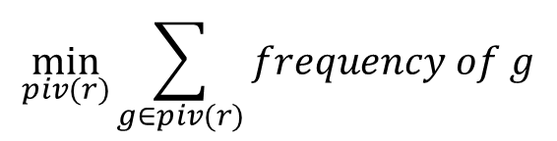
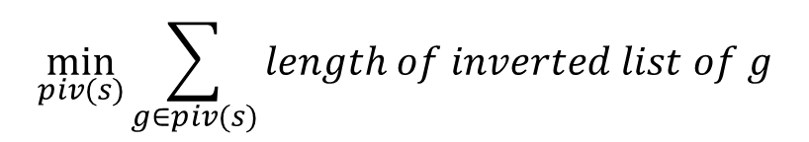
Pivotal Prefix Selection
Evaluating Different Pivotal Prefixes:
The longer the inverted lists we probe, the more candidates we may have.
$$\min_{piv(s)}{\sum_{g∈piv(s)}{length of inverted list of g}}$$
For query string:
$$\min_{piv(r)}{\sum_{g∈piv(r)}{frequency of g}}$$
For data string:

Slide 23
Optimal Pivotal Prefix Selection
Dynamic Programming:
  Object: Select m=τ+1 optimal pivotal q-grams
  from the first n=qτ+1 grams in the prefix
  Select m-1 optimal pivotal q-grams from the first n-1 q-grams in prefix
  Select as last pivotal q-gram

Slide 24
Optimal Pivotal Prefix Selection
Dynamic Programming:
  Select m-1 optimal pivotal q-grams from the first n-2 q-grams
  Select as last pivotal q-gram

Slide 25
Optimal Pivotal Prefix Selection
Dynamic Programming:
  Select m-1 optimal pivotal q-grams from the first m-1 q-grams
  Select as last pivotal q-gram
Recursive formula:
$$f\left(m,n\right)=\min_{1≤k≤m}(\left|weight\left[gk\right]\right|+f\left(k,n−1)\right)$$
$$weight is length of inverted list for query and frequency for data string$$

Slide 26
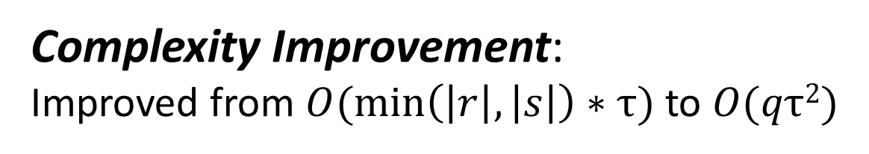
Filter-and-Verification Framework
Query string s
Filter:
Signature(s) ∩
Signature(r) = ϕ?
Verify:
alignment filter?
If yes, ED(r,s) ≤ τ?
No
Yes
Index
Dataset R
Results
Threshold τ
Complexity Improvement:
Improved from $O(\min\left(\left|r\right|,\left|s\right|\right)∗τ)$ to $O(qτ2)$

Slide 27
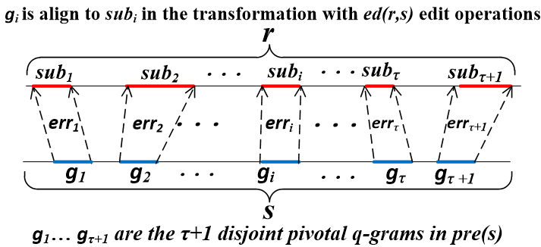
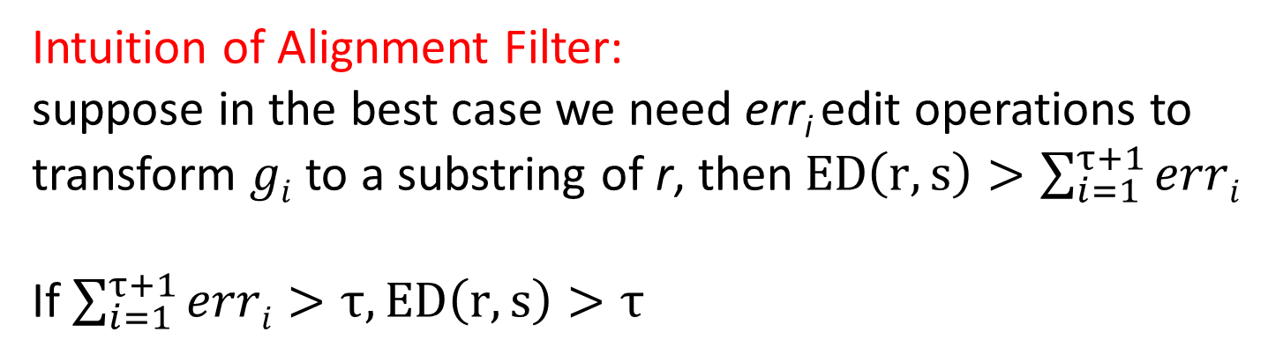
Alignment Filter
Intuition of Alignment Filter:
suppose in the best case we need err_{i} edit operations to
transform $gi$ to a substring of r, then$ED\left(r, s\right)>\sum_{i=1}^{τ+1}{erri}$
If$\sum_{i=1}^{τ+1}{erri}>τ,ED\left(r, s\right)>τ$

Slide 28
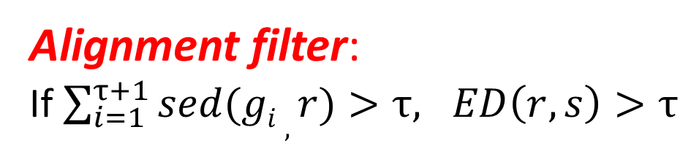
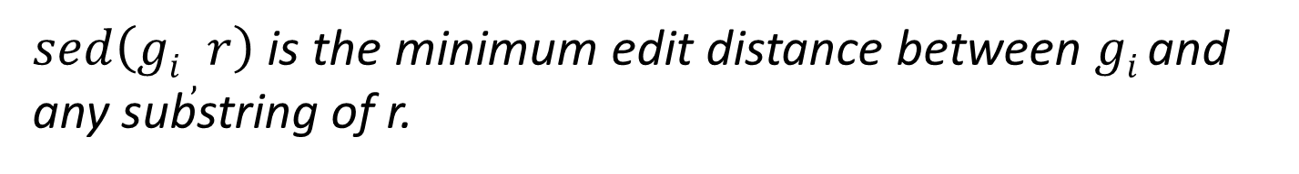
Alignment Filter
Substring edit distance (sed)
$sed\left(gi , r\right)$ is the minimum edit distance between $gi$ and
any substring of r.
Alignment filter:
If $\sum_{i=1}^{τ+1}{sed(gi , r)}>τ, ED\left(r, s\right)>τ$

Slide 29
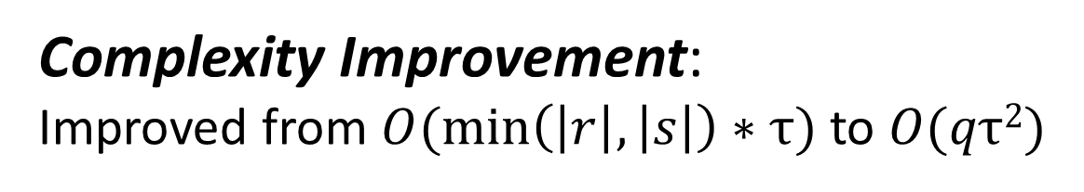
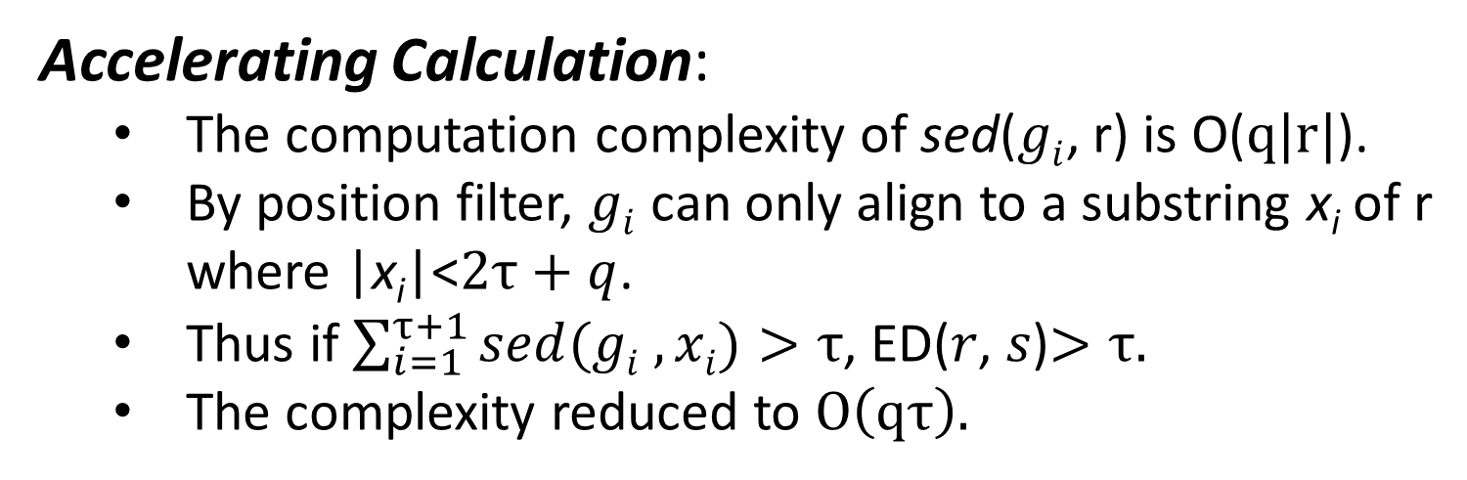
Alignment Filter
Accelerating Calculation:
  The computation complexity of sed($gi$, r) is O($q|r|$).
  By position filter, $gi$ can only align to a substring x_{i} of r
  where |x_{i}|<$2τ+q$.
  Thus if $\sum_{i=1}^{τ+1}{sed(gi ,xi)}>τ$, ED(𝑟, 𝑠)$>τ.$
  The complexity reduced to $O\left(qτ\right).$
Complexity Improvement:
Improved from $O(\min\left(\left|r\right|,\left|s\right|\right)∗τ)$ to $O(qτ2)$

Slide 30
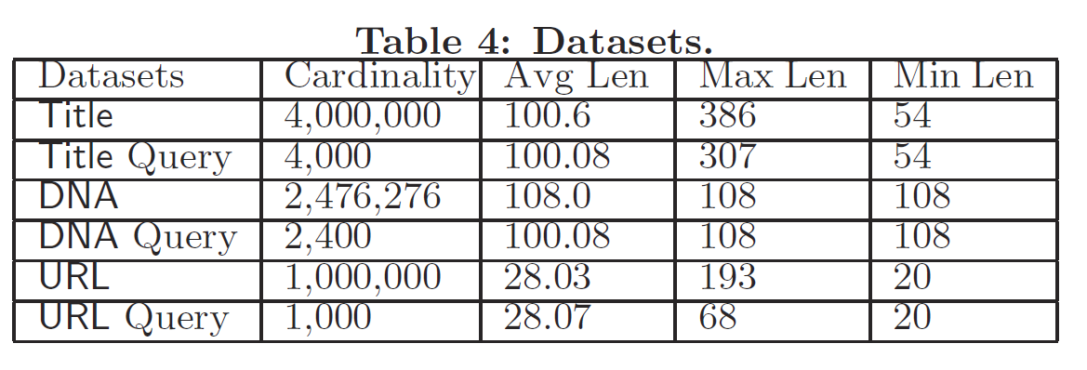
Experiments
Settings:
C++, g++ 4.8.2 with -O3 flags
64bit Ubuntu Server 12.04 LTS version
Intel Xeon E5-2650 2.00GHz processor and 16GB memory.

Slide 31
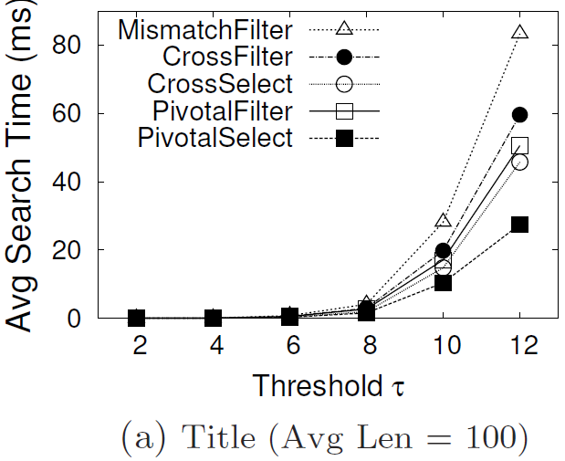
Evaluating Pivotal Prefix Filter
Average Search Time
Mismatch: From EDJoin
CrossFiler: Cross Filter
PivotalFilter: PivotalFilter
CrossSelect: CrossFilter + Pivotal Prefix Selection
PivotalSearch: PivotalFilter + Pivotal Prefix Selection

Slide 32
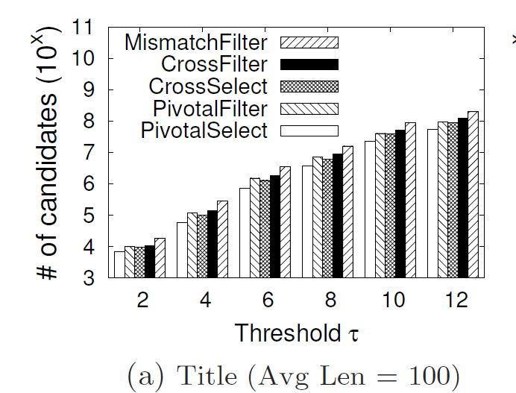
Evaluating Pivotal Prefix Filter
Candidate Number
Mismatch: From EDJoin
CrossFiler: Cross Filter
PivotalFilter: PivotalFilter
CrossSelect: CrossFilter + Pivotal Prefix Selection
PivotalSearch: PivotalFilter + Pivotal Prefix Selection

Slide 33
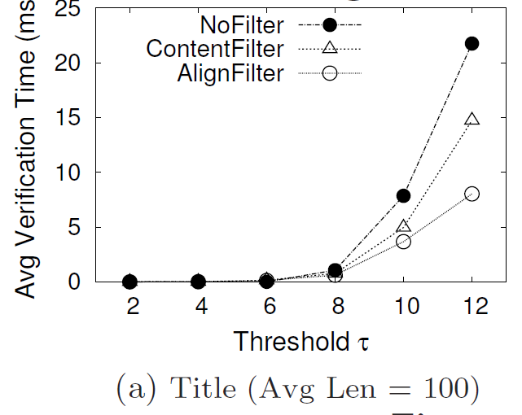
Evaluating Alignment Filter
Average Search Time
NoFilter: without any filter
ContentFilter: From EDJoin
AlignFilter: Alignment Filter

Slide 34
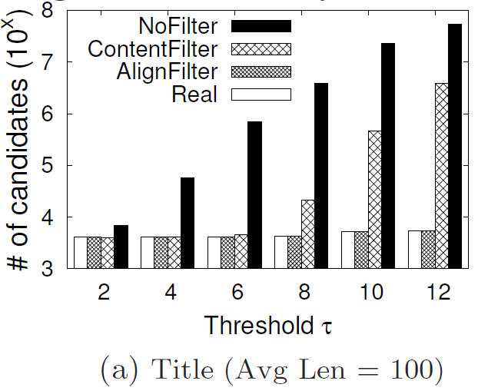
Evaluating Alignment Filter
Candidate Number
NoFilter: without any filter
ContentFilter: From EDJoin
AlignFilter: Alignment Filter
Real: Number of results

Slide 35
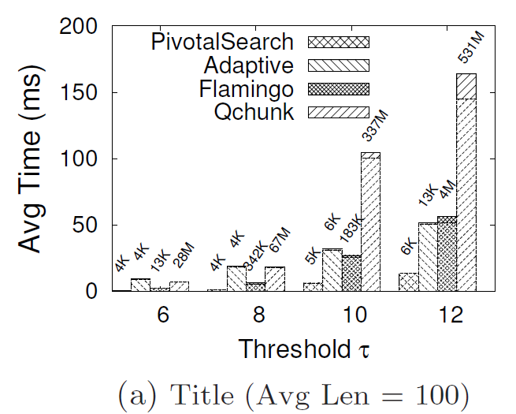
Comparison with State-of-the-arts
PivotalSearch: Our method
Adaptive: [Wang2012]
Flamingo: [Li2008]
Qchunk: [Qin 2011]

Slide 36
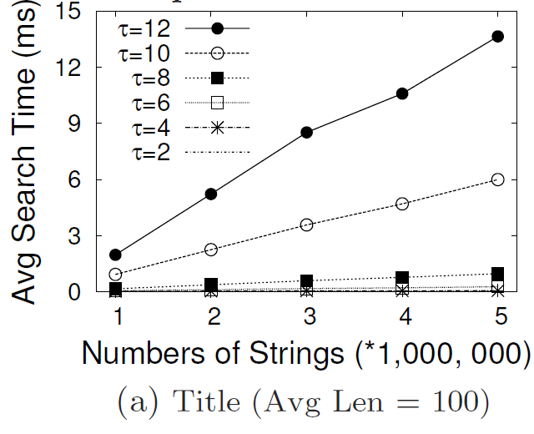
Scalability

Slide 37
Conclusion
Pivotal prefix filter
Pivotal search algorithm
Optimal pivotal prefix selection
Alignment filter

Slide 38
Thank you
Q & A
Project hompage: http://dbgroup.cs.tsinghua.edu.cn/dd/pivotal.html

