Slide 1

Pass-Join: A Partition based Method for Similarity Joins
Guoliang Li (Tsinghua, China)
Dong Deng (Tsinghua, China)
Jiannan Wang (Tsinghua, China)
Jianhua Feng (Tsinghua, China)

Slide 2
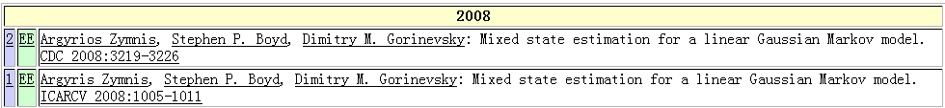
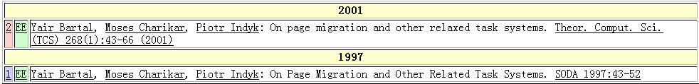
Real-world Data is Rather Dirty！☹
DBLP Complete Search
Typo in “author”
Typo in “title”
Argyrios Zymnis
Argyris Zymnis
relaxed
related

Slide 3
Real World Data is Dirty
Typo
Argyrios Zymnis
Argyris Zymnis

Slide 4
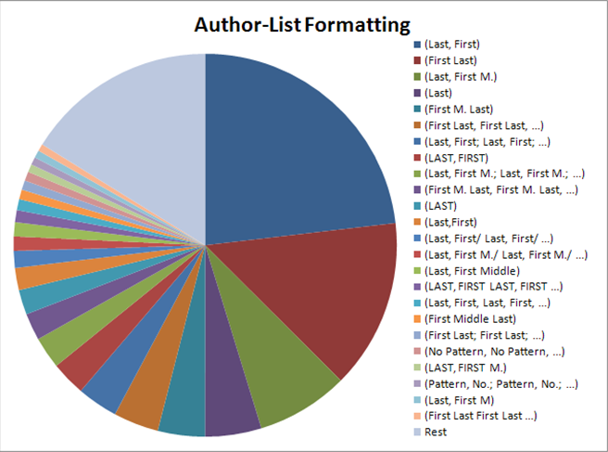
Real World Data is Dirty
Inconsistent Format

Slide 5

Fuzzy Matching: A use case :-)
Find speeches similar to Melania Trump's RNC speech
This slide is borrowed from Chen Li: https://chenli.ics.uci.edu/

Slide 6
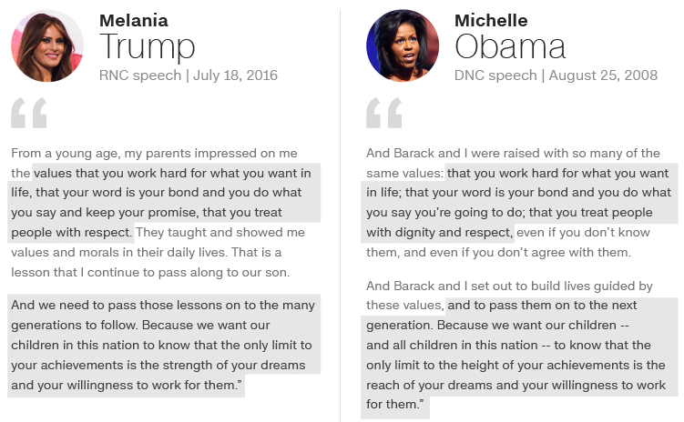
Fuzzy Matching: A use case :-)
This slide is borrowed from Chen Li: https://chenli.ics.uci.edu/

Slide 7
Similarity Join
Equal Join
Dataset R
Dataset S
Conference
VLDB
SIGMOD
ICDE
Conference
CIDR
SIGMOD
PVLDB

Slide 8
Similarity Join
Similarity Join
Dataset R
Dataset S
Conference
VLDB
SIGMOD
ICDE
Conference
CIDR
SIGMOD
PVLDB

Slide 9
Applications
Data Cleaning and Integration
Near Duplicate Object Detection
Collaborative Filtering
……..

Slide 10
Edit Distance
ED(r, s): The minimum number of single-character edit operations(insertion/deletion/substitution) to transform r to s.
For example: ED(hilton, huston) = 2
hilton
substitute i with u
hulton
substitute l with u
huston

Slide 11
Edit Distance
ED(r, s): The minimum number of edit operations (insertion/deletion/substitution) needed to transform r to s.
Property: ED(r, s) ≥ ||r|-|s||
  Since it needs at least ||r|-|s|| deleting operations

Slide 12

Problem Formulation
Input:
  A collection of strings S
  An edit distance threshold 𝜏
Output:
  All string pairs $\left(s, r\right)∈S×S such that ED\left(s, r\right)≤τ$

Slide 13
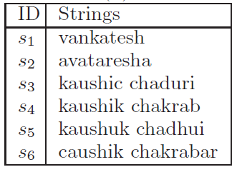
Problem Formulation
Give threshold τ=3
ED <s₁ ,s₂>=5 ED <s₁ ,s₃>=13 ED <s₁ ,s₄>=12 ED <s₁ ,s₅>=12
ED <s₁ ,s₆>=14 ED <s₂ ,s₃>=12 ED <s₂ ,s₄>=12 ED <s₂ ,s₅>=12
ED <s₂ ,s₆>=14 ED <s₃ ,s₄>=5 ED <s₃ ,s₅>=4 ED <s₃ ,s₆>=8
ED <s₄ ,s₅>=4 ED <s₄ ,s₆>=3 ED <s₅ ,s₆>=8

Slide 14
Filter-and-refine Methods
Basic idea
  Filter a large number of dissimilar string pairs
  Verify the remaining potentially similar pairs

Slide 15
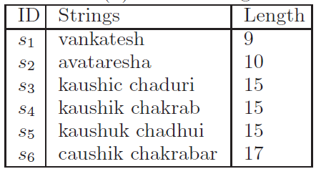
Filter-and-refine Methods
Give threshold τ=3
Pruning Condition:
||s_{i}| - |s_{j}|| > 3
ED <s₁ ,s₂>=5 ED <s₁ ,s₃>=13 ED <s₁ ,s₄>=12 ED <s₁ ,s₅>=12
ED <s₁ ,s₆>=14 ED <s₂ ,s₃>=12 ED <s₂ ,s₄>=12 ED <s₂ ,s₅>=12
ED <s₂ ,s₆>=14 ED <s₃ ,s₄>=5 ED <s₃ ,s₅>=4 ED <s₃ ,s₆>=8
ED <s₄ ,s₅>=4 ED <s₄ ,s₆>=3 ED <s₅ ,s₆>=8

Slide 16
Filter-and-refine Methods
Basic idea
  Filter a large number of dissimilar string pairs
  Verify the remaining potentially similar pairs
Drawbacks
  Need to tune parameters
  Bad for short strings

Slide 17
Outline
Motivation & Problem Formulation
Partition-based Framework
Improving Substring Selection
Improving the Verification
Experiment
Conclusion

Slide 18
Our Filter Condition
Give threshold τ=1
hilton
huston
1

Slide 19
Our Filter Condition
Give threshold τ=1
hilton
huston
1
Minimum # edit operations is 2
Prune!

Slide 20
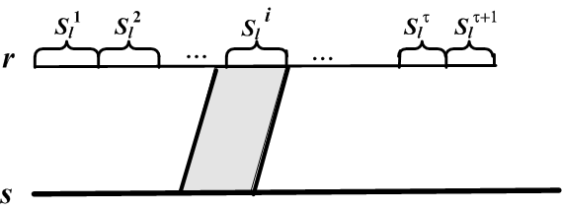
Our Filter Condition
Threshold τ
String r
String s
Split r to τ +1 disjoint segments
Is there any substring of s matching a segment of r ?
Yes
No
<r, s> is a candidate
We prune <r, s>

Slide 21
How to partition?
Give threshold τ=1
hilton
huston
Match
Candidate!

Slide 22
Partition Scheme
Even Partition Scheme
  tau = 3 “avataresha” → {“av”, “at”, “are”, “sha”}
Other Schemes
  Select good partition strategies.
  Adaptive partition scheme [Deng et al. 2012a].

Slide 23
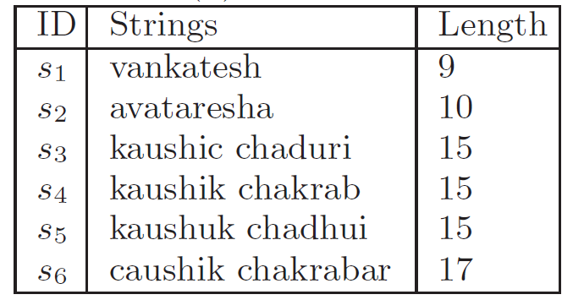
Partition-based Framework
1. Group all the strings by length: S_{l}
S₉
S₁₀
S₁₅
S₁₇

Slide 24
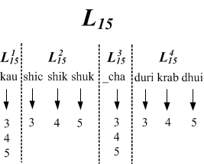
Partition-based Framework
  2. For each S_{l ,} partition strings into segments and build tau+1 inverted indexes L_{l}^{i}
S₁₅ 1 2 3 4
s₃=kau shic _cha duri
s₄=kau shik _cha krab
s₅=kau shuk _cha dhui

Slide 25
Partition-based Framework
3. Select substrings and generate candidates
s₆=caushik _chakrabar
Candidates: <s₃, s₆>; <s₄, s₆>; <s₅, s₆>

Slide 26
Partition-based Framework
4. Verify the candidates
Candidates: <3, 6>; <4, 6>; <5, 6>
ED(s₃, s₆) > 3
ED(s₄, s₆) = 3
ED(s₅, s₆) > 3

Slide 27
Challenge
Decrease selected substring set size.
Accelerate the verification.

Slide 28
Outline
Motivation & Problem Formulation
Partition-based Framework
Improving Substring Selection
Improving the Verification
Experiment
Conclusion

Slide 29


Naive Method
For each L_{l}^{i}, put all the substrings of s into W(s, l).
va
nk
at
esh
a v a t a r e s h a
L₉¹
av va at ta ar re es sh ha
L₉²
ava vat ata tar are res esh sha
L₉³
…… …… ……
avataresh vataresha
L₉⁴
avataresha

Slide 30


Naive Method
For each L_{l}^{i}, put all the substrings of s into W(s, l).
The size of W(s, l) is:
For example, with 4 segments
and , the size of W(s, l) is 220.

Slide 31
Length-based Method
For each L_{l}^{i}, only select substrings with the same length.
L₉¹
va
nk
at
esh
av va at ta ar re es sh ha
L₉²
av va at ta ar re es sh ha
L₉³
av va at ta ar re es sh ha
L₉⁴
ava vat ata tar are res esh sha

Slide 32
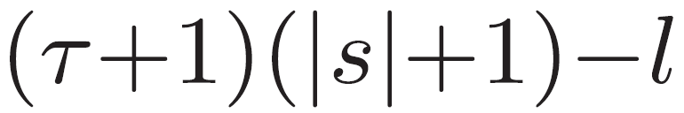
Length-based Method
The size of W(s, l) is:
For and , the size of W(s, l) is 35.

Slide 33
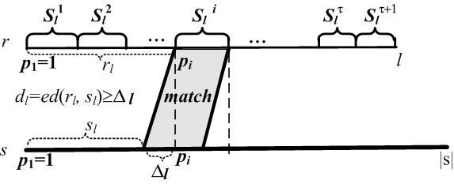
Shift-based Method
For each inverted index L_{l}^{i} with start position p_{i,} select all substrings with start position in [p_{i} - τ, p_{i}+τ].
First transform r_{l} to s_{l}
Pruning Condition: ||s_{l}|-|r_{l}|| > τ

Slide 34
Shift-based Method
The size of W(s, l) is: (tau+1)(2tau+1)
For and , the size of W(s, l) is 22.
L₉¹
va
nk
at
esh
av va at ta
L₉²
av va at ta ar re
L₉³
va at ta ar re es sh
L₉⁴
tar are res esh sha

Slide 35
Position-aware Method
r_{l}
r_{r}
s_{l}
s_{r}
||s_{l}|-|r_{l}||+||s_{r}|-|r_{r}||=2+3>3

Slide 36

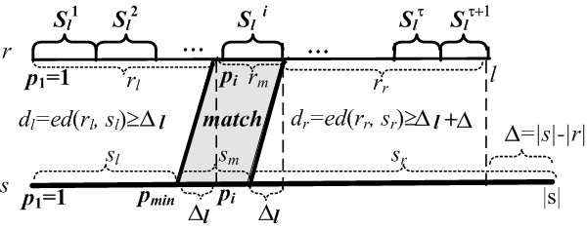
Position-aware Method
For each inverted index L_{l}^{i} with start position p_{i,} select all substrings with start position in
where Δ=|s|-|r|=|s|-l.
Transform r_{l} to s_{l} and then transform r_{r} to s_{r}
Pruning Condition: ||s_{l}|-|r_{l}|| +||s_{r}|-|r_{r}||> τ

Slide 37
Position-aware Method
The size of W(s, l) is: (tau+1)²
For and , the size of W(s, l) is 14.
L₉¹
va
nk
at
esh
av va at
L₉²
va at ta ar
L₉³
ta ar re es
L₉⁴
res esh sha

Slide 38
Multi-match-aware Method
-- Left-side Perspective
r_{l}=“”
s_{l}=“a”
||s_{l}|-|r_{l}|| = 1
<= 2 errors in 3 undetected partitions.
Still have matching segments

Slide 39

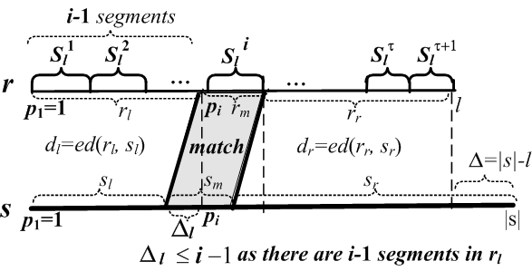
Multi-match-aware Method
-- Left-side Perspective
For each inverted index L_{l}^{i} with start position p_{i,} select all substrings with start position in
Pruning Condition: ||s_{l}|-|r_{l}||+(# undetected parts) > τ

Slide 40
Multi-match-aware Method
-- Left-side Perspective
The size of W(s, l) is: tau²+2tau
For and , the size of W(s, l) is 14.
L₉¹
va
nk
at
esh
av
L₉²
va at ta
L₉³
at ta ar re es
L₉⁴
tar are res esh sha

Slide 41
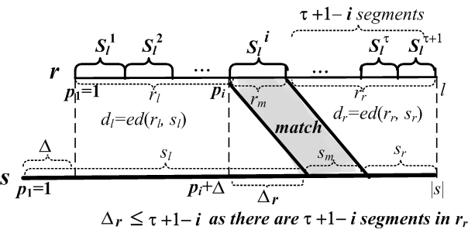
Multi-match-aware Method
-- Right-side Perspective
For each inverted index L_{l}^{i} with start position p_{i,} select all substrings with start position in
Pruning Condition: (# undetected parts)+||s_{r}|-|r_{r}|| > τ

Slide 42

Multi-match-aware Method
We can combine the conclusion from left and right side simultaneously.
For each inverted index L_{l}^{i} with start position p_{i,} select all substrings with start position in

Slide 43
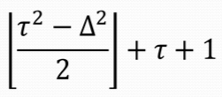
Multi-match-aware Method
The size of W(s, l) is:
For and , the size of W(s, l) is 8.
L₉¹
va
nk
at
esh
av
L₉²
va at ta
L₉³
ar re es
L₉⁴
sha

Slide 44
Theoretical Results
The number of selected substrings by the multi-match-aware method is minimum
For strings longer than 2*(tau+1), our selection method is the only way.

Slide 45
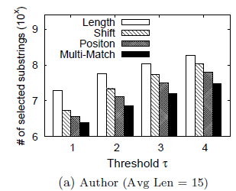
Number of Selected Substrings

Slide 46
Outline
Motivation
Problem Formulation
Partition-based Framework
Improving Substring Selection
Improving the Verification
Experiment
Conclusion

Slide 47
Improving Verification
  Length-aware Verification
  Extension-based Verification
  Sharing Computations

Slide 48
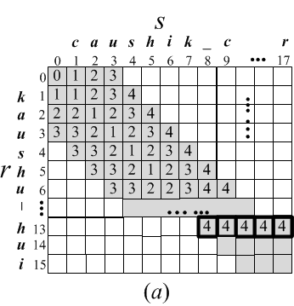

Length-aware Verification

Slide 49
Length-aware Verification
Total difference is 4 > tau,
No need to process M[2][5].
Length
Difference: 3
Length
Difference: 1

Slide 50
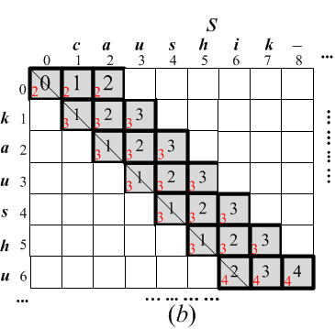
Length-aware Verification

Slide 51
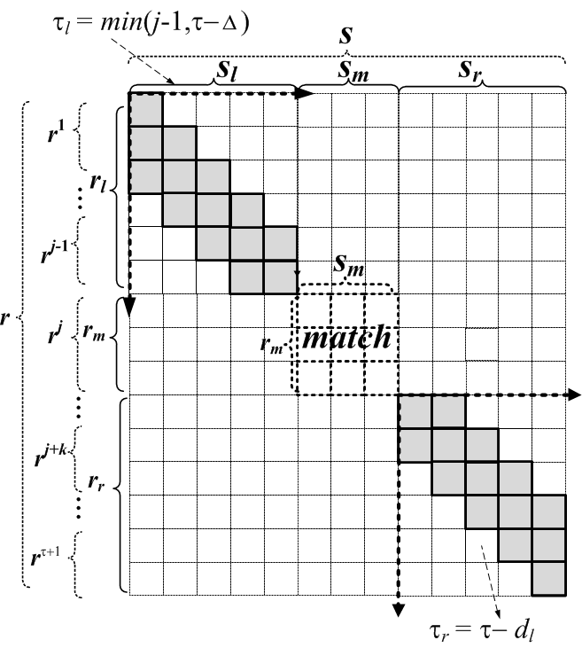
Extension-base Method
Share computation between different r

Slide 52


Extension-base Method
We can verify a candidate pair using tighter thresholds:
For the left parts we can set
For the right parts we can set

Slide 53
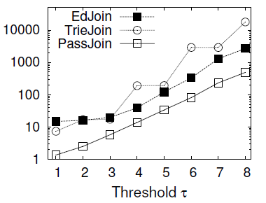
Verification Time

Slide 54
Outline
Motivation & Problem Formulation
Partition-based Framework
Improving Substring Selection
Improving the Verification
Experiment
Conclusion

Slide 55
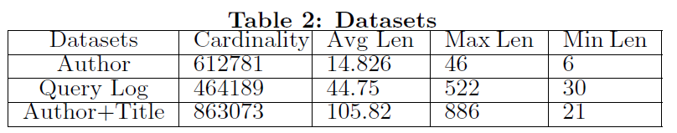
Experimental Results
Setting
  Datasets
  Baselines
    Trie-Join
    ED-Join

Slide 56
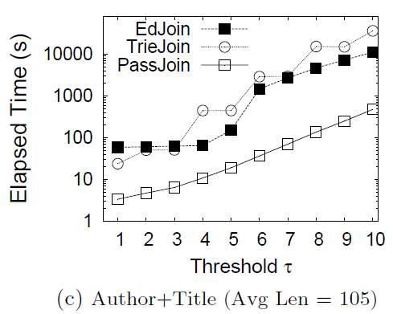
Comparison with existing methods

Slide 57
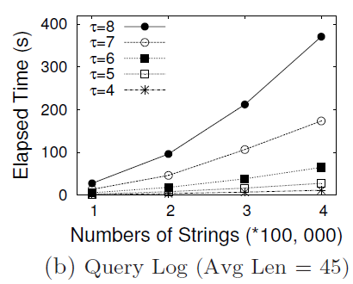
Scalability

Slide 58
Outline
Motivation & Problem Formulation
Partition-based Framework
Improving Substring Selection
Improving the Verification
Experiment
Conclusion

Slide 59
Conclusion
We propose a partition-based framework.
We develop techniques to select substrings.
We prove that our method can minimize the number of selected substrings.
We propose an extension-based method to efficiently verify a candidate pair.

Slide 60

Thanks!
Q&A
http://dbgroup.cs.tsinghua.edu.cn/dd/projects/passjoin/

