Slide 1



Scalable Column Concept Determination for Web Tables Using Large Knowledge Bases
Dong Deng⁺, Yu Jiang⁺, Guoliang Li⁺, Jian Li⁺, Cong Yu^
⁺Tsinghua University, Beijing, China
^ Google Research, New York, USA

Slide 2
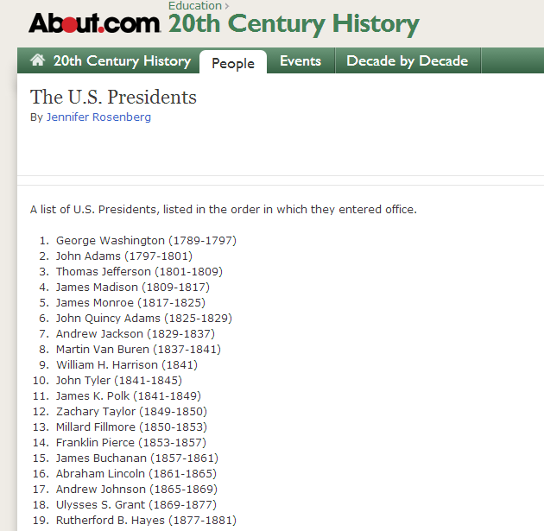
Web Table
High Quality
  Structured data
Rich Source
  14 billion raw HTML
  Tables
  150 million relational
  data tables
http://history1900s.about.com/od/worldleaders/a/uspresidents.htm

Slide 3
Web Tables: Application
Table Search
Table Extension
Knowledge Base Augmentation
Natural Language Processing Tasks

Slide 4
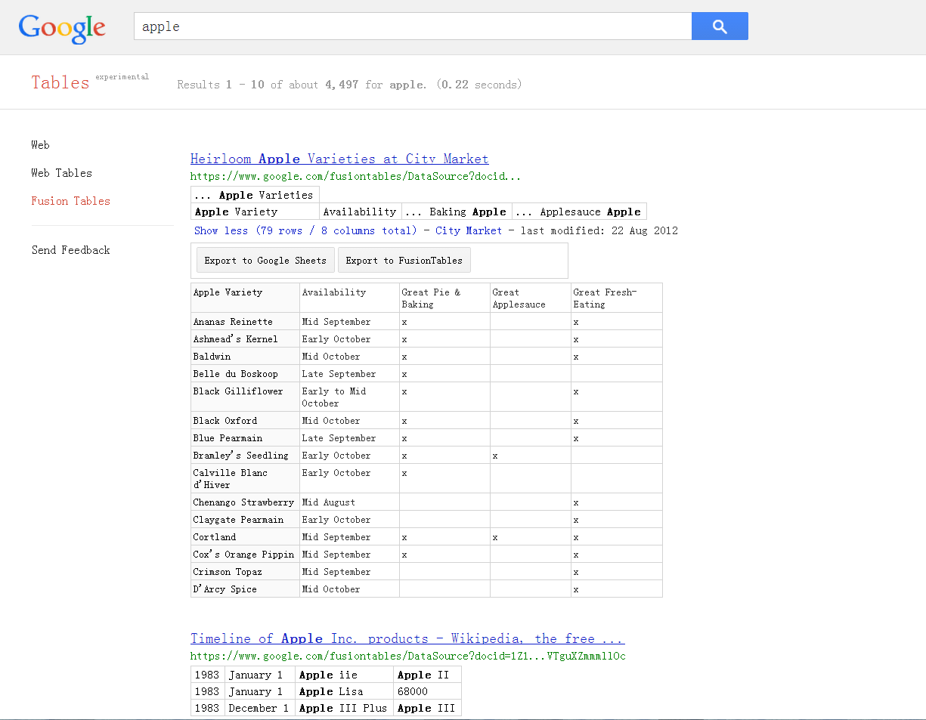
Google Tables
http://research.google.com/tables

Slide 5

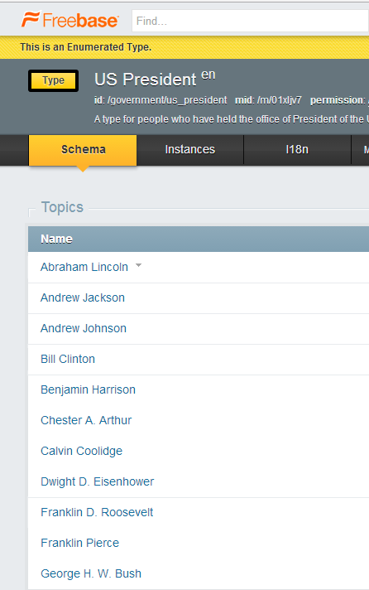
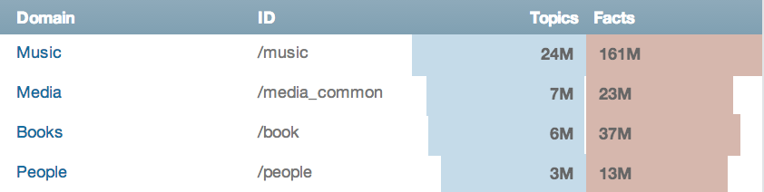
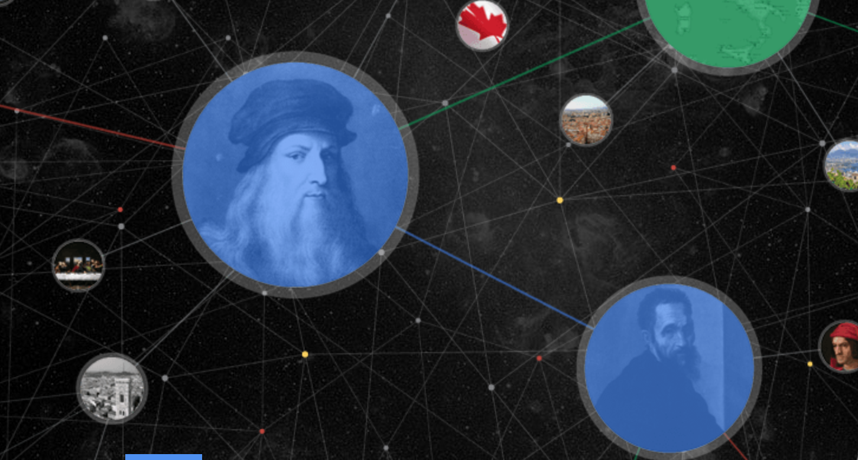


Knowledge Base
Type/
Concept
Google knowledge graph
Instance/Entity
https://www.freebase.com/government/us_president?schema=

Slide 6
Column Concept Determination

Slide 7
Related Work
[Limaye2010]:
  Graph Model, not scalable
[Venetis2011]:
  Using facts extracted from text on the Web

Slide 8

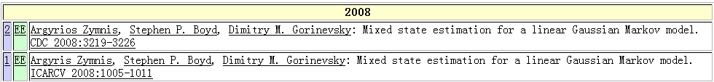
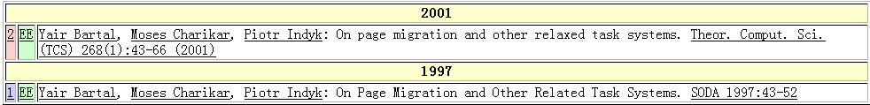
Data in Real Word is Dirty
DBLP
Typos
Typo in “title”
Argyrios Zymnis
Argyris Zymnis
relaxed
related

Slide 9
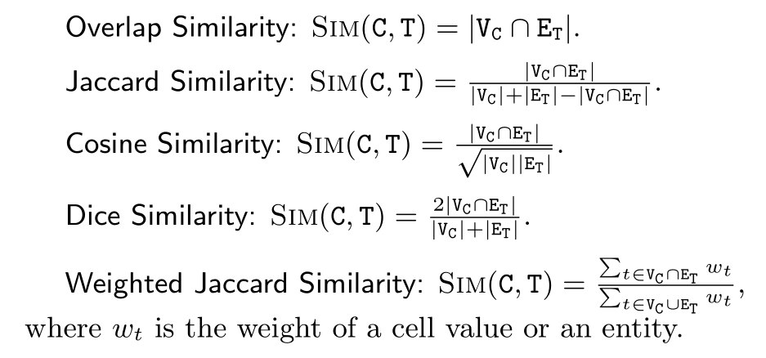
Similarity Functions

Slide 10
Problem Definition
[Column Concept Determination]
Given a column of cells within a Web Table, determining the most likely concept for the column, where a concept is a type within a given knowledge base.
Annotating cell values
Discovering table subjects
Identifying table schema
……
Column Concept
Determination

Slide 11
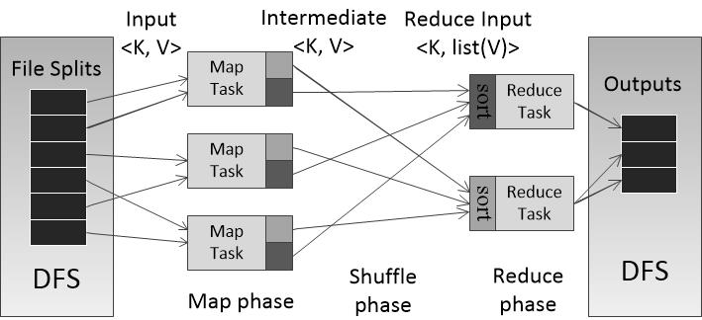
Scalability Requirement
MapReduce

Slide 12
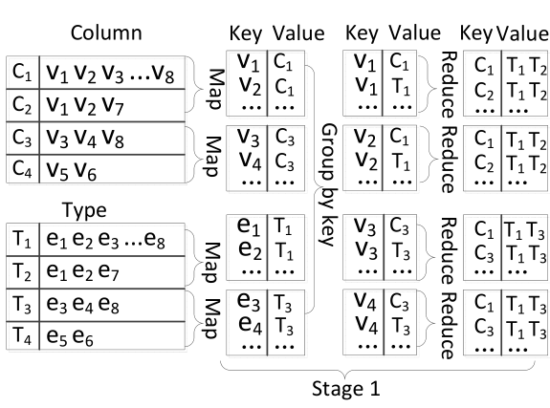
Similarity Join Framework
For each column, identify the types which share at least one common entity/cell value with the column.
v₁=e₁
v₂=e₂
v₃=e₃
v₄=e₄

Slide 13

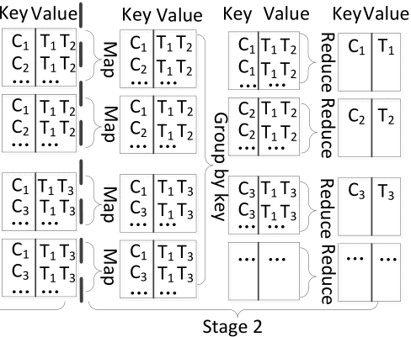
Similarity Join Framework
Count the number of their shared entities/cell values and retrieve top-k types with the largest similarity.

Slide 14
Observations
To improve the performance, our optimization goal is to reduce the number of key-value pairs
We can aggregate the types contain the same entity into different groups.
We can partition all the cell values into different partitions.

Slide 15

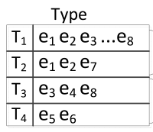
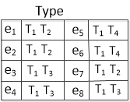
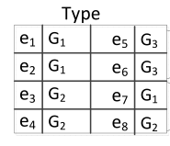

Knowledge Type Aggregation
All the types contain e as an entity
Type Aggregation:
<e, {T₁, T₆, T₅, T₃, T₈, … , T_{n}}>
G₁(e) G₂(e) … G_{l}(e)
A hash map contains the
list of types in a group

Slide 16
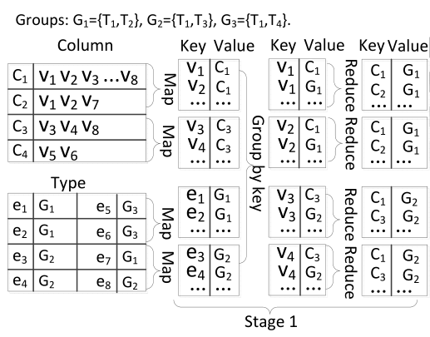
Knowledge Type Aggregation
First Step:

Slide 17

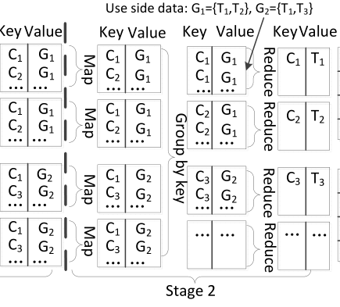
Knowledge Type Aggregation
Second Step:
Distribute as side data in reducer

Slide 18
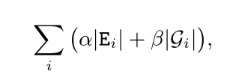
Knowledge Type Aggregation
Aggregation Cost Model:
α: the cost of processing a key-value pair in MapReduce
β: the cost of distributing a type in side data
E_{i}: the set of entities whose groups include G_{i}
|G_{i}|: the number of types in G_{i}
Reduce from the 3-CNF-SAT problem

Slide 19

Knowledge Type Aggregation
the total cost of the basic framework:
Aggregation Algorithm:
Greedily select a group from all possible groups such
that is minimum.

Slide 20
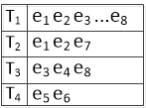
Knowledge Entity Partition
Entity Partition
Partition all distinct cell values into p disjoint partitions P₁, P₂, ...,P_{p}
As the web tables are not given, we cannot partition the cell values off-line, thus we use the entities in the knowledge base to facilitate the partition.

Slide 21

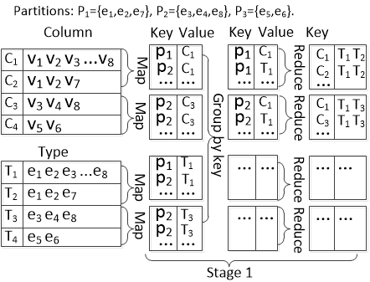
Knowledge Entity Partition
First Step:
Second Step: The same as the basic framework

Slide 22
Knowledge Entity Partition
Cost Model: Number of Key-Value Pairs
Finding the optimal partition strategy is NP-hard
(By a reduction from the graph partition problem)
We extend existing graph-partitioning algorithms to partition the weighted graph
For each partition, we use a bloom filter to represent the
entities in the partition.

Slide 23
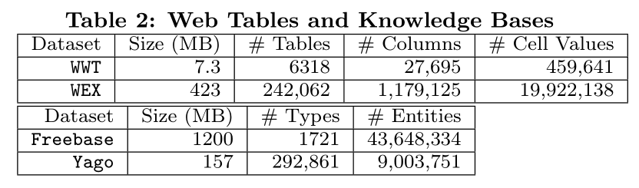
Experiments
Settings:
20 Nodes, each with eight cores, 16GB RAM, and 1TB disk.
Runs on 64-bit Ubuntu Server 10.04, Java 1.6, and Hadoop 1.0.3.

Slide 24
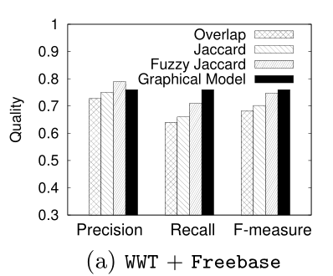
Annotation Quality
k = 3
We can achieve an annotation quality as good as the graphical model

Slide 25
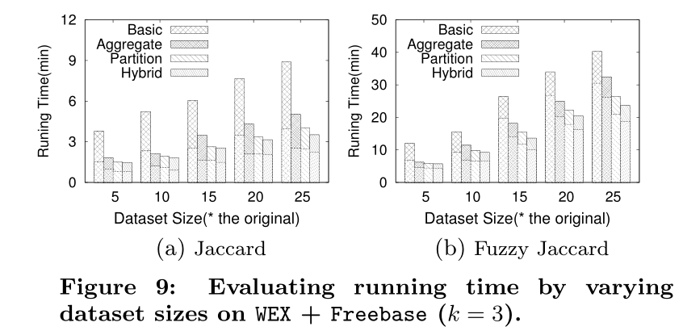
Running Time

Slide 26
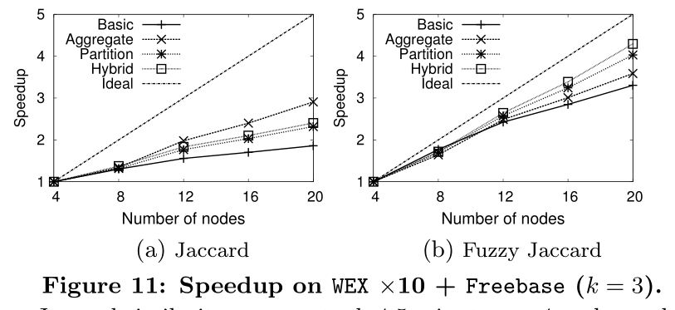
Speedup

Slide 27
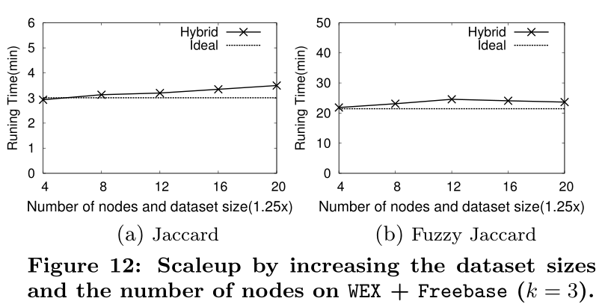
Scaleup

Slide 28
Conclusion
Column Concept Determination Framework
Knowledge Type Aggregation
Knowledge Entity Partition

Slide 29
Thank you
Q & A
Project hompage: http://dbgroup.cs.tsinghua.edu.cn/dd/projects/webtable

