Slide 1
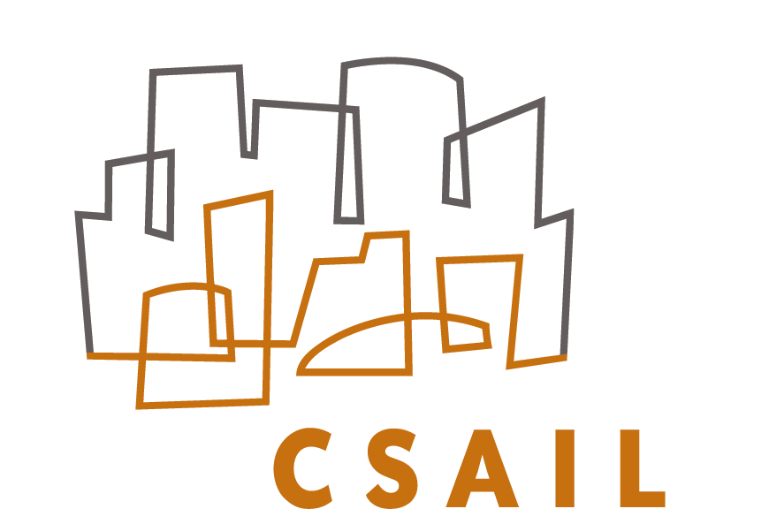

Detecting Data Errors: Where are we and what needs to be done?
Ziawasch Abedjan, Xu Chu, Dong Deng, Raul C.-Fernandez, Ihab F. Ilyas, Mourad Ouzzani, Paolo Papotti, Michael Stonebraker, Nan tang

Slide 2
Motivation
There has been extensive research on many different cleaning algorithms
  Usually evaluated on errors injected into clean data
  Which we find unconvincing (finding errors you injected…)
How well do current techniques work “in the wild”?
What about combinations of techniques?
This study is not about finding the best tool or better tools!

Slide 3
What we did
Ran 8 different cleaning systems on real world datasets and measured
  effectivity of each single system
  combined effectivity
  upper-bound recall
Analyzed impact of Enrichment
Tried out domain specific cleaning tools

Slide 4
Error Types
Literature:
  [Hellerstein 2008, Ilyas&Chu 2015,Kim et al. 2003, Rahm&Do 2000]
  General types:
Quantitative
Outliers
Pattern violations
Qualitative
Duplicates
Constraint violations

Slide 5
Error Detection Strategies
Rule-based detection algorithms
  Detecting violation of constraints, such as functional dependencies
Pattern verification and enforcement tools
  Syntactical patterns, such as date formatting
  Semantical patterns, such as location names
Quantitative algorithms
  Statistical outliers
Deduplication
  Discovering conflicting attribute values in duplicates

Slide 6
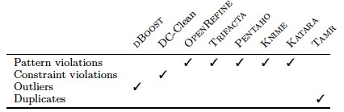
Tool Selection
Premise:
  Tool is State-of-the-Art
  Tool is sufficiently general
  Tool is available
  Tool covers at least one of the leaf error types:

Slide 7
5 Data Sets
MIT VPF
  Procurement dataset containing information about suppliers (companies and individuals)
  Contains names, contact data, and business flags
Merck
  List of IT-services and software
  Attributes include location, number of end users, business flags
Animal
  Information about random capture of animals,
  Attributes include tags, sex, weight, etc
Rayyan Bib
  Literature references collected from various sources
  Attributes include author names, publication titles, ISSN, etc.
BlackOak
  Address dataset that have been synthetically dirtied
  Contains names, addresses, birthdate, etc.

Slide 8
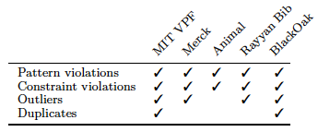
5 Data Sets continued
Dataset | # columns | # rows | Ground truth | Errors
MIT VPF | 42 | 24K | 13k (partial) | 6.7%
Merck | 61 | 2262 | 2262 | 19.7%
Animal | 14 | 60k | 60k | 0.1%
Rayyan Bib | 11 | 1M | 1k (partial) | 35%
BlackOak | 12 | 94k | 94k | 34%

Slide 9
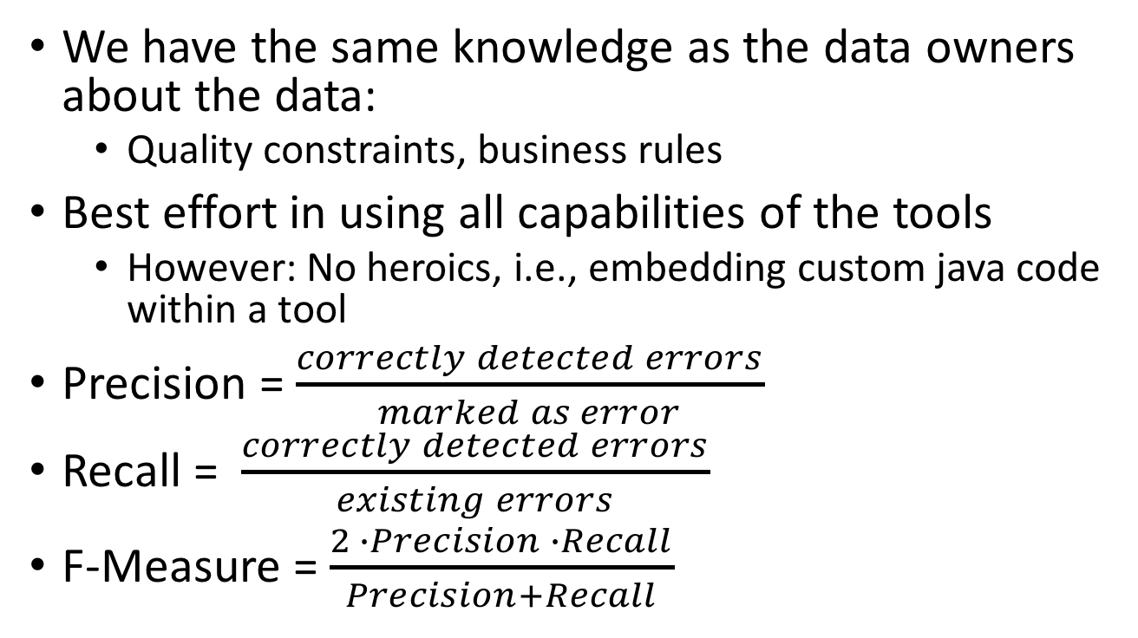
Evaluation Methodology
We have the same knowledge as the data owners about the data:
  Quality constraints, business rules
Best effort in using all capabilities of the tools
  However: No heroics, i.e., embedding custom java code within a tool
Precision = $\frac{correctly detected errors}{marked as error}$
Recall = $\frac{correctly detected errors}{existing errors}$
F-Measure = $\frac{2 ∙Precision ∙Recall}{Precision+Recall}$

Slide 10
Single Tool Performance: MIT
Tools | MIT VPF P R F
DC-Clean | .25 | .14 | .18
Trifacta | .94 | .86 | .90
OpenRefine | .95 | .86 | .90
Pentaho | .95 | .59 | .73
KNIME | .95 | .86 | .90
Gaussian | .07 | .07 | .07
Histogram | .13 | .11 | .12
GMM | .14 | .29 | .19
Katara | .40 | .01 | .02
Tamr | .16 | .02 | .04
Union | .24 | .93 | .38
# columns | # rows | Ground truth | Errors
42 | 24K | 13k (partial) | 6.7%

Slide 11
Single Tool Performance: Merck
Tools | Merck P R F
DC-Clean | .99 | .78 | .87
Trifacta | .99 | .78 | .87
OpenRefine | .99 | .78 | .87
Pentaho | .99 | .78 | .87
KNIME | .99 | .78 | .87
Gaussian | .19 | .00 | .01
Histogram | .13 | .02 | .04
GMM | .17 | .32 | .22
Katara | -- | -- | --
Tamr | -- | -- | --
Union | .33 | .85 | .48
# columns | # rows | Ground truth | Errors
61 | 2262 | 2262 | 19.7%

Slide 12
Single Tool Performance: Animal
Tools | Animal P R F
DC-Clean | .12 | .53 | .20
Trifacta | 1.0 | .03 | .06
OpenRefine | .33 | .001 | .20
Pentaho | .33 | .001 | .20
KNIME | .33 | .001 | .20
Gaussian | .00 | .00 | .00
Histogram | .00 | .00 | .00
GMM | .00 | .00 | .00
Katara | .55 | .04 | .07
Tamr | -- | -- | --
Union | .13 | .58 | .21
# columns | # rows | Ground truth | Errors
14 | 60k | 60k | 0.1%

Slide 13
Single Tool Performance: Rayyan
Tools | Rayyan Bib P R F
DC-Clean | .74 | .55 | .63
Trifacta | .71 | .59 | .65
OpenRefine | .95 | .60 | .74
Pentaho | .71 | .58 | .64
KNIME | .71 | .58 | .64
Gaussian | .41 | .13 | .20
Histogram | .40 | .16 | .23
GMM | .53 | .39 | .44
Katara | .60 | .39 | .47
Tamr | -- | -- | --
Union | .47 | .85 | .61
# columns | # rows | Ground truth | Errors
11 | 1M | 1k (partial) | 35%

Slide 14
Single Tool Performance: BlackOak
Tools | BlackOak P R F
DC-Clean | .46 | .43 | .44
Trifacta | .96 | .93 | .94
OpenRefine | .99 | .95 | .97
Pentaho | 1.0 | .66 | .79
KNIME | 1.0 | .66 | .79
Gaussian | .91 | .73 | .81
Histogram | .52 | .51 | .52
GMM | .38 | .37 | .38
Katara | .88 | .06 | .11
Tamr | .41 | .63 | .50
Union | .39 | .99 | .56
# columns | # rows | Ground truth | Errors
12 | 94k | 94k | 34%

Slide 15
Single Tool Performance
Tools | MIT VPF P R F |  |  | Merck P R F |  |  | Animal P R F |  |  | Rayyan Bib P R F |  |  | BlackOak P R F
DC-Clean | .25 | .14 | .18 | .99 | .78 | .87 | .12 | .53 | .20 | .74 | .55 | .63 | .46 | .43 | .44
Trifacta | .94 | .86 | .90 | .99 | .78 | .87 | 1.0 | .03 | .06 | .71 | .59 | .65 | .96 | .93 | .94
OpenRefine | .95 | .86 | .90 | .99 | .78 | .87 | .33 | .001 | .20 | .95 | .60 | .74 | .99 | .95 | .97
Pentaho | .95 | .59 | .73 | .99 | .78 | .87 | .33 | .001 | .20 | .71 | .58 | .64 | 1.0 | .66 | .79
KNIME | .95 | .86 | .90 | .99 | .78 | .87 | .33 | .001 | .20 | .71 | .58 | .64 | 1.0 | .66 | .79
Gaussian | .07 | .07 | .07 | .19 | .00 | .01 | .00 | .00 | .00 | .41 | .13 | .20 | .91 | .73 | .81
Histogram | .13 | .11 | .12 | .13 | .02 | .04 | .00 | .00 | .00 | .40 | .16 | .23 | .52 | .51 | .52
GMM | .14 | .29 | .19 | .17 | .32 | .22 | .00 | .00 | .00 | .53 | .39 | .44 | .38 | .37 | .38
Katara | .40 | .01 | .02 | -- | -- | -- | .55 | .04 | .07 | .60 | .39 | .47 | .88 | .06 | .11
Tamr | .16 | .02 | .04 | -- | -- | -- | -- | -- | -- | -- | -- | -- | .41 | .63 | .50
Union | .24 | .93 | .38 | .33 | .85 | .48 | .13 | .58 | .21 | .47 | .85 | .61 | .39 | .99 | .56

Slide 16
Combined Tool Performance
Naïve appraoch
  k tools agree on a value to be an error
    Typical precision-recall trade-off
Maximum entropy-based order selection:
  Run tool on samples and verify the results
  Pick the tool with highest precision (maximum entropy reduction)
  Verify the results
  Update precision and recall of other tools accordingly
  Repeat step 2
Drop tools with precision below 10%

Slide 17
Ordering-based approach
Precision and recall depending on different minimum precision thresholds (compared to union)
MIT VPF with 39,158 errors
Merck with 27,208 errors

Slide 18
Maximum possible recall
Manually checked each undetected error and reasoned whether it could have beendetected by a better variant of a tool, e.g. a more sophisticated rule or transformation.
Dataset | Best effort recall | Upper-bound recall | Remaining errors
MIT VPF | 0.92 | 0.98 (+1,950) | 798
Merck | 0.85 | 0.99 (+4,101) | 58
Animal | 0.57 | 0.57 | 592
Rayyan Bib | 0.85 | 0.91 (+231) | 347
BlackOak | 0.99 | 0.99 | 75

Slide 19
Enrichment and Domain-specific tools
Enrichment
  Manually appended more columns through joining to other tables of the database
  Improves performance of rule-based and duplicate detection systems
Domain-specific tool:
  Used a commercial address cleaning service
  High precision on the specific domain
  But did not lead to the increase of overall recall

Slide 20
Conclusions
There is no single dominant tool.
Improving individual tools has marginal benefit. We need a combination of tools
Picking the right order in applying the tools can improve the precision and help reduce the cost of validation by humans.
Domain specific tools can achieve on average high precision and recall compared to general-purpose tools.
Rule-based systems and duplicate detection benefited from data enrichment.

Slide 21
Future Directions
More reasoning on holistic combination of tools
Data enrichment can benefit cleaning
Interactive dashboard
More reasoning on real-world data
ধন্যবাদ
நன்றி
धन्यवाद
ਤੁਹਾਡਾ ਧੰਨਵਾਦ
આભાર
آپ کا شکریہ
നന്ദി
ಧನ್ಯವಾದಗಳು
ధన్యవాదాలు
Thank you!

