Slide 1

META: An Efficient Matching-Based Method for Error-Tolerant Autocompletion
Dong Deng, Guoliang Li, He Wen, H. V. Jagadish, Jianhua Feng
DCST, Tsinghua University EECS, University of Michigan

Slide 2
Problems with Typing
Tedious and slow
Prone to error

Slide 3


Autocompletion

Slide 4
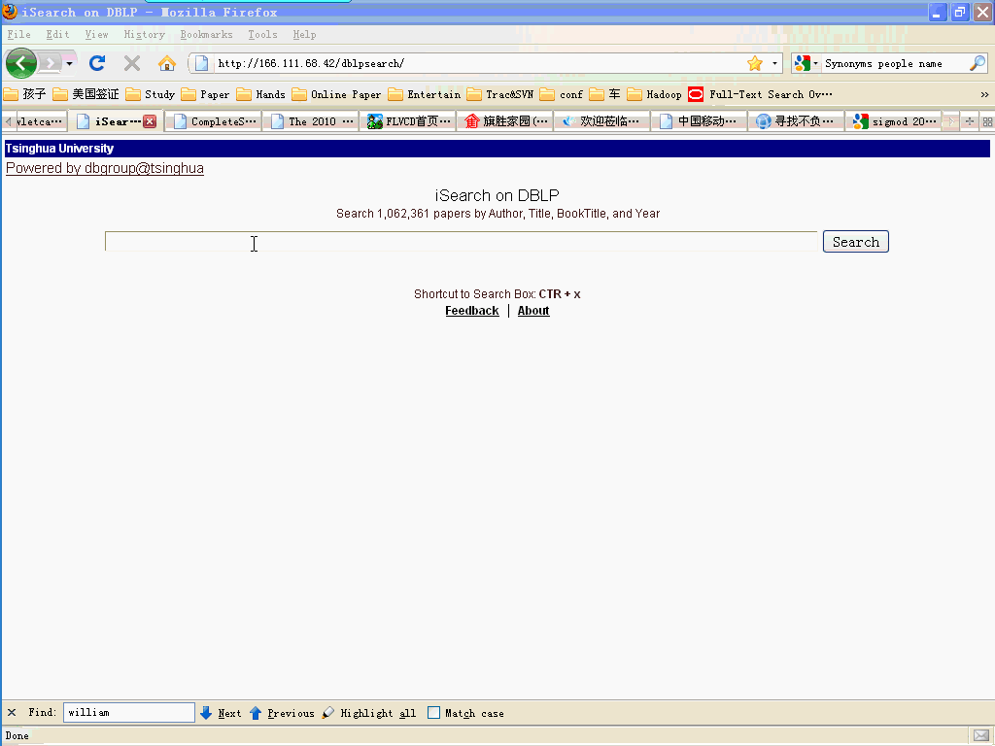
Error-Tolerant Autocompletion

Slide 5

Speed is Very Important
Autocompletion must be done in real-time

Slide 6
Edit Distance
ED(r, s): The min number of edit operations (insertion/deletion/substitution) needed to transform r to s.
For example: ED(sso, solve) = 4
sso
delete s
so
insert l, v, e
solve

Slide 7
Prefix Edit Distance
PED(r, s): The min number of edit operations (insertion/deletion/substitution) needed to transform r to any prefix of s.
For example: PED(sso, solve) = 1
sso
delete s
so
is a prefix of
solve

Slide 8
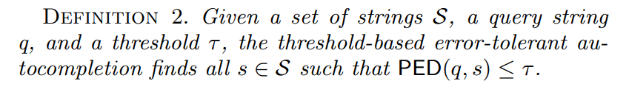
Problem Definition
Threshold-based: 𝜏 = 1
Top-k: k = 3
Input query q:
Input query q:
q₁ = ‘s’ → s₁, s₂, s₃, s₄, s₅, s₆
q₁ = ‘s’ → s₁, s₂, s₃
q₂ = ‘ss’ → s₁, s₂, s₃, s₄, s₅, s₆
q₂ = ‘ss’ → s₁, s₂, s₃
q₃ = ‘sso’ → s₁, s₂, s₃, s₄, s₅
q₃ = ‘sso’ → s₁, s₂, s₃
q₄ = ‘ssol’ → s₁, s₂, s₃, s₄, s₅
q₄ = ‘ssol’ → s₂, s₃, s₄

Slide 9
Related Work
Error-Tolerant Auto-completion
String Similarity Search
  Cannot share computation between continuous queries

Slide 10
Contributions
Matching-based Framework
Reduce redundant computations between consecutive keystrokes
Support top-k queries

Slide 11
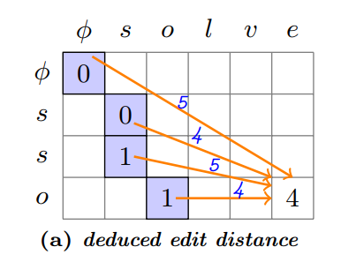
Edit Distance Calculation
if q_{i} = s_{j} is the last matching in the optimal transformation, then
ED(q, s) = ED(q[1..i], s[1..j]) + max(|q|-i, |s|-j)
Enumerate every matching q_{i} = s_{j}
ED(q, s)=min( ED(q[1..i], s[1..j]) + max(|q|-i, |s|-j) )

Slide 12
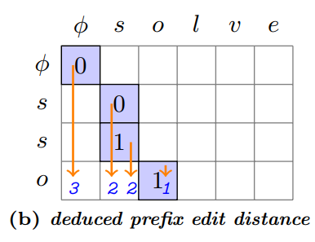
Prefix Edit Distance Calculation
if q_{i} = s_{j} is the last matching in the optimal transformation, then
PED(q, s) = ED(q[1..i], s[1..j]) + (|q|-i)
Enumerate every matching q_{i} = s_{j}
PED(q, s)=min( ED(q[1..i], s[1..j]) + (|q|-i) )

Slide 13
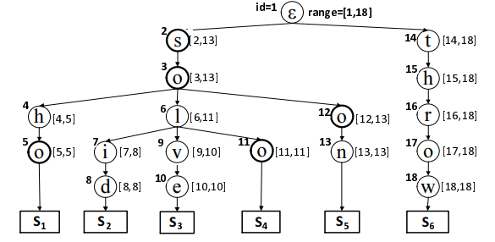
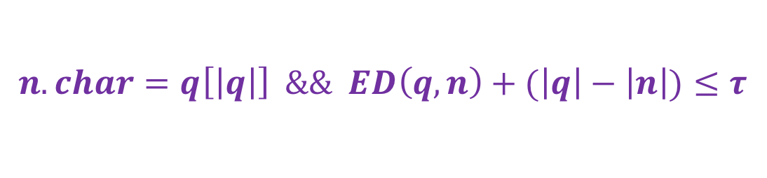
Matching-based Framework
Active Nodes: matching nodes that can deduce results
$$n.char=q\left[\left|q\right|\right] \&\& ED\left(q,n\right)+(\left|q\right|−\left|n\right|)≤τ$$
Find new active nodes from existing ones by binary searching the matching nodes

Slide 14

Matching-based Framework
Active Nodes: matching nodes that can deduce results
$$n.char=q\left[\left|q\right|\right] \&\& ED\left(q,n\right)+(\left|q\right|−\left|n\right|)≤τ$$
𝜏 = 2 & q= ‘’ → n₁

Slide 15
Matching-based Framework
Active Nodes: matching nodes that can deduce results
$$n.char=q\left[\left|q\right|\right] \&\& ED\left(q,n\right)+(\left|q\right|−\left|n\right|)≤τ$$
𝜏 = 2 & q=‘s’ → n₂

Slide 16
Matching-based framework
Active Nodes: matching nodes that can deduce results
$$n.char=q\left[\left|q\right|\right] \&\& ED\left(q,n\right)+(\left|q\right|−\left|n\right|)≤τ$$
𝜏 = 2 & q='ss’ →

Slide 17
Matching-based Framework
Active Nodes: matching nodes that can deduce results
$$n.char=q\left[\left|q\right|\right] \&\& ED\left(q,n\right)+(\left|q\right|−\left|n\right|)≤τ$$
𝜏 = 2 & q='sso’ → n₃, n₅, n₁₁, n₁₂

Slide 18
Matching-based Framework
Active Nodes: matching nodes that can deduce results
$$n.char=q\left[\left|q\right|\right] \&\& ED\left(q,n\right)+(\left|q\right|−\left|n\right|)≤τ$$
𝜏 = 2 & q='ssol’ → n₆

Slide 19
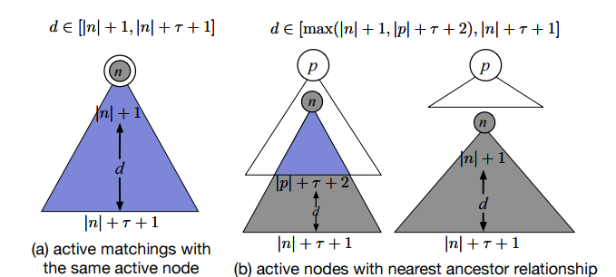
Compact Tree Based Framework
Motivation: reduce redundant computations
Nodes marked in blue may lead to redundant computation.
We need a way to skip all overlapped depth

Slide 20
Compact Tree Based Framework
We addressed the problem by building compact tree for only the active nodes
Nodes in compact tree remain their relative orders in trie
Use depth information stored in the compact node to skip overlapped nodes
1
2
6
12
7

Slide 21
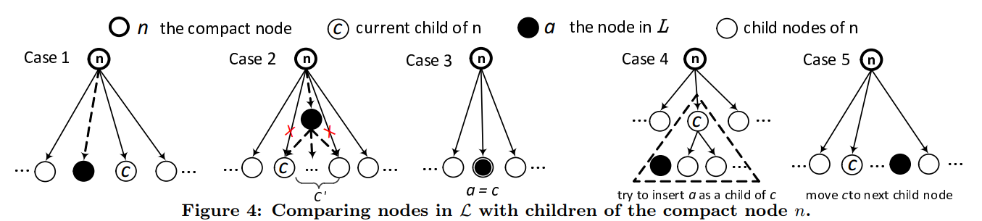
Compact Tree Based Framework
Maintain the compact tree: add active nodes

Slide 22
Supporting Top-K Queries
Observation: for two continuous queries, their largest prefix edit distances to their results remains unchanged or increases 1,
For each continuous query, we can group all the active nodes by their edit distance b to the query, which is called b-matching set.

Slide 23
Supporting Top-K Queries
Extend matching-based framework
Once the current matching set can no more produce K results, we:
(1) First deduce matchings with threshold b untill reach K results. If all active nodes with threshold b are deduced,
(2) Then set b=b+1 and repeat (1). Note it is guaranteed the second deduction will always suceed.
τ=b still produces at least K results
b-Matching Set
b-Matching Set
new keystroke
(b+1)-Matching Set
τ=b produces less than K results

Slide 24
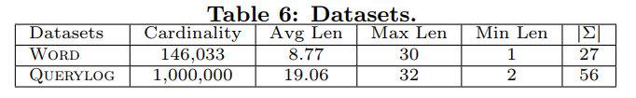
Experiments
Datasets：
State-of-the-art methods：
  IncNGTrie
  ICAN
  IPCAN
String Similarity Search：
  HSTree
  Pivotal
Setup：
  C++，GCC 4.8.2 with –O3
  Intel Xeon E3650 2.00GHz
  48 GB memory

Slide 25
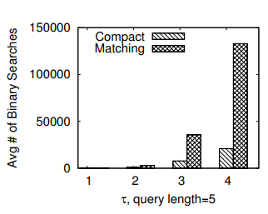
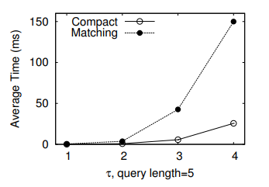
Matching vs Compact Tree
On AOL QueryLog
Compact Tree outperforms Matching by avoiding
the redundant binary searches

Slide 26
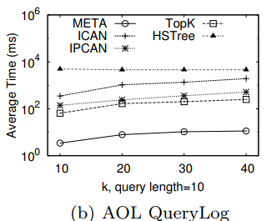
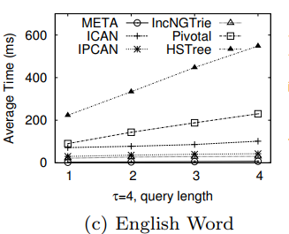
Comparing with State-of-the-arts
Top-k query
Threshold-based Query

Slide 27
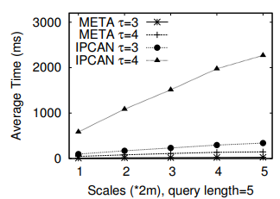
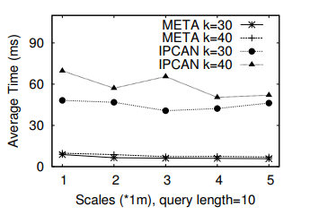
Scalability
On AOL QueryLog
Threshold-based
Top-K

Slide 28
Conclusion
Matching-based Framework
Compact Tree Based Method
Supporting Top-K Queries

Slide 29
Thank you
Q & A

