Slide 1

An Efficient Partition Based Method for Exact Set Similarity Joins
Dong Deng, Guoliang Li, He Wen, Jianhua Feng
Database Group, Tsinghua University

Slide 2
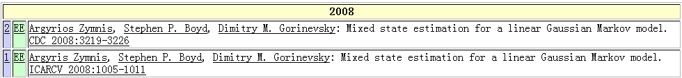
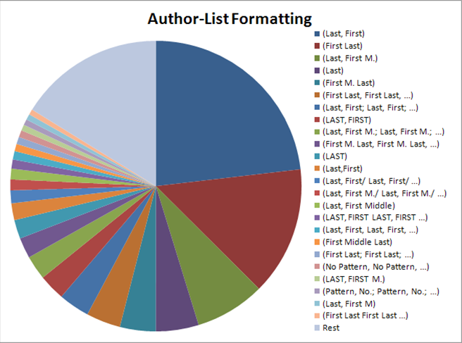
Real World Data is Dirty
Typo
Inconsistent
Format
Argyrios Zymnis
Argyris Zymnis

Slide 3

Fuzzy Matching: A use case :-)
Find speeches similar to Melania Trump's RNC speech
This slide is borrowed from Chen Li: https://chenli.ics.uci.edu/

Slide 4

Fuzz Matching: A use case :-)
This slide is borrowed from Chen Li: https://chenli.ics.uci.edu/

Slide 5

Token-based Similarity
Token-based Similarity
  $Jaccard\left(X,Y\right)=\frac{|X∩Y|}{|X∪Y|}$
  $Cosine\left(X,Y\right)=\frac{|X∩Y|}{\sqrt{\left|X\right||Y|}}$
  $Dice\left(X,Y\right)=\frac{2|X∩Y|}{\left|X\right|+|Y|}$

Slide 6
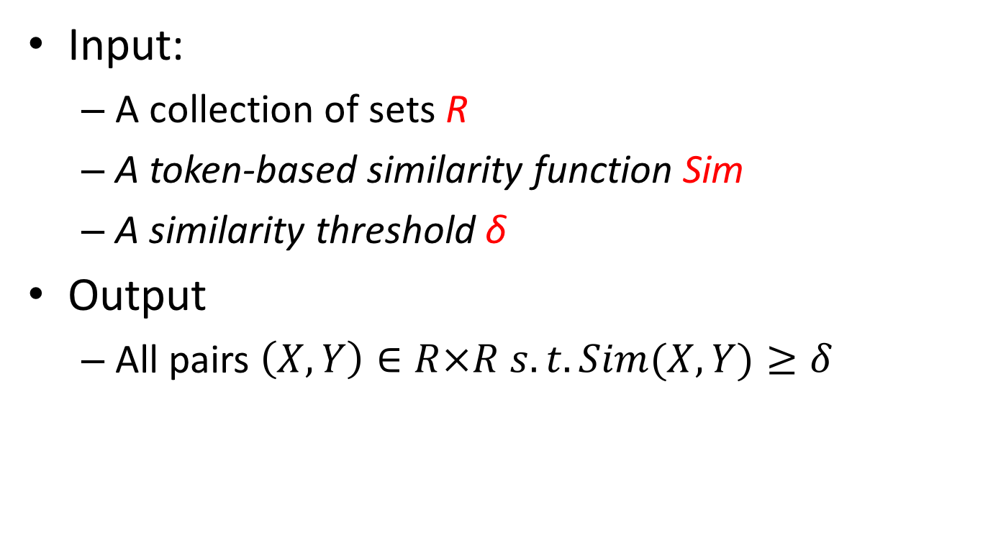
Similarity Join Problem Definition
Input:
  A collection of sets R
  A token-based similarity function Sim
  A similarity threshold δ
Output
  All pairs $\left(X, Y\right)∈R×R s.t. Sim(X, Y)≥δ$
*We also addressed the two-relation similarity join problem in the paper

Slide 7

An Example
Input:
  R
  Sim = Jaccard Similarity
  δ = 0.73
Output
  Jaccard(X₁, X₅) = 0.82 $≥δ$

Slide 8

Challenge
brute-force: $O\left(n2\right) pairs‼!$
For n = 1 million,
there are 1 trillion pairs !!

Slide 9
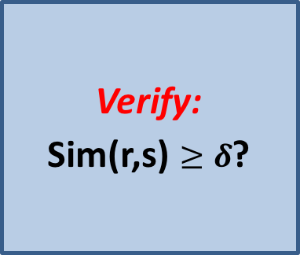
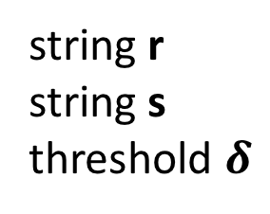
Filter-and-Verification Framework
Filter:
Signature(s) ∩
Signature(r) = ϕ?
Verify:
  Sim(r,s) $≥δ$?
No
Yes
string r
string s
threshold $δ$
Results

Slide 10
Related Works
Most of recent related works fit in the Prefix Filter Framework
  “Based on our findings, we do not expect significant impact from future techniques that sit on top of the prefix filter, but see opportunities in fast candidate generation.”
  By Mann et. al. @ VLDB16 Experimental Paper

Slide 11
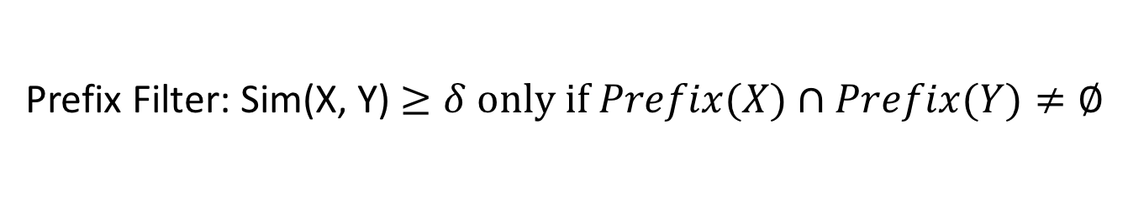
Prefix Filter Framework
The list of all elements in order (universe)
RID
1
2
3
4
Prefixes
Suffixes
Prefix Filter: Sim(X, Y) $≥δ only if Prefix(X)∩Prefix(Y)≠∅$

Slide 12
Prefix Filter Framework
the pruning power is limited!
two dissimilar sets are a candidate
if they share 1 element in their prefixes

Slide 13
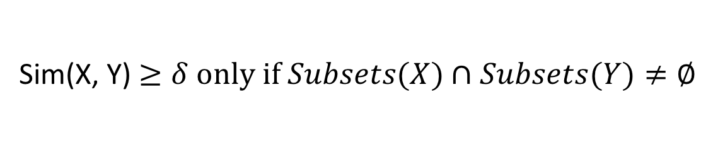
Partition-based Framework
The list of all elements in order (universe)
RID
1
2
3
4
Subsets
Subsets
Subsets
Sim(X, Y) $≥δ only if Subsets(X)∩Subsets(Y)≠∅$

Slide 14
Partition-based Framework
What is the minimum number of partitions
that can guarantee completeness?

Slide 15
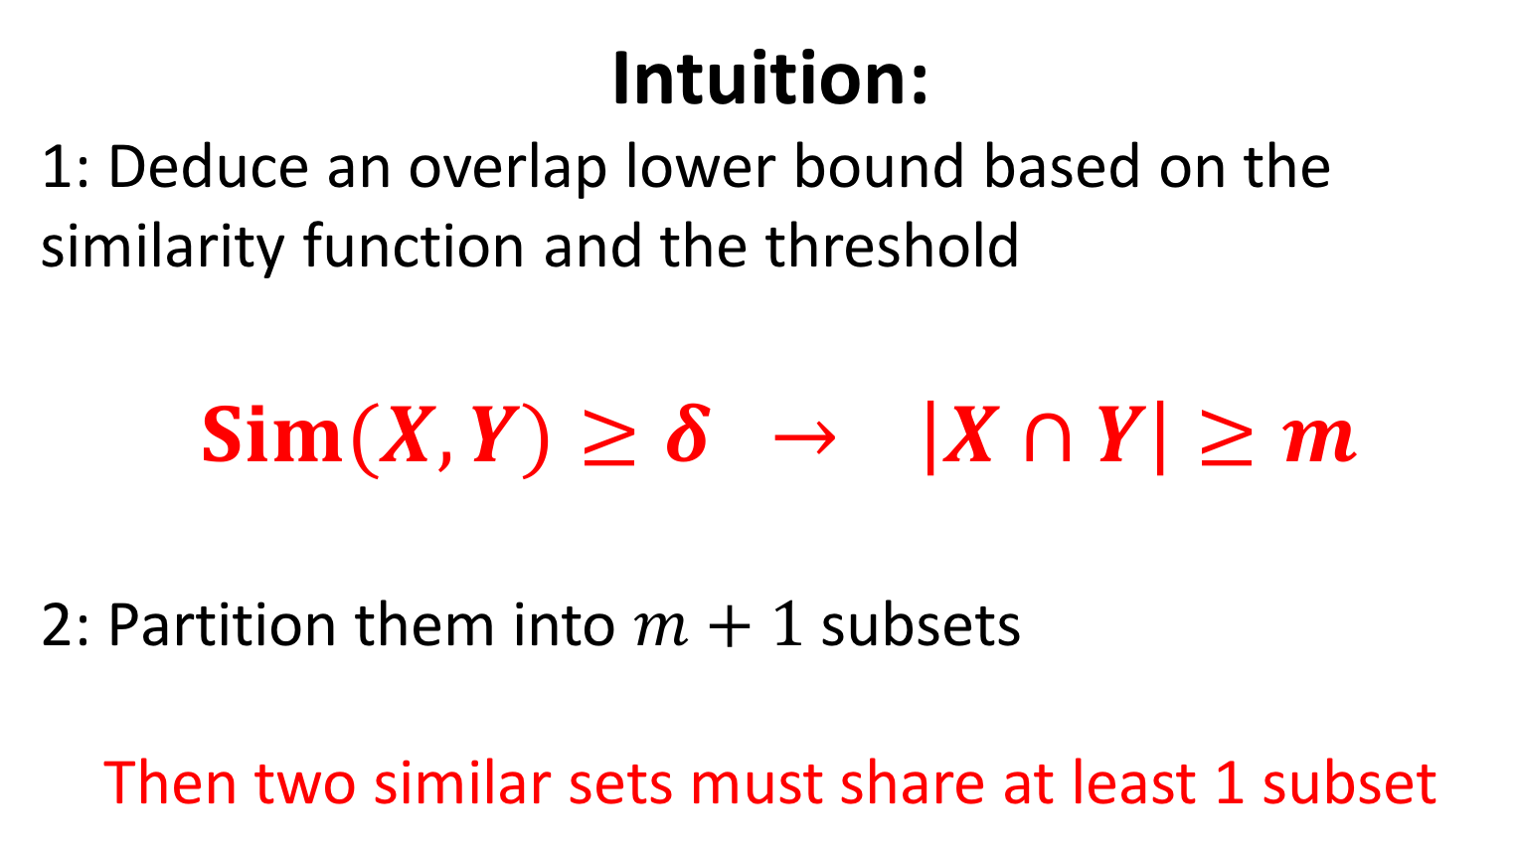
The number of partitions
Intuition:
1: Deduce an overlap lower bound based on the similarity function and the threshold
$Sim(X,Y)≥δ → \left|X∩Y\right|≥m$
2: Partition them into $m+1$subsets
Then two similar sets must share at least 1 subset

Slide 16
Element Skew Problem
Some subsets have limited number of elements
  The ‘empty’ subsets yield quadratic candidates
Solution: Add some flexibility
  Skip the subsets with less elements
  Select more signatures from subsets with more elements to guarantee completeness

Slide 17
Signatures: 1-deletion neighborhoods
Given a non-empty set Z, its 1-deletion neighborhoods are its subsets with size of |Z| − 1, denote as del(Z)
Z
del(Z)

Slide 18
using 1-deletion neighborhood
$$U≠V,V∉del\left(U\right), U∉del(V)→\left|U ∆ V\right|≥2$$
U
,
del(U)
V
,
del(V)
$$\left|U ∆ V\right|=2$$
Skip x subsets & select 1-deletion neighborhoods from another x subsets
guaranteed completeness !!

Slide 19
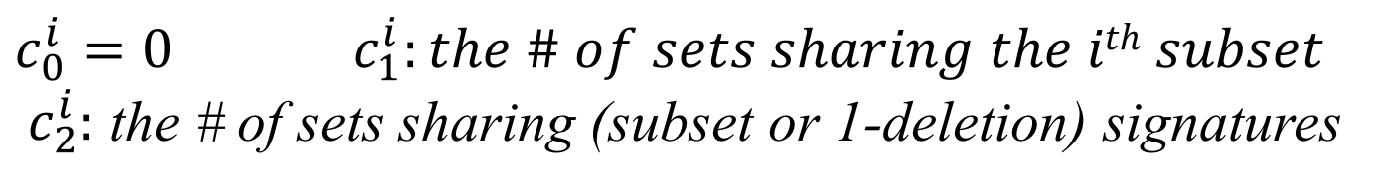
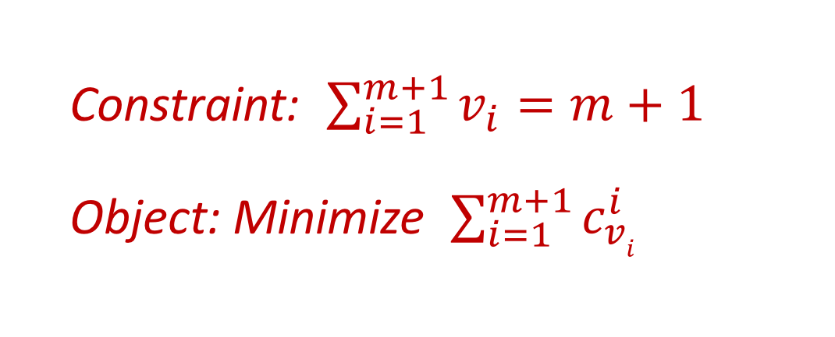
Optimal Allocation Strategy
  0: skip the i^{th} subset
  1: only use the i^{th} subset as signature
  2: use both the i^{th} subset and 1-deletions
  v_{i}=
  Constraint: $\sum_{i=1}^{m+1}{v_{i}}=m+1$
  Object: Minimize $\sum_{i=1}^{m+1}{c_{vi}^{i}}$
$$c_{0}^{i}=0 { c}_{1}^{i}:the \# of sets sharing the ith subset$$
${ c}_{2}^{i}:$ the # of sets sharing (subset or 1-deletion) signatures

Slide 20
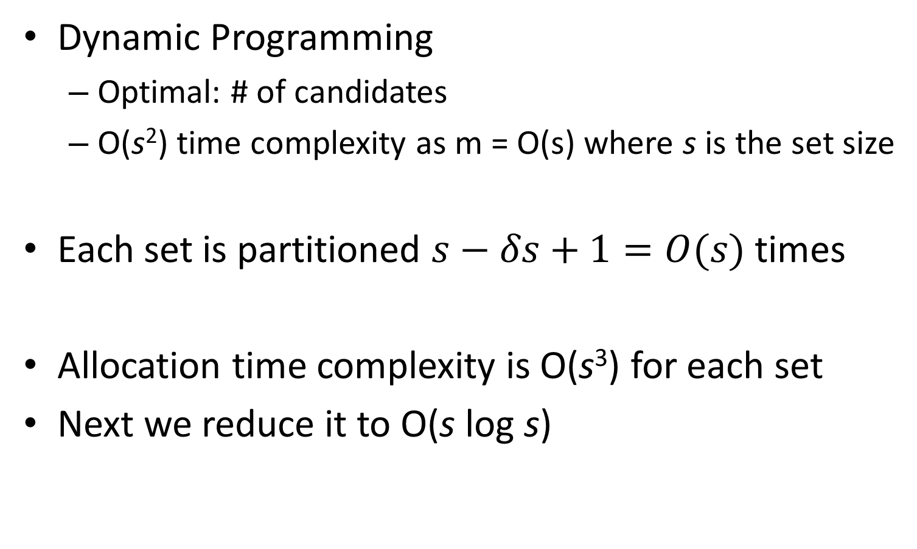
Time complexity
Dynamic Programming
  Optimal: # of candidates
  O(s²) time complexity as m = O(s) where s is the set size
Each set is partitioned $s−δs+1=O(s)$ times
Allocation time complexity is O(s³) for each set
Next we reduce it to O(s log s)

Slide 21
Greedy Method for Allocation Selection
Heap-based Method
2-approximation algorithm
Time complexity: O(s²) → O(s log s)

Slide 22
Adaptive Grouping
𝜹 s
𝜹 s+1
. . .
s-2
s-1
s
s

Slide 23
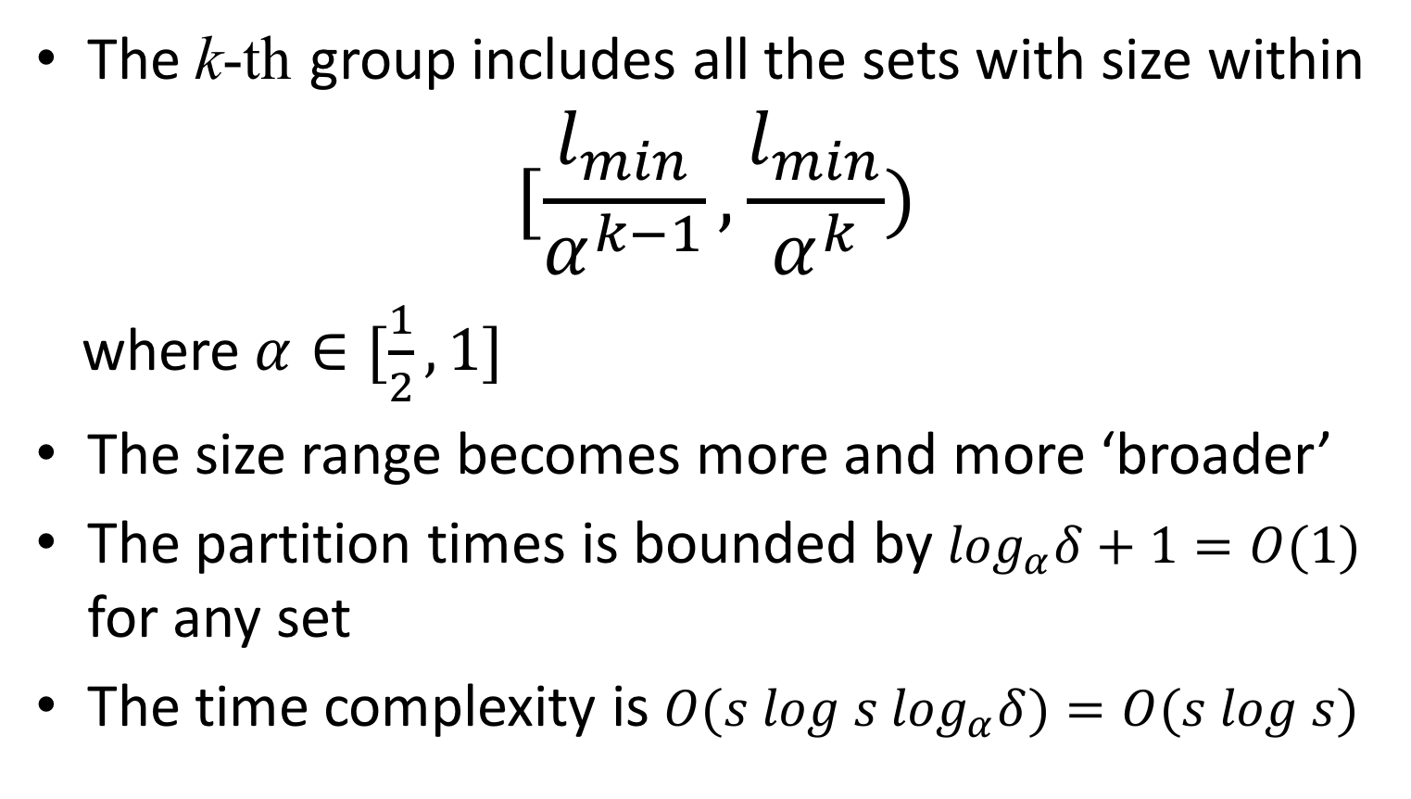
Adaptive Grouping
The k-th group includes all the sets with size within
$$[\frac{l_{min}}{α^{k−1}},\frac{l_{min}}{α^{k}})$$
where $α∈[\frac{1}{2},1]$
The size range becomes more and more ‘broader’
The partition times is bounded by $\log_{α}δ+1=O(1)$ for any set
The time complexity is ${O(s log s log}_{α}δ)=O(s log s)$

Slide 24
Experiments
Datasets：
State-of-the-art methods：
  ppjoin
  adaptjoin
Setup：
  C++，GCC 4.8.2 with –O3
  24 Intel Xeon X5670 2.93GHz
  64 GB memory

Slide 25
Adaptive Grouping
Observation:
Greedy and Optimal largely reduced the # of candidates and the elapsed time compared to Framework
Greedy has almost the same # of candidates compared to Optimal
Greedy outperformed Opiaml

Slide 26
Greedy Selection w/o Adaptive Grouping
Observation:
Greedy outperformed Optimal
Greedy and Optimal are not competitive to Framework without the adaptive grouping
This is because the adaptive grouping technique bounds the # of partition times from O(s) to O(1) for each set

Slide 27
Comparing with State-of-the-arts
The elapsed time
The number of candidates

Slide 28
Scalability and R-S Join
Scalability
R-S Join

Slide 29
Conclusion
Partition-based Framework
1-Deletion Neighborhood
Optimal Allocation Algorithm
2-approximation Greedy Algorithm
Adaptive Grouping Mechanism

Slide 30
Thank you
Q & A
Project hompage: http://people.csail.mit.edu/dongdeng/projects/setjoin

