Slide 1
SilkMoth
An Efficient Method for Finding Related Sets with Maximum Matching Constraints
Dong Deng* Albert Kim* Samuel Madden Michael Stonebraker
{dongdeng,alkim,madden,stonebraker}@csail.mit.edu
MIT CSAIL
*Both authors contributed equally to this work.

Slide 2
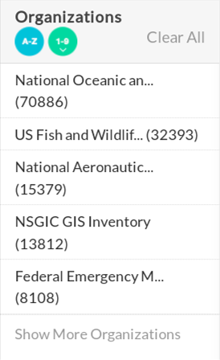
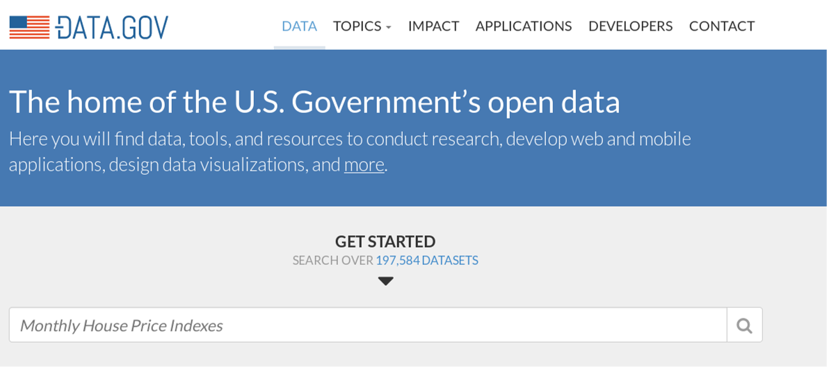
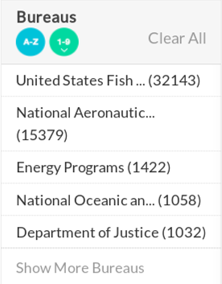
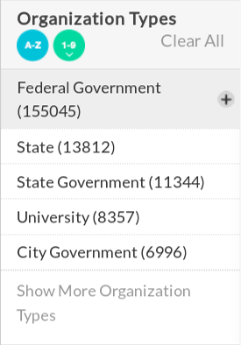
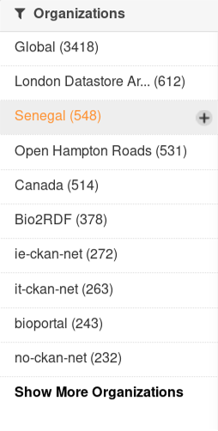
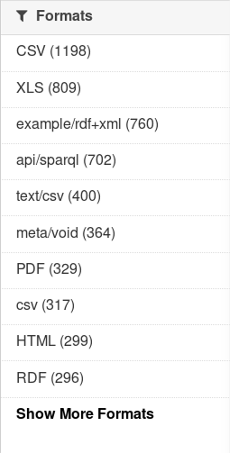
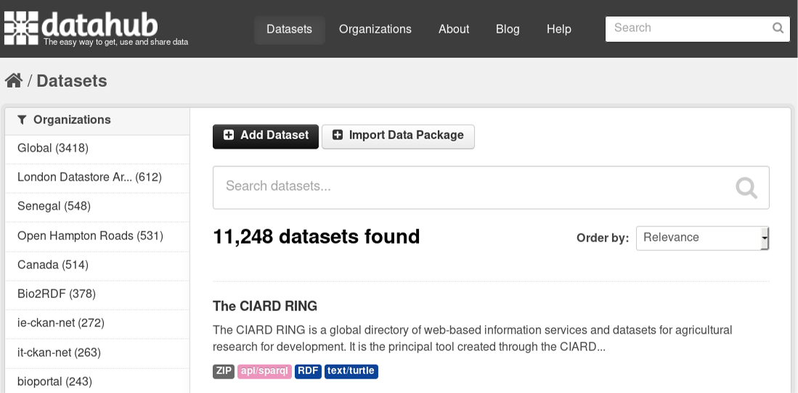

Slide 3



Motivation
Location
77 Mass Ave Boston MA
5th St 02115
Chicago IL
1 Kendall Sq Cambridge MA
Address
77 Fifth Street Chicago
77 Massachusetts Avenue Boston MA
Fifth Street Seattle WA
One Kendall Square Cambridge MA
$$≃$$
$$R$$
$$S$$

Slide 4
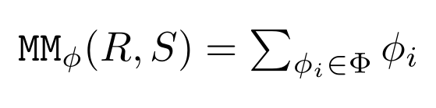



Set Relatedness Metric
Maximum Matching Metric
$$R$$
$$φ$$
$$S$$
77 Mass Ave Boston MA
77 Fifth Street Chicago
$φ$(“77 Mass Ave Boston MA”, “77 Massachusetts Ave Boston MA”) $≈0.7$
5th St 02115
77 Massachusetts Ave Boston MA
$φ$(“77 Mass Ave Boston MA”, “77 Fifth Street Chicago”) $≈0.1$
Chicago IL
Fifth Street Seattle WA
1 Kendall Sq Cambridge MA
One Kendall Square Cambridge MA

Slide 5
Applications of maximum matching
Schema Matching:
Robust to missing or slightly different attributes
[Ganti and Sarma 2013], [Melnik et al. ICDE 2002], [Sarma et al. SIGMOD 2012]
String Matching:
Robust to missing or slightly different tokens
[Wang et al. ICDE 2011]
Inclusion Dependency:
Robust to missing or slightly different column values
[Bauckmann et al. CIKM 2012], [Deng et al. CIDR 2017]

Slide 6


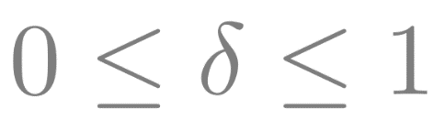
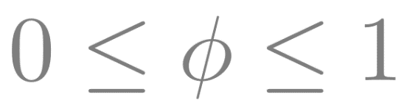
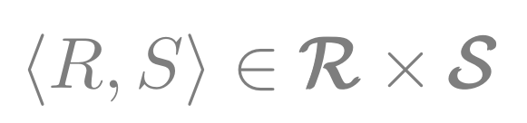

Problem Formulation
Assume we are given:
Two collections of sets: and
Relatedness Threshold:
Similarity function between elements:
Goal:
Find all pairs of related sets
such that .

Slide 7

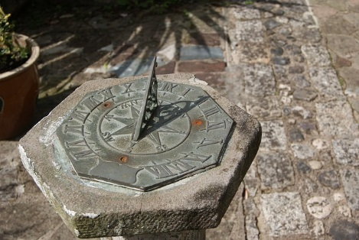


Key Issue
Time!!

Slide 8
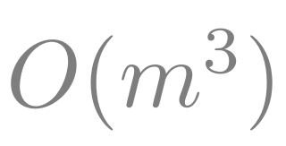
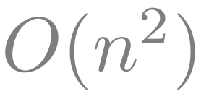
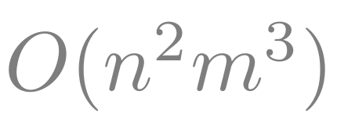
Key Issue
Time complexity to perform maximum matching:
Time complexity to compare all pairs of sets:

Slide 9
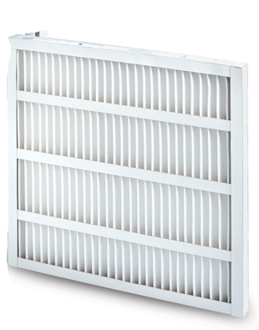
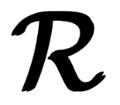

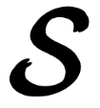
Set Relatedness Metric
Filter and Refine Strategy
Filter
Location
…
…
Location
…
…
Location
…
…
Salary
…
…
Age
…
…
Candidates
Refined
Candidates
Salary
…
…
Address
…
…
Location
…
…
Name
…
…
Only produces false positives
No false negatives!!
(
Location
…
…
,
Address
…
…
(
Location
…
…
Address
…
…
(
,
Name
…
…
(
Location
…
…
Name
…
…
Location
…
…
Related
Sets
Verify
Year
…
…
Address
…
…
Name
…
…
Address
…
…
Name
…
…
3. Verification
2. Filtering
1. Signature Matching

Slide 10
Set Relatedness Metric
Filter and Refine Strategy
Location
…
…
Location
…
…
Location
…
…
Salary
…
…
Age
…
…
Candidates
(
Location
…
…
,
Address
…
…
(
Location
…
…
Address
…
…
(
,
Name
…
…
(
Location
…
…
Name
…
…
Location
…
…
Year
…
…
Address
…
…
Name
…
…
Address
…
…
Name
…
…
1. Signature Matching

Slide 11
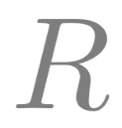
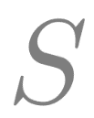

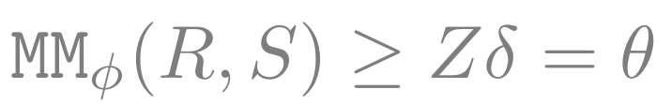
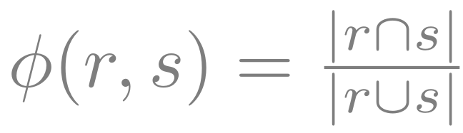
Formulation
For this talk:
and are sets which contain elements, and elements contain space-delimited tokens
Goal:
Use Jaccard similarity:
$φ$(“77 Mass Ave Boston MA”, “77 Massachusetts Ave Boston MA”) $≈0.7$

Slide 12
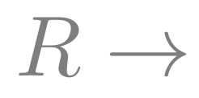
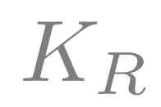
Signature Generation
Set Signature
What is a signature:
Subset of tokens in given set
Matching signatures:
A set and a signature are a match if they have a common token
Location: “Mass Ave Boston”, “Chicago IL” → {‘Mass’, ‘Ave’, ‘Chicago’}
{‘Mass’, ‘Ave’, ‘Chicago’} $\underset{↔}{M}$ Address: “Fifth Street Seattle”, “Fifth Street Chicago”

Slide 13
Signature Generation
Set Signature
What is a valid signature:
A signature which satisfies
Quality of signature:
Minimize number of matches to sets
Notes:
Notice how these two properties form a tradeoff with each other
Signature validity will try to add more tokens to a signature
While to get higher quality, there will try to be fewer tokens in the signature

Slide 14






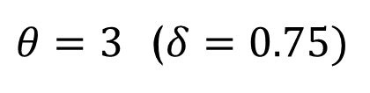



Set Relatedness Metric
Weights!
Upper bound estimate on contribution to MM
$$R$$
$$S$$
$θ=3$ ($δ=0.75)$
$≤$0.2
77 Mass Ave Boston MA
$$≤1$$
77 Fifth Street Chicago
5th St 02115
77 Massachusetts Ave Boston MA
$≤$0.5
$$≤2$$
$$≤1$$
$$≤2.5$$
Fifth Street Seattle WA
Chicago IL
1 Kendall Sq Cambridge MA
$$≤1$$
One Kendall Square Cambridge MA
Notes:
With weights, you might want to avoid putting low-weighted tokens in signature since you may get more matches with them
With weights, you can also create signatures at a finer granularity

Slide 15
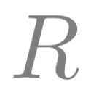
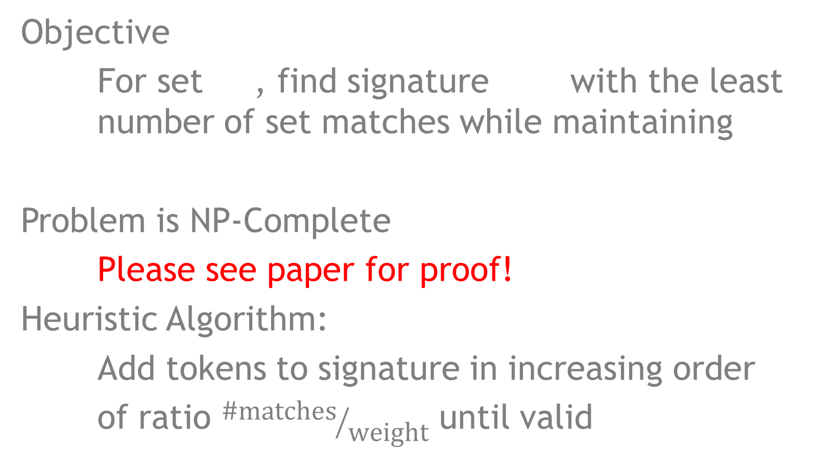
Optimal Signature Generation
Objective
For set , find signature with the least number of set matches while maintaining
Problem is NP-Complete
Please see paper for proof!
Heuristic Algorithm:
Add tokens to signature in increasing order
of ratio ${\text{\#}\text{matches}}/{\text{weight}}$ until valid

Slide 16
Set Relatedness Metric
Filter and Refine Strategy
Filter
Location
…
…
Location
…
…
Location
…
…
Salary
…
…
Age
…
…
Candidates
Refined
Candidates
(
Location
…
…
,
Address
…
…
(
Location
…
…
Address
…
…
(
,
Name
…
…
(
Location
…
…
Name
…
…
Location
…
…
Related
Sets
Verify
Year
…
…
Address
…
…
Name
…
…
Address
…
…
Name
…
…
2. Filtering

Slide 17
Set Relatedness Metric
Filter and Refine Strategy
Filter
Candidates
Refined
Candidates
(
Location
…
…
,
Address
…
…
(
Location
…
…
Address
…
…
(
,
Name
…
…
(
Location
…
…
Name
…
…
Location
…
…
2. Filtering

Slide 18
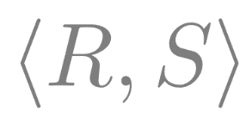



Check Filter
Have access to specific
Can put tighter bounds on estimates
$$R$$
$$S$$
$θ=3$ ($δ=0.75)$
77 Mass Ave Boston MA
$$≤1$$
77 Fifth Street Chicago
5th St 02115
$$=0.2$$
77 Massachusetts Ave Boston MA
$≤$0.5
Chicago IL
Fifth Street Seattle WA
$$≤2.2$$
$$≤2.5$$
1 Kendall Sq Cambridge MA
$$≤1$$
One Kendall Square Cambridge MA
Notes:
Now that you have access to specific R, S pair, you can have tighter bounds on your estimates

Slide 19
Set Relatedness Metric
Filter and Refine Strategy
Filter
Location
…
…
Location
…
…
Location
…
…
Salary
…
…
Age
…
…
Candidates
Refined
Candidates
(
Location
…
…
,
Address
…
…
(
Location
…
…
Address
…
…
(
,
Name
…
…
(
Location
…
…
Name
…
…
Location
…
…
Related
Sets
Verify
Year
…
…
Address
…
…
Name
…
…
Address
…
…
Name
…
…
3. Verification

Slide 20
Set Relatedness Metric
Filter and Refine Strategy
Refined
Candidates
Related
Sets
Verify
3. Verification

Slide 21
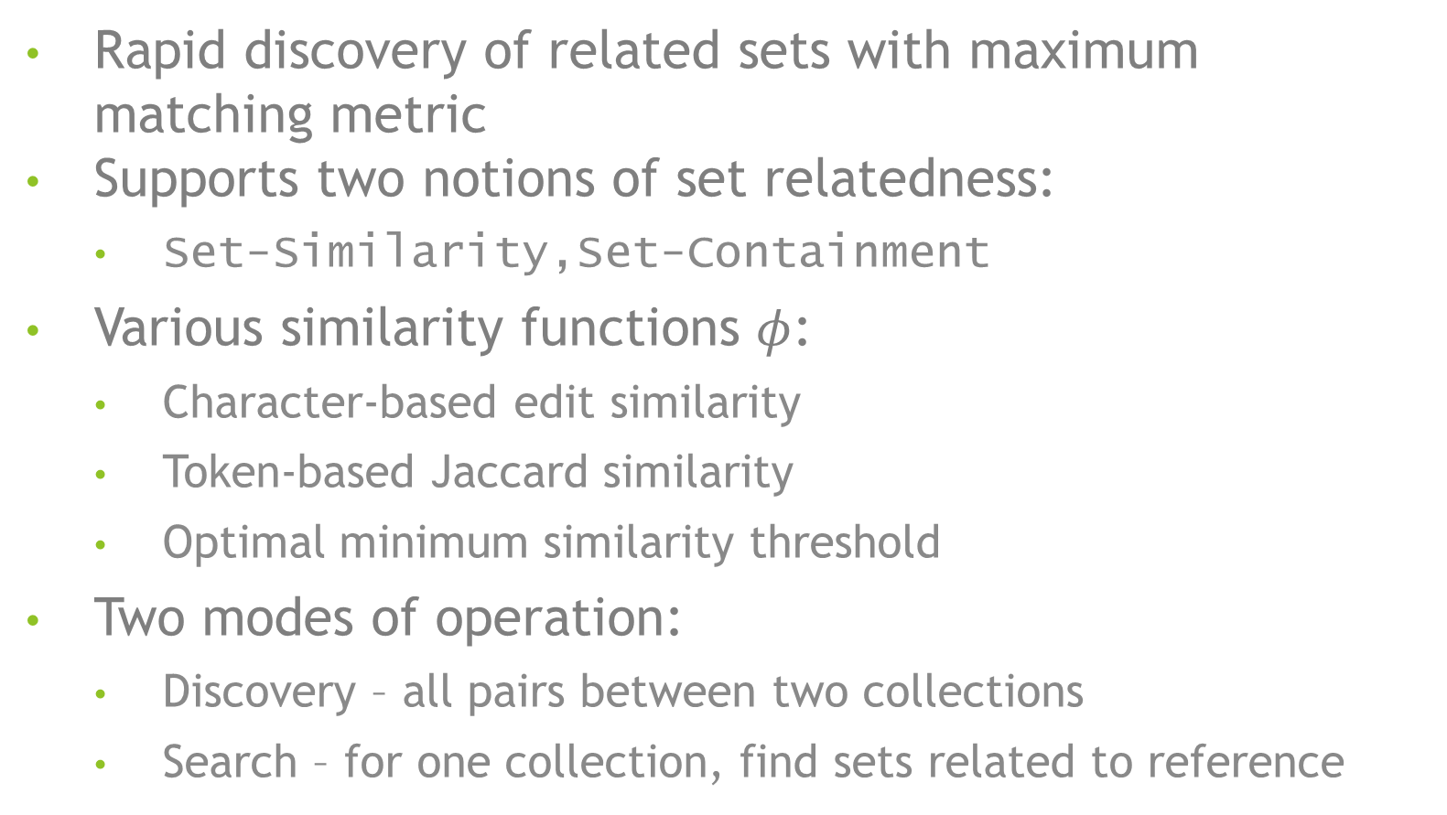
SilkMoth
Rapid discovery of related sets with maximum matching metric
Supports two notions of set relatedness:
  Set-Similarity,Set-Containment
Various similarity functions 󠆑$φ$:
  Character-based edit similarity
  Token-based Jaccard similarity
  Optimal minimum similarity threshold
Two modes of operation:
  Discovery – all pairs between two collections
  Search – for one collection, find sets related to reference
Please read the paper!

Slide 22
Experimental Setup
Datasets:
  DBLP: Computer science publications bibliography
  WebTable: HTML tables scraped from web
Tasks:
  String Matching:
    Match publication titles in DBLP
    Robust to missing or slightly misspelled words in title
  Schema Matching:
    Match between WebTable schemas
    Robust to attributes which are missing or slightly diff
  Inclusion Dependency:
    Find columns in WebTable which subsume another
    Robust to columns values which are missing or diff

Slide 23
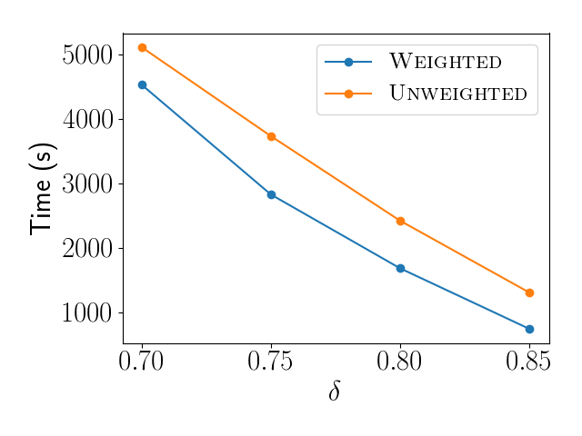
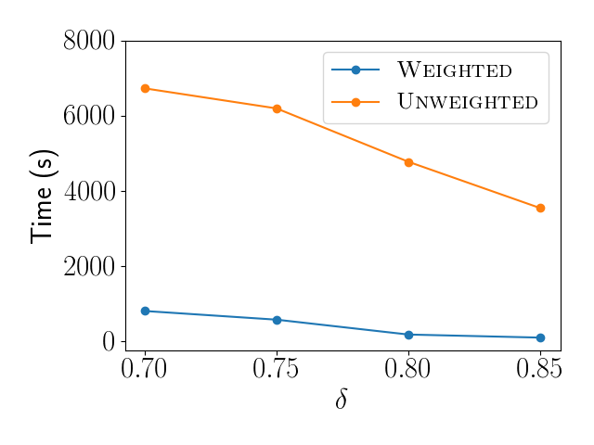
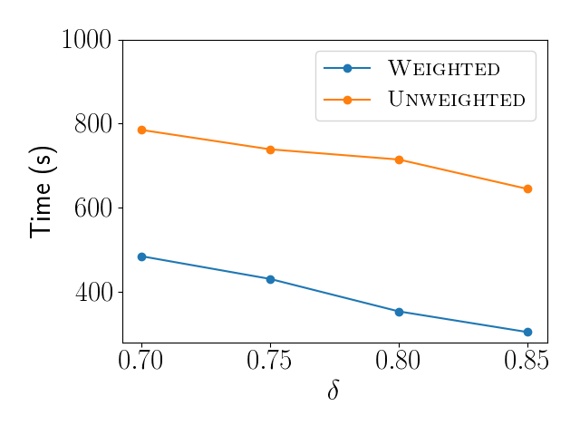
Weighted vs Unweighted
String Matching
Schema Matching
Inclusion Dependency

Slide 24
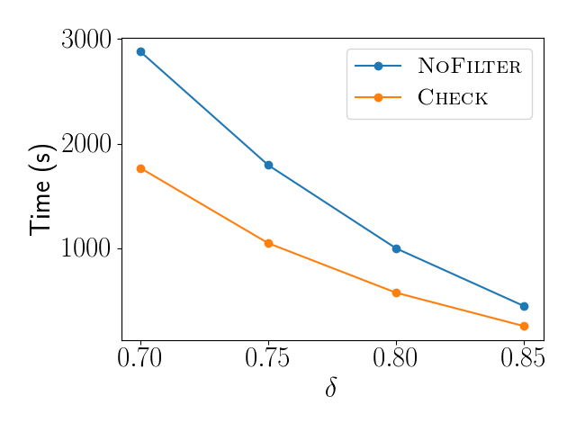
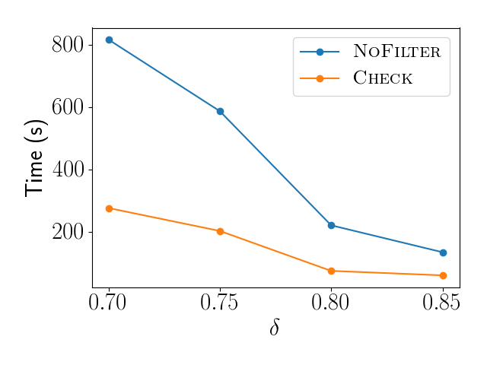
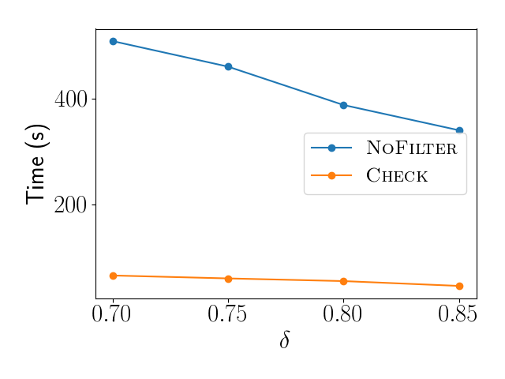
Effect of Check Filter
String Matching
Schema Matching
Inclusion Dependency

Slide 25
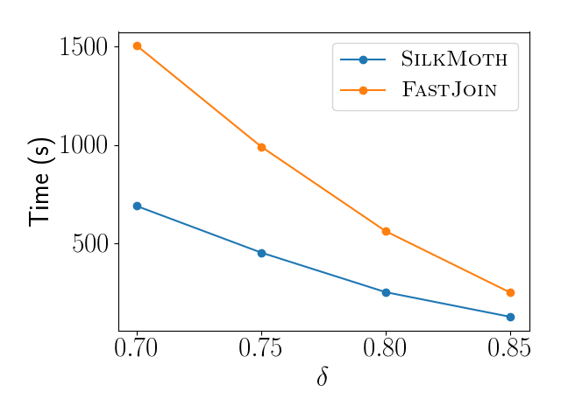
Comparison Against FastJoin

Slide 26
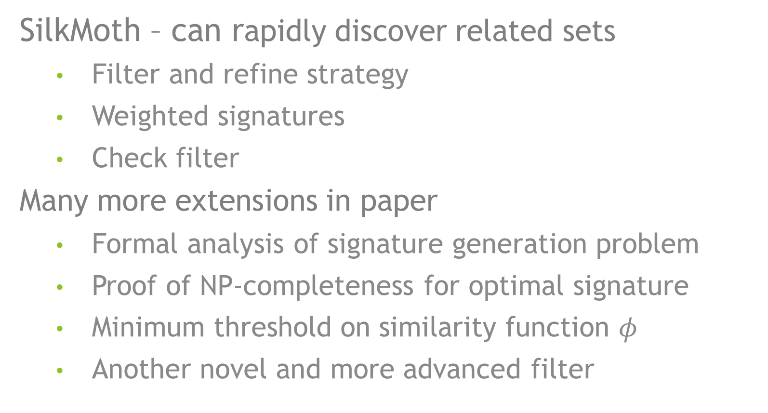
Final Remarks
SilkMoth – can rapidly discover related sets
  Filter and refine strategy
  Weighted signatures
  Check filter
Many more extensions in paper
  Formal analysis of signature generation problem
  Proof of NP-completeness for optimal signature
  Minimum threshold on similarity function $φ$
  Another novel and more advanced filter

